Slide 1


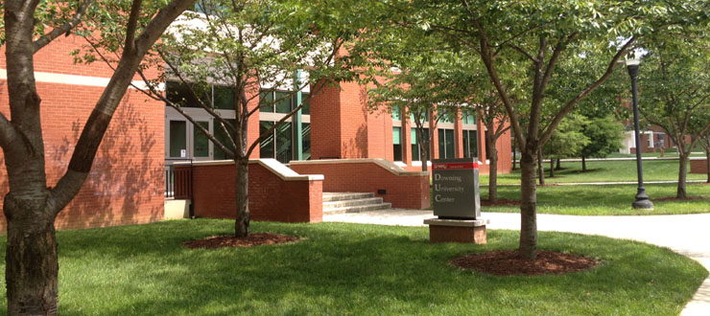
Student Academic Success
Academic Advising & Retention Center
Downing Student Union A330
(270) 745-5065
academic.advising@wku.edu

Slide 2
FERPA
(Family Education Rights & Privacy Act)
Institutions may release the information defined as “directory information” including:
Student’s Name
Address
E-Mail Address
Telephone Number
Date of birth
Major field of study
Dates of attendance
Enrollment status (including full-time, part-time, not enrolled, withdrawn, and date of withdrawal)

Slide 3
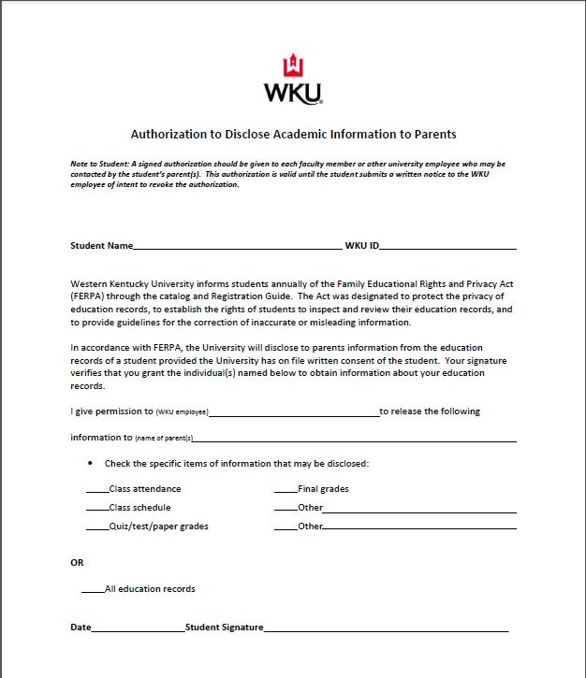
FERPA
(Family Education Rights & Privacy Act)

Slide 4
Exploratory students are advised in the Academic Advising & Retention Center or may be Exploratory within a particular college:
  Potter College of Arts & Letters
  Gordon Ford College of Business
  College of Education & Behavioral Sciences
  College of Health and Human Services
  Ogden College of Science and Engineering

Slide 5


Slide 6
General Education Requirements (required for all WKU students)
Category A: Organization and Communication of Ideas
(12 hours)
Category B: Humanities
(9 hours)
Category C: Social and Behavioral Sciences
(9 hours)
Category D: Natural Sciences—Mathematics
(9 hours)
Category E: World Cultures and American Cultural Diversity
(3 hours)
Category F: Health and Wellness
(2 hours)
Total: 44 hours (22 hours for associate degree programs)

Slide 7

Interactive Curriculum &
Academic Progress
~online degree audit~

Slide 8
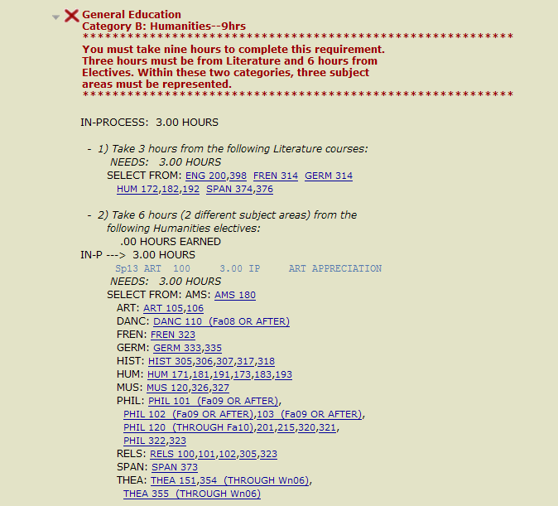

Slide 9
Academic Standing
First year students must maintain a 1.7 GPA or higher if they have attempted less than 17 hours. Students with GPAs below 1.7 will go on academic probation.
A 2.0 GPA is required to graduate from WKU.

Slide 10
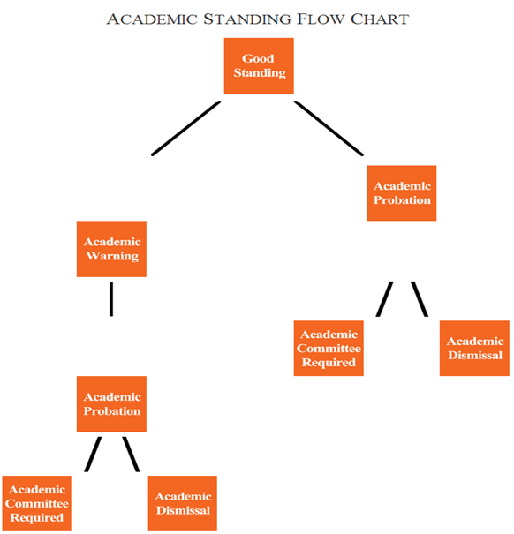

Slide 11
Best Expectation Programs
Includes students on academic probation and students looking for extra academic support
Monitored study time each week
Meet with a Peer Intrusive Advisor
Attend the Majors and Minors Fair
Attend the Academic Advantage Series Workshops
Contact Brittany Wagner at (270) 745-5065 for more information

Slide 12
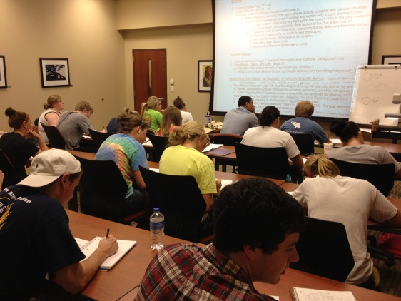
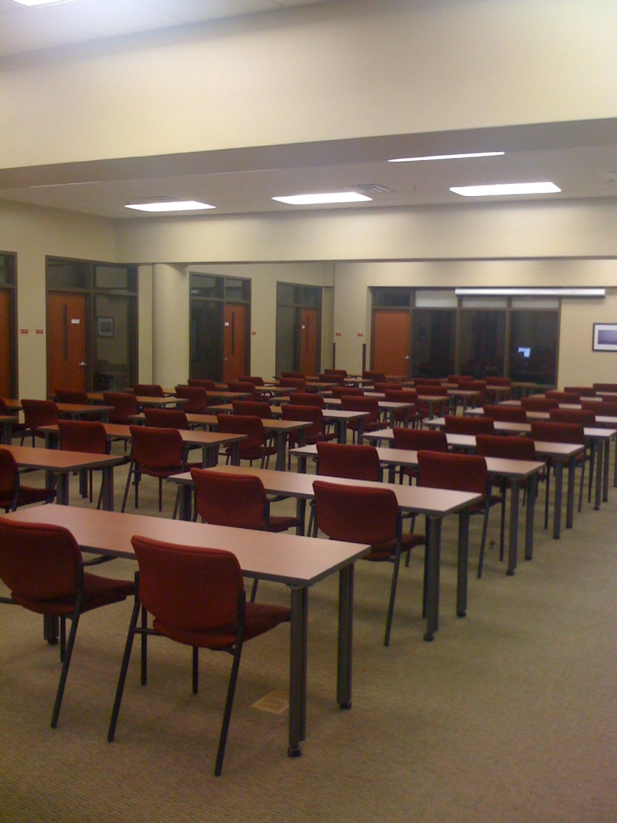


The Learning Center (TLC)

Slide 13
The Learning Center (TLC)
Free tutoring in over 300 subjects as well as academic skills (time management, test-taking skills, note taking) http://www.wku.edu/tlc/courses_we_tutor.php
All tutors have a minimum 3.25 GPA
Online tutoring is available
Location in Downing Student Union
Quiet learning facilities located around campus (Downing Student Union, Keen Hall, McCormack Hall, Pearce Ford Tower, and the Fine Arts Center beginning in fall
Academic computer labs

Slide 14
The Learning Center (TLC)
Peer Assisted Study Sessions (PASS)
Fall 2013 Courses:
ASTR 104
BCOM 185
BIOL 122
BIOL 224
CHEM 120
ECON 202
HIST 119
HIST 120
NURS 102
PSY 100
RELS 100
SOCL 100

Slide 15


Slide 16
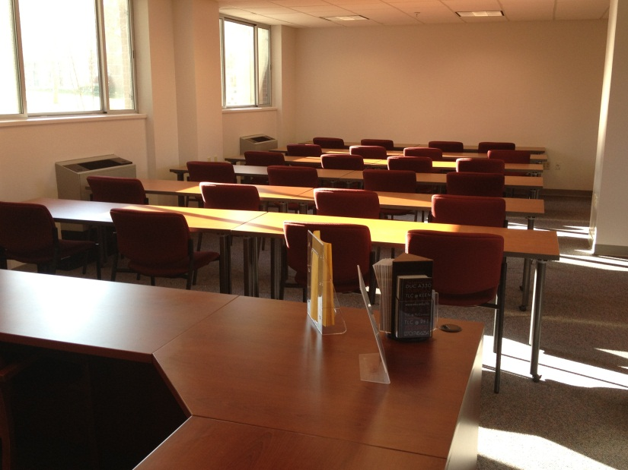
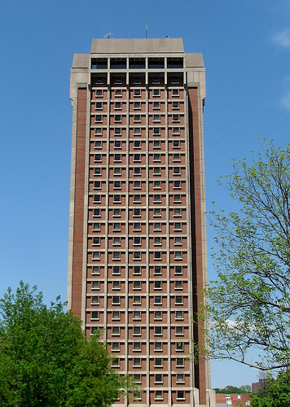
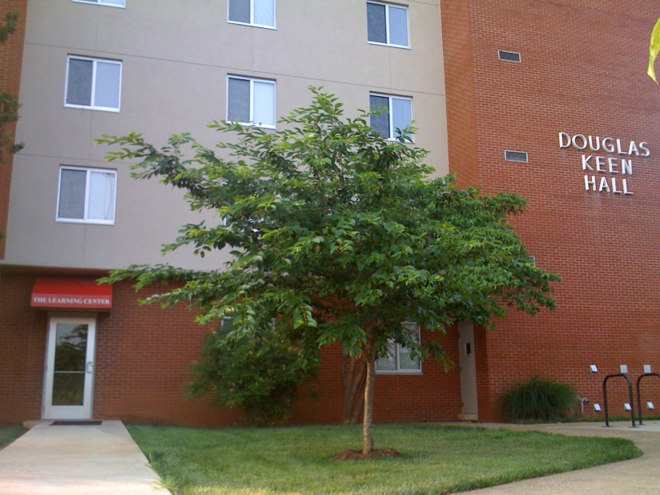

Slide 17

MAP Works

Slide 18
5th Week Freshmen Assessment
Assessment tool for first year students only
Allows freshmen to find out early in the semester if they are having academic or attendance issues
Students meet with professional staff to discuss these issues
Refer students to tutoring, meeting with faculty, or to withdraw from a course
5th Week available online through TopNet

Slide 19
5th Week Freshmen Assessment
Example
  Student Name (800123456)
  Classification: FR
  Term: Spring 2013
  Course Credit Hours Grade Absent
  ENG 100 022 3 Pass
  RELS 102 001 3 Pass
  BIOL 114 001 1 D/F Excessive Absences
  BIOL 113 007 3 D/F

Slide 20
Academic Advising
CRN | CourseID | Course Title | Hours | Days | Time | Date | Location | Instructor
18212 | COMM 145 -015 | FUND OF PUBLIC SPKG | 3.00 | TR | 11:10 am - 12:30 pm | 01/22-05/10 | FAC 0137 | Donna K. Schiess
04617 | HIST 120 -002 | WESTERN CIV SINCE 1648 | 3.00 | MWF | 9:10 am - 10:05 am | 01/22-05/10 | CH 0204 | Tamara Van Dyken
33336 | PH 100 -015 | PERSONAL HEALTH | 3.00 | MWF | 10:20 am - 11:15 am | 01/22-05/10 | AC 0203 | Amy K. Wininger
08513 | PSY 100 -002 | INTRO PSY | 3.00 | MWF | 11:30 am - 12:25 pm | 01/22-05/10 | GRH 3010 | Mark A. Graves
08927 | RELS 100 -001 | NEW TESTAMENT | 3.00 | TR | 9:35 am - 10:55 am | 01/22-05/10 | CH 0302 | Joseph L. Trafton

Slide 21
Academic Advising
Please be aware of:
Advanced Placement (AP) tests from high school
CLEP (College Level Examination Program); $105 per test through the Counseling and Testing Center in Potter Hall, (270) 745-3159
ENG ACT of 29 or higher – students will earn credit for ENG 100 and do not need to take that course
Developmental courses – courses in reading, English, or math based on ACT scores that do not count toward graduation

Slide 22

Questions?
Academic Advising & Retention Center
Downing Student Union A330
(270) 745-5065
academic.advising@wku.edu

