Slide 1
Department of Biology
Faculty
Slideshow
By the Biology Office

Slide 2
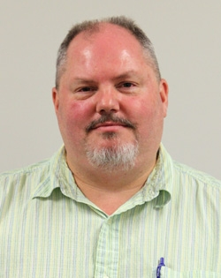
Lawrence Alice, Ph.D.
University of Maine
Associate Professor
Courses
BIOL 122 - Biological Concepts: Evolution, Diversity & Ecology
BIOL 222/223 Plant Biology and Diversity
BIOL 348 Plant Taxonomy
Research
My research interests include the systematics of the economically important plant genera Rubus (Rosaceae), which includes blackberries and raspberries, and Mentha (Lamiaceae), including spearmint and peppermint. These groups have long been considered taxonomically difficult due in part to polyploidy (more than two sets of chromosomes), agamospermy (asexual seed production) in Rubus, and hybridization. I primarily use molecular techniques, in particular DNA sequencing, to address evolutionary biology questions. These data can be used, for example, to infer evolutionary relationships (phylogeny reconstruction), test hypotheses of hybridization, examine biogeographic patterns, and consider modes of speciation especially in polyploid taxa.
Bio
Ph.D. - Plant Science, University of Maine 1997
M.A. - Botany, Southern Illinois University at Carbondale 1989
B.A. - Botany, Southern Illinois University at Carbondale 1986

Slide 3
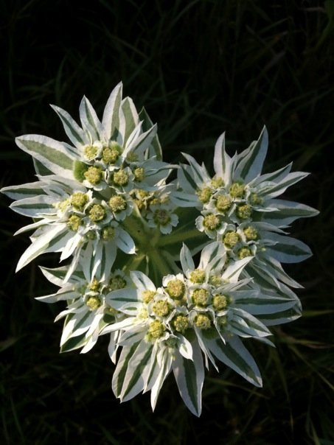
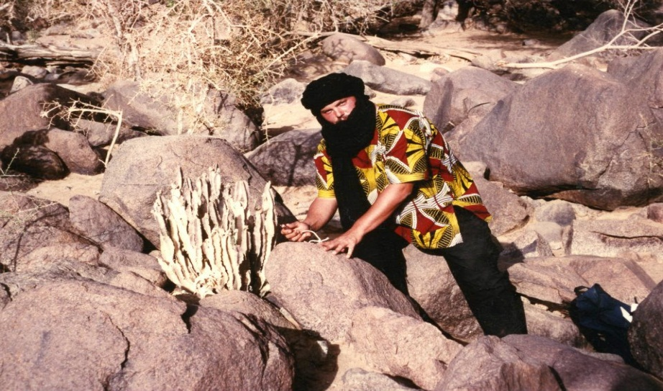
Research by Dr. Alice
I primarily use molecular techniques, in particular DNA sequencing, to address evolutionary biology questions. These data can be used, for example, to infer evolutionary relationships (phylogeny reconstruction), test hypotheses of hybridization, examine biogeographic patterns, and consider modes of speciation especially in polyploid taxa. I am also interested in systematics of subfamily Rosoideae and the Rose family (Rosaceae), tribe Mentheae of the mint family (Lamiaceae), and subfamily Chloridoideae of the grass family (Poaceae).
  Current Research Projects:
Plant ProtectionResearch Institute –"Taxonomic Status and Phylogenetic Affinity of an Invasive Blackberry in South Africa"
Flora of North America & Jepson Flora - Rubus
National Science Foundation – "RUI: Molecular Phylogenetics and Allopolyploidization in Rubus (Rosaceae)“

Slide 4
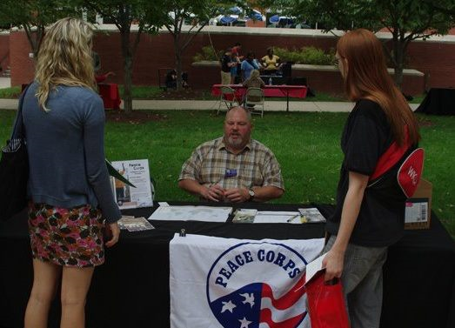
Graduate Research with Dr. Alice
Lauren Ebbeck
Tim Ferguson
David Kem
Jessie Lyne
Taryn Shelton

Slide 5
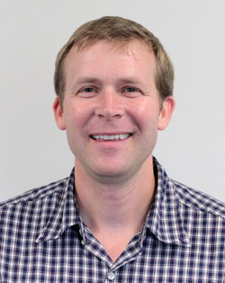
Noah Ashley, Ph.D.
University of Washington
Assistant Professor
Courses
BIOL 131: Human Anatomy & Physiology I
BIOL 464: Endocrinology
Research
Endocrine-Immune Interactions in Vertebrates
Hormonal Regulation of Inflammation during Sleep Loss
Comparative Evolution of Sickness Behavior and Inflammation
Ecological Immunology
Sleep/Wake Cycles and Chronobiology
Non-Invasive Measures of Stress Hormones
Regulation of Immune Function by Androgens
Bio
Ph.D. Zoology, University of Washington, Seattle.WA
B.A. Biology, Colby College, Waterville, ME

Slide 6
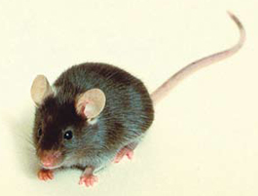
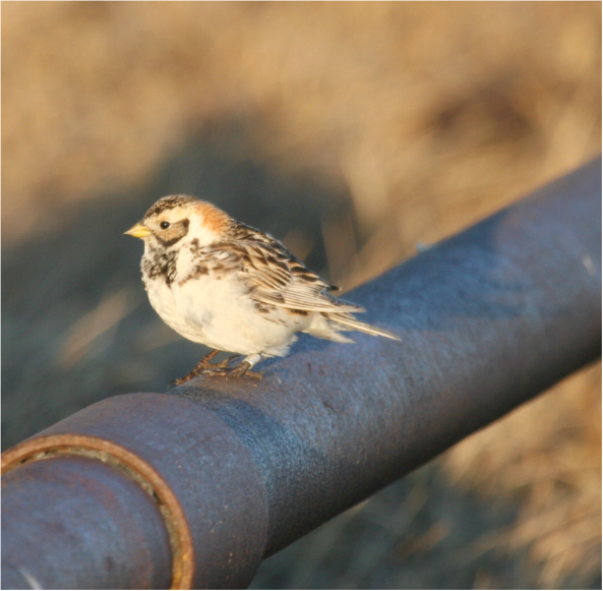
Current Research in Ashley Lab
Effects of sleep loss in rodents
  Inflammation/Immune function & microglial activation
  Stress hormones
  Anxiety/memory
Comparative biology of sleep
  Latitudinal studies (arctic vs. temperate comparisons)
  Determining responses to sleep deprivation
  Assessing seasonal and hormonal effects
  This project involves field work in Alaska!!
C57BL/6 mouse
Female Lapland Longspur (Calcarius laponnicus)

Slide 7
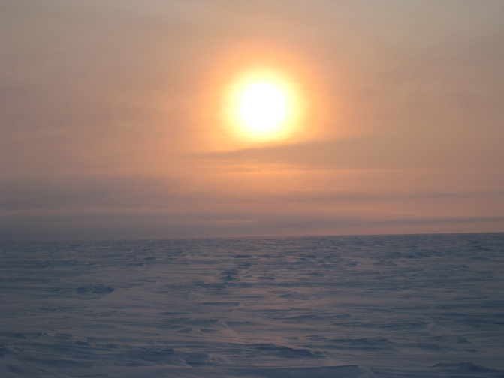
Graduate Students
Jennie Dumaine
  B.S. Hanover College
  Starting in Fall 2013
I am currently recruiting a student (Master’s level) who is interested in examining the comparative biology of sleep in songbirds. Please let me know if you are interested! Contact me at noah.ashley@wku.edu
Land of the Midnight Sun, Barrow, Alaska
(Where we conduct field work!)

Slide 8
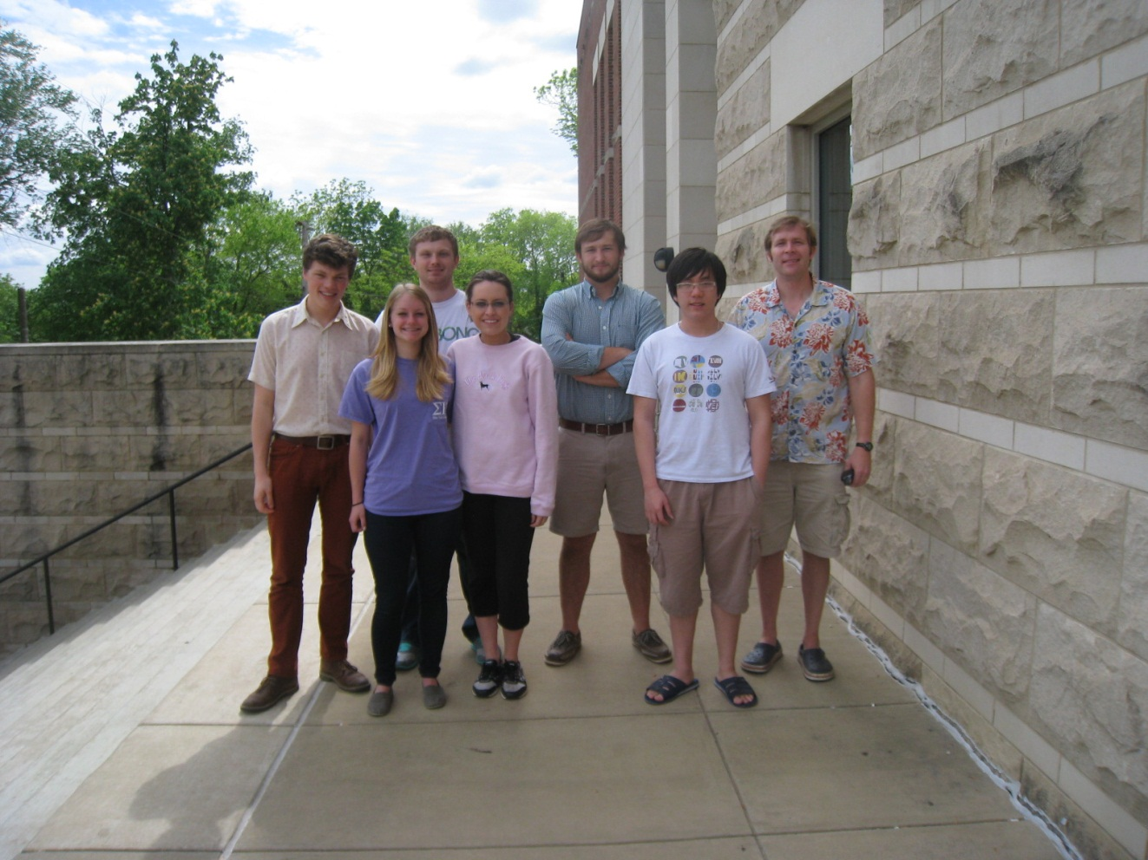
Undergraduate Students
Involvement of undergraduate students is an essential part of my research philosophy!
2012-2013 Lab members
  Austin Huff
  Kaley Coffey
  Jamie Doctrow
  Ryne Armes
  Johnny England
  David Sams
  Audrey Brown
  Dai Le Hieu Vo
  Katelyn Dobson
Interested in gaining laboratory experience for professional or graduate school?
Please contact me (Noah.Ashley@wku.edu) if you are interested!

Slide 9
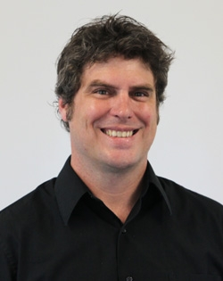
Michael Collyer, Ph.D.
North Dakota State University
Assistant Professor
Bio
Post-Doc - 2003-2007 – Iowa State University, Ecology, Evolution, and Organismal Biology & Statistics
Ph.D.. – 2003 - North Dakota State University, Zoology
M.A. - 2000 – North Dakota State University, Zoology
Courses
BIOL 501 - Biometry
Research
Research in my lab focuses on the ecological and evolutionary morphology of vertebrates, and development of quantitative methods for analyzing phenotypic change. We are especially interested in understanding how often human-influenced – local ecological changes affect the phenotypic evolution of organisms. My students typically work on research projects that have implications for the management and conservation of rare or endangered species.

Slide 10
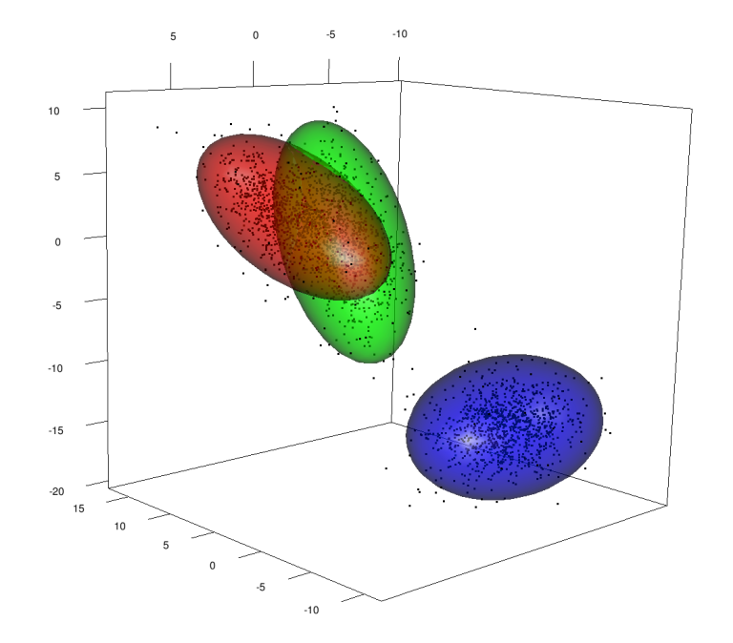
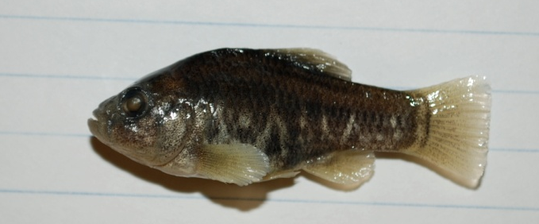
Research by Dr. Collyer
Development of multivariate statistical methods
Ecological and Evolutionary Morphology
& anything in between
Development of methods to analyze phenotypic change

Slide 11
Graduate Research with Dr. Collyer
Ecological or Evolutionary Morphology
GRAD STUDENTS NEEDED!
Strength in Math and/or Statistics required
Contact me if you are interested
Methods for statistical analysis of high-dimensional morphological data
GRAD STUDENTS NEEDED!
Strength in Math and/or Statistics required
Contact me if you are interested

Slide 12
Undergraduate Research with Dr. Collyer
Interested in Undergraduate Research?
Have a background in biology and math?
Interested in biostatistics?
Maybe need an Honors thesis project?
CHECK BACK HERE IN DECEMBER!
Or contact me for more information

Slide 13
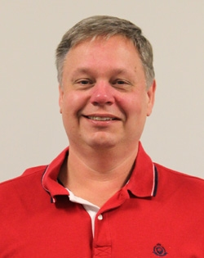
Kenneth M. Crawford, Ph.D.
University of Michigan
Education
B.A. 1978 : SUNY College at Buffalo
M.A. 1980 : SUNY College at Buffalo
Ph.D. 1988 : University of Michigan
L.Y. Lancaster Professor
Chief Pre-Health Professions Advisor
Courses
BIOL 330: Animal Physiology
BIOL 324: Histology
BIOL 328: Biology of Aging
BIOL 526: Physiological Ecology
Research
Wound healing, cell proliferation and Cell migration in corneal endothelial cells.
Activity of Endothelin-1 in corneal endothelial cells.

Slide 14
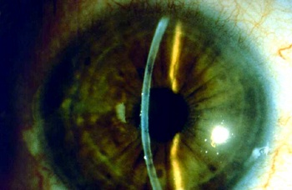
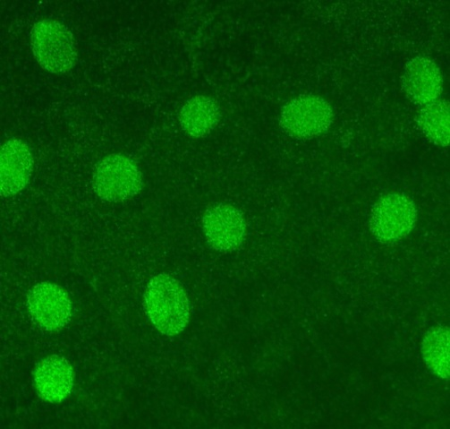
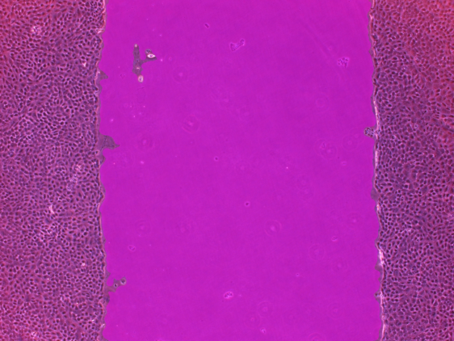
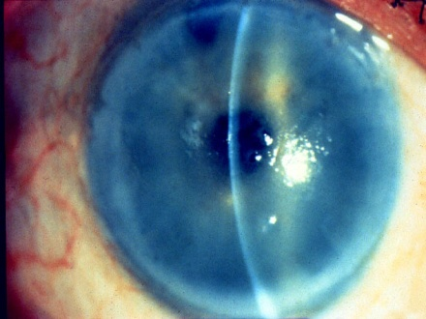
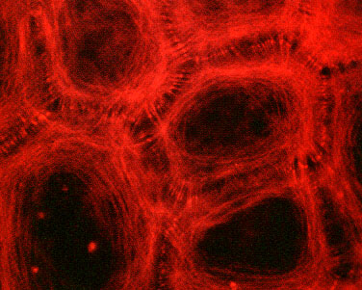
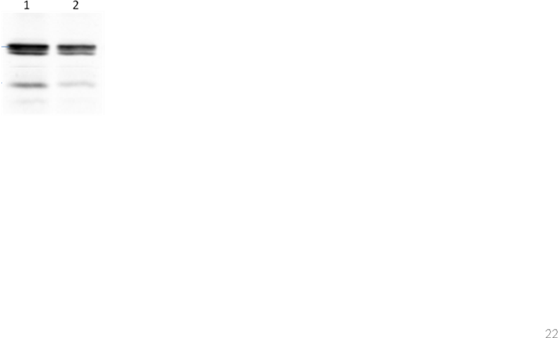

Dr. Crawford’s Research
A mechanically wounded culture
Nuclear localization of p27
Corneal clarity depends
on the endothelium
1 2
Actin
p27
Cellular expression of p27
Actin localization in
corneal endothelial cells
Wounds heal faster with endothelin-1
Actin
p27

Slide 15
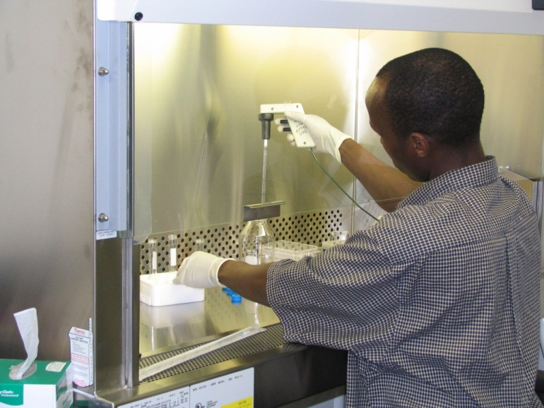
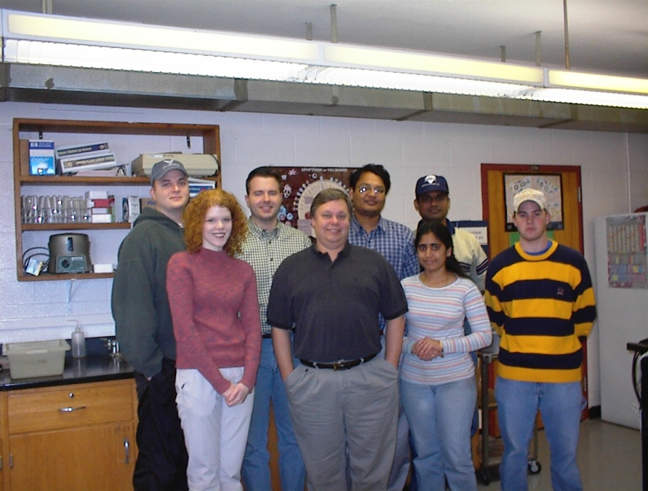
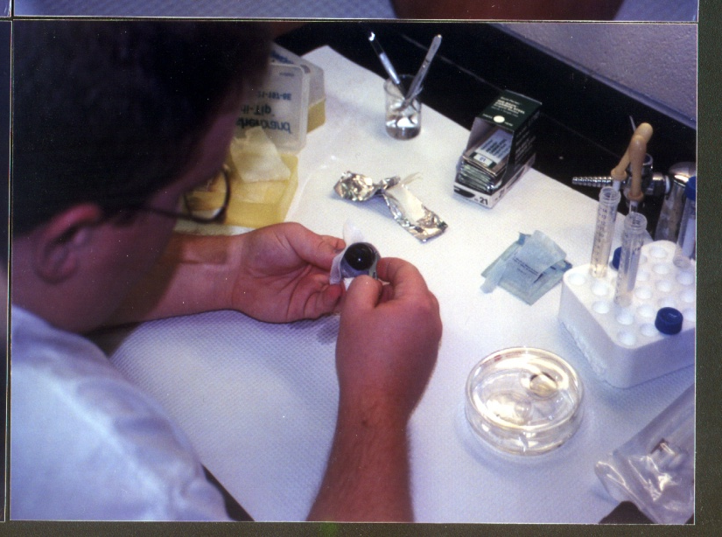
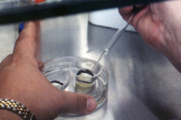
Research with Gatton Academy, Undergraduate
and Graduate Students

Slide 16
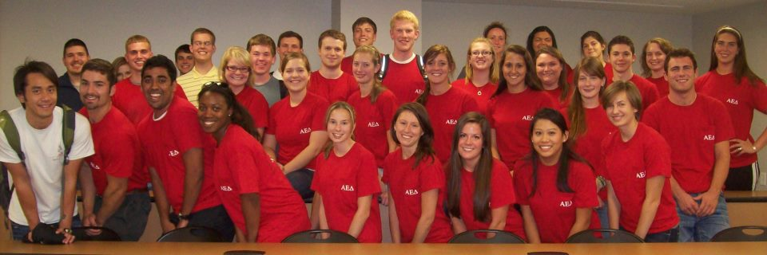

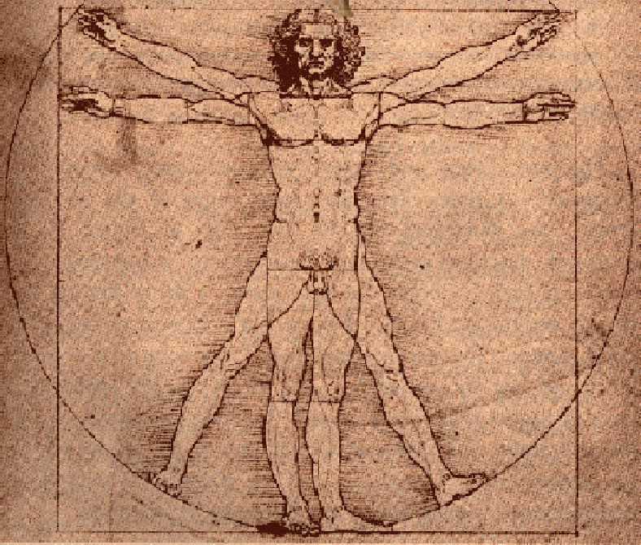

Chief Pre-Health Professions Advisor
Faculty Advisor – Alpha Epsilon Delta

Slide 17
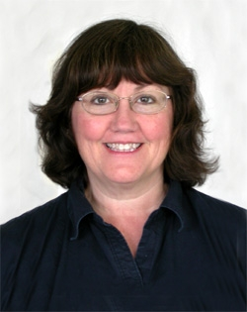
Cheryl Davis, Ph.D.
Wake Forest University
Professor
Bio
Ph.D. - Biology (1988). Wake Forest University, Winston-Salem, NC.
M.S. - Zoology (1983). The University of Oklahoma, Norman, OK.
B.S. - Zoology (1979). The University of Oklahoma, Norman, OK.
Courses
BIOL 121 Biological Concepts Laboratory
BIOL 328 Immunology
BIOL 460 Parasitology
BIOL 570 Advanced Immunology
Research
Immunobiology of Parasite-Host Interactions
Tick-borne and parasitic disease surveillance

Slide 18
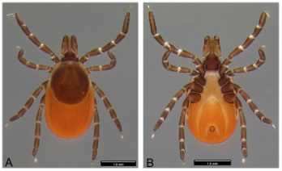
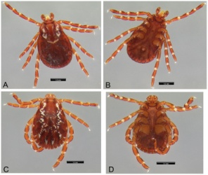
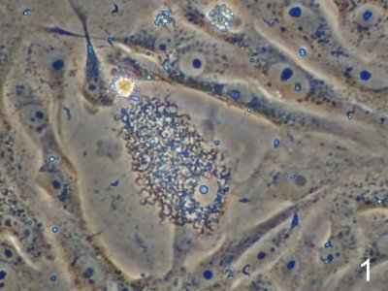
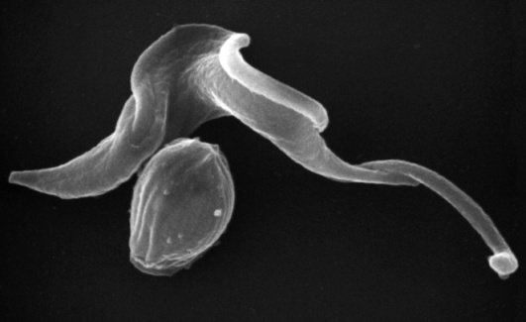
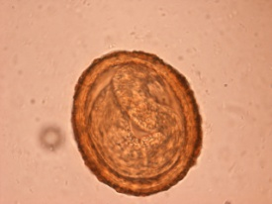
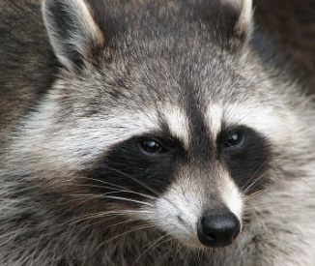
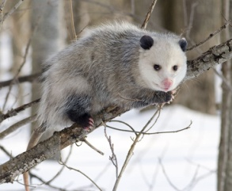
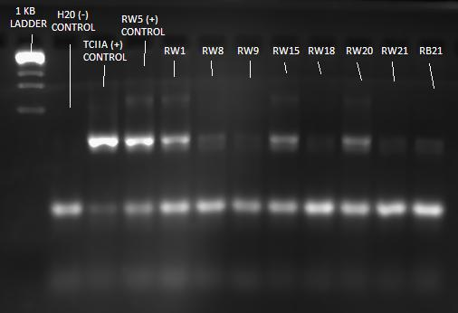
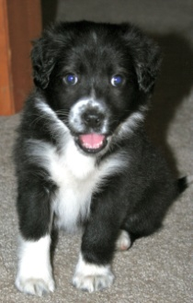
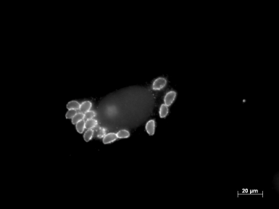
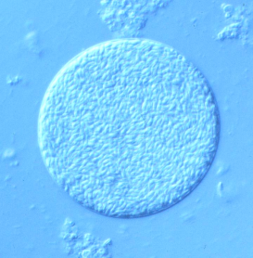
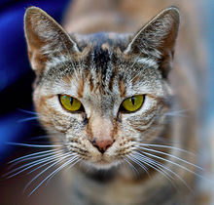
Research by Dr. Davis
Tick-borne and parasitic disease surveillance
Immunobiology of Parasite-Host Interactions
Trypanosoma cruzi (causative agent of Chagas’ disease)
Trypomastigotes in cell culture
Toxoplasma gondii
(causative agent of toxoplasmosis)
Ixodes scapularis
Dermacentor variabilis
Trypomastigote and Amastigote
Baylisascaris procyonis
PCR detection
Tachyzoite stages
Tissue Cyst

Slide 19
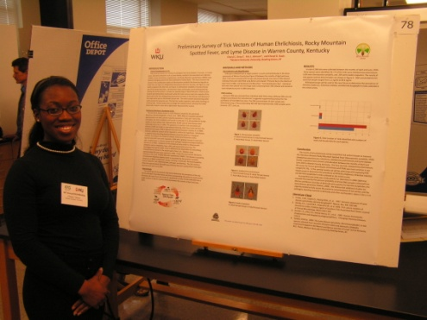
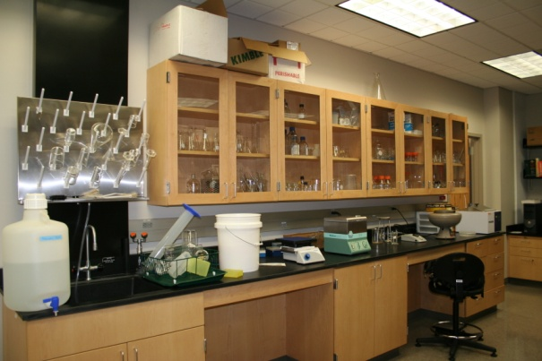
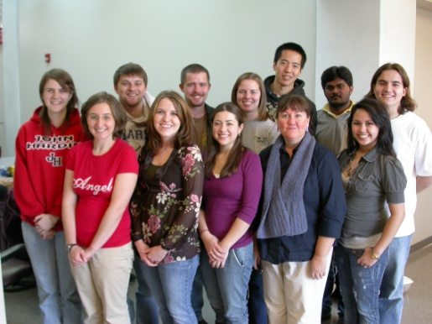
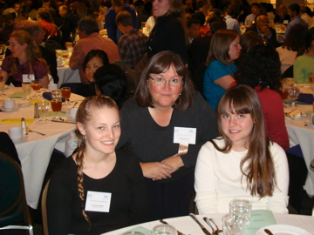
Research Students
M.S. Students
Curry, Bridget
Gajavilli, Neelima
Hemingway, Nicholette
Howard, Samantha
Miller, Jean
Undergraduate Students
Beeler, Travis
Emmert, Alison
Gingerich, Aaron
Onwu, Cheryl
Randolph, Jonathan
Tucker, William (Griffin)

Slide 20
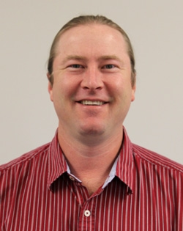
Bio
PhD - Zoology (2005), Texas Tech
University
MS - Biology (1998), University of
Central Arkansas
BA - Biology/Env. Science (1992),
Tabor College
Courses
BIOL 122 Introductory Biology
BIOL 430 Evolution
BIOL 523 Evolution of Symbioses
BIOL 598 Graduate Seminar
Research
Evolution and ecology of parasite-host associations; taxonomy and systematics of bat flies; biodiversity and faunal surveys
Carl W, Dick, Ph.D.
Texas Tech University
Assistant Professor

Slide 21
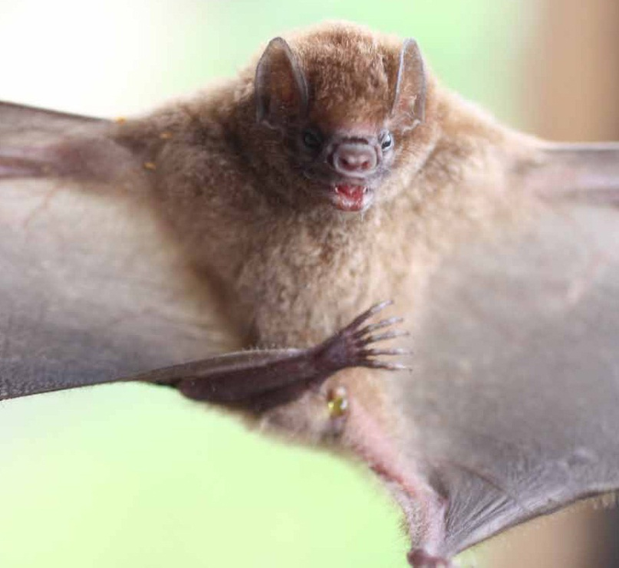
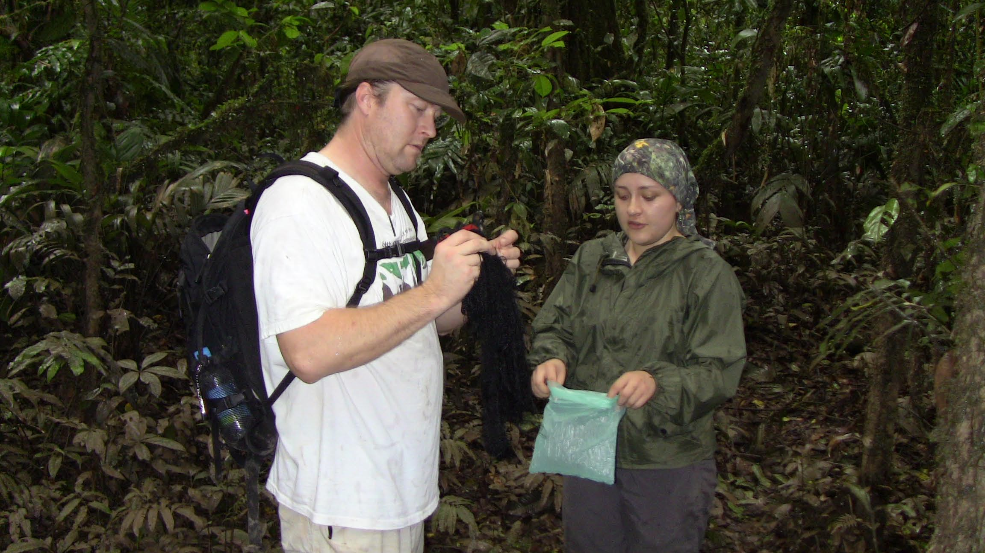
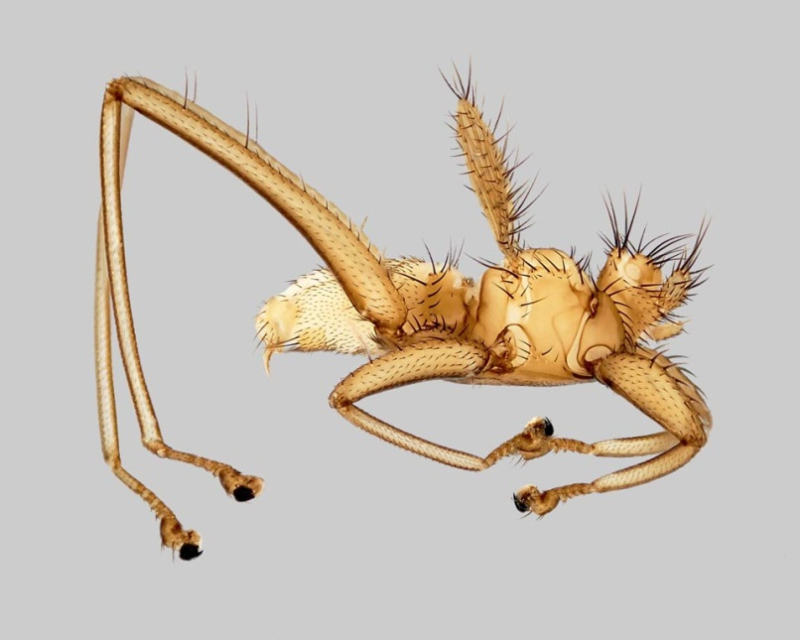
Research by Dr. Dick
Why do parasites specialize on host species?
How can multiple parasite species coexist?
What characteristics of hosts influence parasite
distribution and abundance?
Can bat parasites transmit viruses and other
pathogens?
Have parasites evolved in concert with their
hosts?

Slide 22
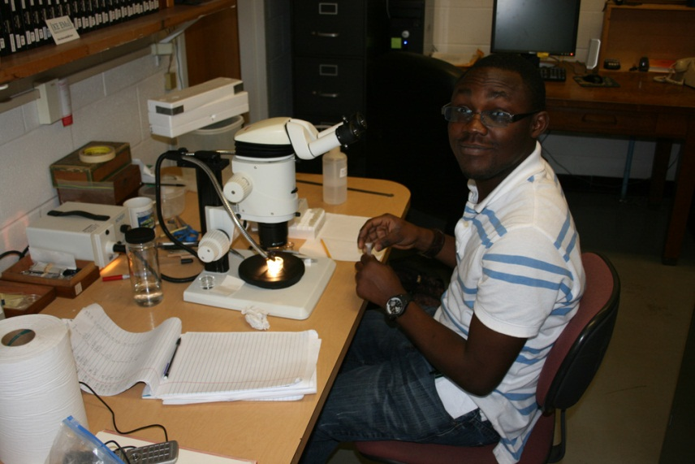
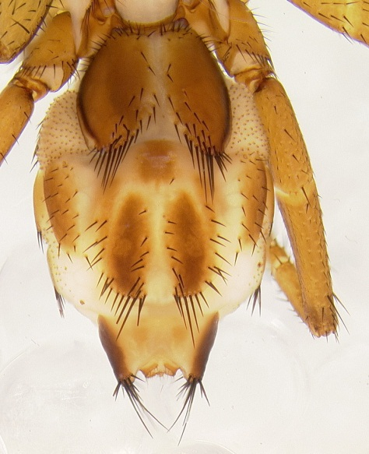
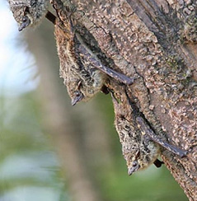
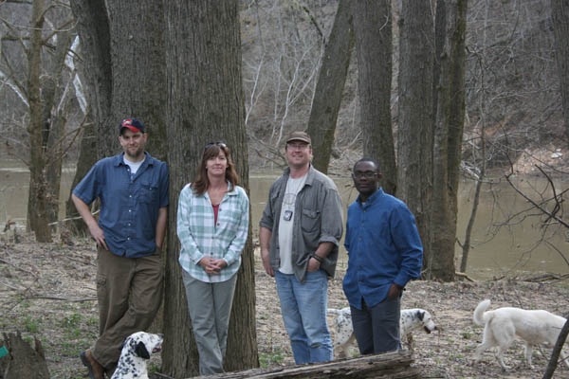



Graduate Research with Dr. Dick contact me if you are interested in research
Mr. Ayodele Atolagbe working on bat flies from Madagascar bats
Abdomen of a new species of nycteribiid bat fly (Paracyclopodia sp.) being described by Ayodele; his project has discovered SIX species new to science
Installing experimental bat houses at WKU’s Upper Green River Biological Preserve, Hart county, Kentucky
Our research shows that the type of roosts used by bats strongly influences the quality and quantity of their parasites. Such research also takes us to interesting places like Kenya, Ecuador, Borneo, and Puerto Rico!

Slide 23




Undergraduate Research with Dr. Dick contact me if you are interested in research
Mr. Eric Stamper working on samples of parasites from bats of Ecuador
An insectivorous red bat (Lasiurus borealis) captured at WKU’s Upper Green River Biological Preserve
Bat flies are highly specialized parasites, with many interesting adaptations for living on bats. Shorter and narrower - an evolutionary trend in vestigial bat fly wings
Ms. Hillary Jones presenting results of her NSF-REU research project at Western Kentucky University

Slide 24

Chandrakanth Emani, Ph.D.
Assistant Professor of Plant Molecular Biology & Biotechnology
Bio
B.Sc. - Genetics, Zoology, Chemistry, Nizam College, India, 1989
M.Sc. - Biochemistry, University of Pune, India 1991
Ph.D. - Plant Molecular Genetics, Osmania University, India, 1997
Courses
Bio 312 – Bioinformatics
Bio 327 - Genetics
Bio 350 – Introduction to Recombinant Gene Technology
Bio 399 – Research Methods in Biology
Bio 412 – Laboratory Cell Biology
Bio 447 – Laboratory Biochemistry
Bio 450 – Recombinant Gene Technology
Bio 495 – Molecular Genetics
Bio 496 – Plant Biotechnology
Research
Plant Genetic Engineering: Engineering sorghum and Indian beech for biofuel usage.
Plant Molecular Biology: Molecular basis of non-neuronal acetylcholine expression in bamboo
Molecular Evolution: Tracing the evolution of seed proteins and ribosomal domains in silico
Biology Education: Using episodic science history to educate the general public on scientific process and scientific thinking

Slide 25








Research by Dr. Emani
Plant Genetic Engineering
Engineering sorghum with a cellulase gene from Acidothermus cellulyticus for biofuel usage
Plant Molecular Biology
Developing a genetic transformation system in bamboo to understand the molecular basis of non-neuronal acetylcholine expression
Molecular Evolution
Tracing the evolution of seed proteins for the cupin domains in silico to examine structural and functional features for nutritional improvement
Biology Education
Using episodic history in science to instill the scientific thought process in classroom and educating the general public about scientific method and scientific thinking
Engineering Indian Beech to manipulate oil content for biofuel and medicinal usage
Tracing the evolution of ribosomal domains in silico to understand the fundamental processes of the origin of RNA and Life

Slide 26



Graduate Research with Dr. Emani
Opportunities exist for graduate students to work in a research incubator setting at the Center for Business Research at Owensboro where Dr. Emani’s lab is housed
Students will have real-world experiences with biotechnology companies and labs within the research incubator
Research projects with Dr. Emani will be in the areas of plant genetic engineering in sorghum, bamboo and Indian beech, and plant molecular evolution involving bioinformatic analysis of seed proteins and ribosomal domains

Slide 27
Undergraduate Research with Dr. Emani
Angela Shouse (graduated, Spring 2011) – Molecular and epistemological basis of polycystic kidney disease by in silico analysis of the PKD-1 gene
Michael Alstott (graduated, Fall 2011) – The molecular evolution of plant cellulase genes
Joey Guinto (Senior, currently working in lab as a student researcher with the RCAP grant) – Assessing the genetics of asthma through in silico analysis of a cow and human G protein-coupled receptor for asthma susceptibility
Andrew Burkhalter (Senior) – Molecular evolution of a protein related to HIV
Joseph Early (Senior) – Genetic engineering of a GFP gene in soybean and examining the efficacy of dicot and monocot promoters
Kendall Wedding (Senior) – In silico analysis of a protein related to rheumotoid disease common to horses and humans
Chelsea Zingg (Senior) – A literature review on culturally significant botanicals and their biotechnological applications

Slide 28

Courses
BIOL 321 Comparative Anatomy
Research
My research interests are related to circadian rhythms in insects and birds. I am an ornithologist, so when I retire this fall, I plan on doing some research with birds again.
I am PI on a USDA/ARS cooperator agreement for $833,000 per year.
Blaine Ferrell, Ph.D.
Louisiana State University
Professor
Bio
Ph.D. - Zoology and Entomology – Louisiana State University, Baton Rouge, LA
M.S. - Biology – Western Kentucky University, Bowling Green, KY

Slide 29

Scott Grubbs, Ph.D.
University of Pittsburgh
Professor
Bio
Ph.D. - 1997, University of Pittsburgh, Department of Biological Sciences
B.S. - 1990, Central Michigan University, Department of Biology
Courses
BIOL 122 - Biological Concepts: Evolution, Diversity & Ecology
BIOL 224 - Animal Biology & Diversity
BIOL 405 - Aquatic Insect Diversity
BIOL 497 - Aquatic Field Ecology
BIOL 505 - Aquatic Insect Ecology
Research
Current research in my lab focuses mainly on two themes: (a) food web and nutrient dynamics of karst riverine watershed and (b) systematics and biogeography of stoneflies (order Plecoptera).

Slide 30


Research by Dr. Grubbs

Slide 31


Graduate Research with Dr. Grubbs
Holly Owens
Jennifer Yates

Slide 32
Undergraduate Research with Dr. Grubbs
Amy Cooper

Slide 33


Bio
Ph.D. - 2003 - Florida Tech
B.S. - 1996 - Western Michigan University
Courses
BIOL 122 Introductory Biology
BIOL 377 Animal Form and Function
BIOL 477 Marine Biology
Research
Functional Morphology, Skeletal Design and Performance, Predator/Prey Interactions, and Animal Behavior
My research examines the link between functional design and ecological utility in vertebrates. I use examinations of dissected carcasses, fully articulated skeletons, and animal behavior to better understand how evolution has shaped organismal design and performance. In my laboratory, we employ EMG's, high-speed video cameras, and pressure transducers to better understand the feeding mechanisms of fishes. In the field, we use SCUBA, rebreathers, portable high-speed video systems, and still-cameras to tease out the intricacies of specialized feeding performance by everything from pelagic species to reef species. My students and I have also worked on the biomechanics of mammal locomotion, tooth development and phenotypic plasticity in fishes, and communication in lizards. We use biomechanics, gross dissection, dermestid beetles, and behavioral observations to draw conclusions about what makes predators successful at doing what they do best -- catching and killing their prey.
Steve Huskey, Ph.D.
Florida Tech
Associate Professor

Slide 34









Research by Dr. Huskey
Feeding Performance in Fishes
Underwater High-Speed Cinematography
Vertebrate Functional Morphology
Barracuda
SCUBA & Rebreathers
Bull Shark
Grouper
Phenotypic Plasticity in Fish Teeth

Slide 35






Graduate Research with Dr. Huskey
Cynthia Worcester
Morgan Maxwell
Phenotypic plasticity in fish teeth
Bite forces in bats

Slide 36






Undergraduate Research with Dr. Huskey
Chameleon Specializations
Vertebrate Skeletons
Whitney Allen
Kaitlin Hartley
Boka, Keyana
Fish Teeth
Paige Kalantarzadeh
Anna Terry
Calhoun, Rachel

Slide 37

Sigrid Jacobshagen, Ph.D.
Free University of Berlin
Professor
Courses
BIOL 400(G) Plant Physiology
BIOL/CHEM 446(G) Biochemistry I
BIOL/CHEM 446(G) on-line Biochemistry I
BIOL/CHEM 447(G) Biochemistry Laboratory
BIOL/CHEM 467(G) Biochemistry II
BIOL/CHEM 562 Advanced Biochemistry
Research
Research in my lab is concerned with the circadian clock. We are using the unicellular green alga Chlamydomonas as a model organism to study the circadian clock, because we can measure its daily rhythm of swimming towards light in an automated fashion. The rhythm is very similar to the daily sleep/wake cycle in humans. Projects in the lab center on the photoreceptor proteins that are able to reset the circadian clock using physiological, molecular, biochemical and cell biological techniques. We are also interested in understanding how the circadian clock regulates genes so that they show a circadian rhythm in their expression. A third interest is the use of mathematical equations to model the circadian clock.
Bio
Ph.D. - 1988 Plant Biochemistry, Free University of Berlin, Germany
M.S. - 1985 Biology, Justus-Liebig-University of Giessen, Germany

Slide 38

Research by Dr. Jacobshagen
How is the circadian clock reset after travel to a different time zone?
How does the circadian clock cause genes to be rhythmically expressed?
Can the circadian clock be modeled using mathematical equations?

Slide 39



Graduate Research with
Dr. Jacobshagen
Howton, Jonathan
Chittaloori, Madhu
Unicellular green alga Chlamydomonas
Swimming into light beam
Jonathan and Madhu handling
strains with manipulated genes
Time in constant conditions [h]

Slide 40


Undergraduate Research with Dr. Jacobshagen
Noelle Spooner
Strain 1
wild-type
Strain 2
Strains with
less of this
protein
Also less able
to reset their
clock?
Noelle testing whether the expression
of a gene was successfully manipulated

Slide 41

Courses
BIOL 122 Introductory Biology
BIOL 327 Genetics
Research
Evolutionary Ecology, Population Genetics, and Conservation of Amphibians.
Research in my lab uses field and laboratory experimentation in conjunction with molecular genetic tools to understand local adaptation, speciation, and gene flow using amphibian species as models. Current projects include analyses of tiger salamander (Ambystoma tigrinum) hybrid zones using single nucleotide polymorphisms (SNPs), and landscape genetics of several California amphibian species (Ambystoma californiense, Bufo boreas, Pseudacris regilla, Rana aurora, and Taricha torosa) using microsatellites. Our goal is to provide empirical data that are relevant to the conservation and management of amphibian populations while simultaneously improving our understanding of evolution and ecology in general.
Jarrett Johnson, Ph.D.
University of Missouri
Assistant Professor
Bio
Ph.D. - 2005 Evolution and Ecology, University of Missouri
B.S. - 1999 Ecology, Ethology, and Evolution, University of Illinois

Slide 42



Research by Dr. Johnson
California Tiger Salamander (Ambystoma californiense)
Hellbender
(Cryptobranchus alleganiensis)
Red Salamander (Pseudotriton ruber)
Notes:
I use field and laboratory experimentation in conjunction with molecular genetic tools to understand local adaptation, speciation, and gene flow using amphibian species as models. My goal is to provide empirical data that are relevant to the conservation and management of amphibian populations while simultaneously improving our understanding of evolutionary mechanisms in general.

Slide 43




Graduate Research with Dr. Johnson
Landscape Genetics = Understanding patterns of gene flow and distribution of genetic diversity
Salamander hunting
Marbled Salamander (Ambystoma opacum)
Notes:
Current graduate research in the Johnson lab involves landscape genetics of the marbled salamander at Mammoth Cave Natl. Park. Landscape genetics identifies patterns of gene flow (red arrows) among breeding sites (blue dots), and correlates genetic structure with landscape attributes such as habitat composition and migratory barriers such as roads and rivers. These data are important for improving our understanding of appropriate methods for integrating human activities with the needs of forest-associated, pond-breeding amphibians.

Slide 44




Undergraduate Research with Dr. Johnson
Rearing salamander larvae
PCR and genotyping
Seining for salamander larvae
Presenting research
Notes:
Undergraduate opportunities in the Johnson Lab include laboratory experiments in evolutionary biology and molecular genetics and field experiences in Kentucky and beyond. Top left: Rearing of hundreds of salamander larvae in individual deli cups to understand the effects of hybridization on phenotypic evolution and viability; top right: Isolation of DNA from salamander tissues for amplification via PCR and genotyping in the Biotechnology Center; bottom left: seining for salamander larvae in ephemeral ponds for excision of tail tips for genetic analysis; bottom right: Student research presentation (Biotech REU).

Slide 45

Rodney King, Ph.D.
Med. College of VA, VCU
Associate Professor
Bio
Ph.D. - Med. Coll. of VA, VCU
B.S. – Virginia Tech
Courses
BIOL 226/227 Microbial Biology & Diversity
BIOL 275 Genome Discovery & Exploration
BIOL 407 Virology
BIOL 470 Pathogenic Microbiology
Research
Bacteriophage Biology
Regulation of Transcription

Slide 46




Research by Dr. King
Research Interests:
Bacterial and Bacteriophage genetics
Bacteriophage biology
Control of transcription elongation and termination
Current Projects:
Identification and characterization of RNA based transcription antiterminators
Genomic analysis of Bacteriophages
Phage-host interactions

Slide 47



Graduate Research with Dr. King
Current Graduate Student:
Amanda Seaton-Defining the requirements for transcription antitermination in bacteriophage HK639
Previous Graduate Students:
Ali Wright
Chandrika Kunapuli
Maduri Janalagadda
Amanda Seaton
Sequencing and annotation of bacteriophage genomes
Dr. King and Ali Wright

Slide 48



Undergraduate Research with Dr. King
Sarah Schrader
Charles Coomer
Sherry Helm
Meaghan Dunn
Jared Williams
Genome Discovery and Exploration

Slide 49


Bio
Ph.D. in Zoology – University of Oklahoma
M.S. in Biology – James Madison University
B.S. Biology – Towson State University
Courses
BIOL 122 Biological Concepts –
Evolution, Diversity & Ecology
BIOL 224 Animal Biology & Diversity
BIOL 456 Ichthyology
BIOL 458 Fisheries Management
Research
My research interests range from basic aquatic ecology to more applied fisheries management.
Recent projects:
Fish population management in reclaimed strip mines.
Effects of dams on stream fishes distributions.
Life history of introduced species.
Use of cave habitats by river fishes.
Trophic structure of springs and caves.
Population genetics of darters.
Catfish foraging.
Philip Lienesch, Ph.D.
University of Oklahoma
Associate Professor

Slide 50





Research in the Lienesch Lab
Aquatic Ecology
Fisheries Management

Slide 51



Graduate Research with Dr. Lienesch
Current Students:
Fose, Jacob – Foraging behavior in catfishes.
Rupert, Derek –
Sportfish management in reclaimed strip mines.

Slide 52



Undergraduate research assistants get hands on experience with field and laboratory techniques.

Slide 53

Hajara Mahmood, Ed.D.
Western Kentucky University
Glasgow Instructor
Courses Frequently Taught:
BIOL 113 General Biology lecture for non-biology majors
BIOL 131 Human Anatomy & Physiology lecture/lab
Other Courses Taught:
BIOL 114 General Biology lab for non-biology majors
BIOL 121 Biological Concepts lab for biology majors
BIOL 207/208 General Microbiology lecture/lab
BIO 223 Botany lab
Education:
Ed.D. Doctoral Student Western Kentucky University
M.S. 2008 Western Kentucky University
B.S. 2006 Western Kentucky University

Slide 54





Research Interests:
Science education and educational leadership
Inquiry learning in STEM
Mentoring underrepresented minority student populations in STEM

Slide 55






Other Interests: Internationalization & Study Abroad Opportunities

Slide 56





Kerrie McDaniel, Ph.D
Instructor
Education:
Ph.D-1997 Southern Illinois University
M.S. 1990 Western Kentucky University
B.S. 1988 Western Kentucky University
Courses Frequently Taught/Developed:
BIOL 113/114 General Biology for non-majors lecture/lab
BIOL 207/208 General Microbiology lecture/lab
BIOL 420 Introduction to Toxicology
BIOL 579 Mechanistic Toxicology
BIOL 493 Internship in Medical Technology
BIOL 507 Science Concepts for Elementary Education

Slide 57











Research Interests (Undergraduate and Graduate):
Increase the quantity and quality of STEM teachers in the P-12 pipeline.
Discover factors and innovations to improve STEM education at all levels.
Evaluate the role of Professionalism in pre-service teacher transition to the classroom.
Promote experiences in Clinical Laboratory Science.
Outreach:
Making science fun, interesting, accessible and accurate for ALL learners!

Slide 58

Doug McElroy, Ph.D.
University of Maine
Professor and Associate Vice President for Academic Affairs
Research
Evolutionary Biology and Genetics, Biostatistics.
My current research focuses on applying evolutionary principles and multivariate statistical methods to examine processes of curricular change and assessment in higher education. Past research interests have addressed questions related to wildlife molecular forensics, morphometrics and conservation of desert fishes, genetics and speciation in African cichlid fishes, and the statistical analysis of population genetic data.
Bio
Ph.D. - 1992 Zoology, University of Maine
M.S. - 1988 Zoology, University of Maine
B.S. - Marine Science, Southampton College

Slide 59

Albert Meier, Ph.D.
University of Georgia
Professor
Bio
Ph.D. – University of Georgia
Courses
BIOL 315 Ecology
Research
Ecology, Biodiversity, and Conservation Biology.
Eastern Old Growth
Response of forest herbs to disturbance
Gap Dynamics in the Ozarks
Upper Green River Research

Slide 60



Research by Dr. Meier
Ecology, Biodiversity, and Conservation Biology.
Eastern Old Growth
Response of forest herbs to disturbance
Gap Dynamics in the Ozarks
Upper Green River Research

Slide 61


Graduate Research with Dr. Meier
Margaret Pridgen
Christine Ricci
Jason Taylor

Slide 62

Undergraduate Research with Dr. Meier
Emily Hollis
Jacob Floyd
Aaron Duggin

Slide 63

Keith Philips, Ph.D.
Ohio State University
Professor
Bio
Ph.D. – Ohio State University
Courses
BIOL 122 Introductory Biology
BIOL 325 Insect Biodiversity
BIOL 485 Costa Rican Biodiversity
BIOL 501 Advances in Systematics Research
BIOL 675 Coleoptera evolution
BIOL 675 Insect evolution
Research
Entomology; Insect biodiversity (systematics), especially on the Coleoptera (beetles).

Slide 64

Research by Dr. Philips
I study insect diversity in highly threatened habitats to understand the effect of habitat alteration on particular groups of interest, such as the scarabaeine dung beetles, and to discover new species before they have gone extinct. Research also centers on the evolution of various groups of beetles. In particular, I am interested in conducting phylogenetic and biogeographic analyses, revisions of poorly known taxa, and behavioral and ecological studies. For phylogenetic projects, the current emphasis in the lab is the acquisition of molecular sequence data, but morphological data is also gathered in some cases for a total evidence approach to produce the most robust hypotheses of evolution. The major current and specific research projects in my lab include:
1. The Ghana Insect Project.
2. The Evolution of the Bostrichoidea.
3. Evolutionary, molecular and ecological studies of Scarabaeine Dung Beetles.
4. The Global Diversity of Spider Beetles.

Slide 65

Graduate Research with Dr. Philips
John Griffin
Robert Moore
Matthew Wood

Slide 66


Undergraduate Research with Dr. Philips
Ashton Fields
Suzanne Scott

Slide 67




Nancy Rice, Ph.D.
University of Tennessee, Health Science Center
Associate Professor
Bio
Ph.D. – Biochemistry; University of Tennessee, Memphis
B.S. – Recombinant Genetics, Western Kentucky University
Courses
BIOL 120 Introductory Biology
BIOL 403 Molecular Basis of Cancer
BIOL 411 Cell Biology
BIOL 475 Medicine in Kenya
BIOL 560 Advanced Cell Biology
Research Interests
Mammalian cell signaling, transcriptional regulation of metabolic genes, and molecular epidemiology of chronic disease in developing countries

Slide 68


















Research by Dr. Rice
Genetic epidemiology of essential hypertension in Kasigau, Kenya
The role of nitric oxide signaling in pulmonary myofibroblasts
Transcriptional regulation of phosphorylase kinase genes

Slide 69



Current Students working with Dr. Rice
Freeman, Julia – M.S. student (Kenya project)
Erin Walch – Gatton Academy (Myofibroblasts)
Andrea Eastes – Gatton Academy (Myofibroblasts)
Lindsay Williams – B.S. student (Kenya project)
John Whitaker – B.S. students (Kenya project)

Slide 70







Opportunities to Study or Research Abroad with Dr. Rice
Partners in Caring: Medicine in Kenya
Opportunities to participate in service learning and /or independent research on the genetic epidemiology of hypertension in rural Kenya
Harlaxton, England –
Opportunities in the summer to explore the British Isles and learn about the British contribution to scientific discovery

Slide 71

Claire Rinehart, Ph.D.
University of Georgia
Professor
Bio
Ph.D. - Botany/Biochemistry, University of Georgia, Athens, GA, 1984
M.S. - Botany/Plant Physiology, Brigham Young University, Provo, UT, 1979
B.S. - Microbiology, Brigham Young University, Provo, UT, 1977
Courses
BIOL 312 Bioinformatics
BIOL 350 Introduction to Recombinant Genetics
BIOL 450 Recombinant Gene Technology
BIOL 495 Molecular Genetics
BIOL 566 Advanced Molecular Genetics
BIOL 275 co-teach Genome Discovery and Exploration with Rodney King
Research
Bioinformatics
Application of genome analysis to discover genes that are differentially expressed and the metabolic and regulatory pathways to which they belong.
Genome sequencing and annotation.
Comparison of bacteriophage families to discover the functional design of their genomes.
In silico prediction of protein structure as an aid in discovering the protein's function.

Slide 72

Research by Dr. Rinehart
Assembly and annotation of functions on newly sequenced viral and bacterial genomes.
Developing and applying bioinformatics tools.
Correlating protein structure and amino acid properties with protein function.

Slide 73



Graduate Research with
Dr. Rinehart
Shrikant Pawar
Jitesh Tiwari
Microarray analysis of gene expression
Genome assembly is done at the WKU
High Performance Computing Center
Past students.

Slide 74





Undergraduate Research with
Dr. Rinehart
HHMI Genome Discovery &
Exploration
Spring 2010 phage explorers annotated
Wizard007and Backyardigan phages
Spring 2011 phage explorers annotated
BarrelRoll and Gemini mycobacteriophages
Clostridium scatologenes annotation teams took top honors at 2009 KAS

Slide 75

Shivendra Sahi, Ph.D.
Professor and ARTP Assistant Director
Education
Ph.D. - North Carolina State University, Raleigh, NC
Teaching
BIOL 319/322 Molecular and Cellular Biology
Research
Plant Biotechnology and Plant Molecular Biology.
BIOL 496/496G Plant Biotechnology
M.S. - Laurentian University, Sudbury, Canada
B.S. - Gorakhpur University, India

Slide 76

Research
Plant Biotechnology and Plant Molecular Biology
Plant based synthesis of nanoparticles
Phytoremediation of heavy metals
Mass production of Algae for biofuel
Gene expression in plants in response to excess phosphorus & remediation
Biomedical application of plants

Slide 77
Tyler Gillenwaters: Using the UV Spectrophotometer to measure the presence of green synthesis silver nanoparticles
Undergraduate researchers use Electron Microscopy (TEM) to examine nanoparticle shapes and sizes.
Andi Esterle: Using the TEM to view and capture images of gold nanoparticles.
Andi Esterle: Presenting her research on Green Synthesis of Gold Nanoparticles in Nanotechnology Symposium.
Plant Based Synthesis of Nanoparticles

Slide 78
Gene Expression in Plants in Response to Excess Phosphorus and Remediation
Real Time PCR analysis of Zinc concentrations
Dr Sinilal Bhaskaran, Post Doc: Phosphorous nutrition and it’s application in phytoremediation
Real Time PCR
Gel
Genetic transformation of Medicago

Slide 79
Phytoremediation of Heavy Metals
TEM of Sesbania roots containing lead in the cells
Sahi et al. EST 36, 4676-4680, 2002
Monodisperse spherical gold particles in Sesbania roots. Sharma et al. 2007

Slide 80
Mass Production of Algae for Biofuel
Maggie Mahan is examining algal cultures grown in different nutrients

Slide 81





Bruce A. Schulte, Ph.D.
SUNY-ESF
Dept. Head of Biology
Bio
Doctorate of Philosophy - Biology (1993). State University of New York, College of Environmental Science and Forestry, Syracuse, NY.
M.S. - Biology. University of Southern California, Los Angeles, CA.
B.S. - Biology. College of William and Mary, Williamsburg, VA.
Courses
BIOL334 Animal Behavior
BIOL 532 Behavioral Ecology
Research
Communication and social behavior of herbivorous mammals, such as elephants, manatees, beavers and horses
Our research group examines the development of social and reproductive behaviors as well as the mechanisms, especially chemical that mediate these interactions. In recent years, we have taken more of a conservation behavior approach, as we work to reduce human-wildlife conflict by studying the behavioral ecology of these species, specifically their modes of communication, reproductive patterns and social systems. Thus, applications of our research hope to use an understanding of behavior to facilitate positive human-animal interactions.

Slide 82






Research by Dr. Schulte
Communication, leadership and personality
Handedness, trichoglyphs and dominance
Human-elephant and Human-wildlife conflict

Slide 83




Graduate Research with Dr. Schulte
Carly and horse friend
Bowling Green, KY
MS Thesis Students WKU
  Felton, Shilo
  Hook, Margaret
  McIntire, Emily
  Sinderbrand, Carly (MS 2011)
  Wisniewska, Malgorzara
Non-Thesis
  Maney, Krista
  Polk, Jessica
Maggie and Maggie at World Cup, South Africa
Molly and Shilo in Balule, South Africa

Slide 84


Undergraduate Research with Dr. Schulte
Opportunities exist for undergraduates to work with graduate students locally and abroad
Research also can be conducted independently under tutelage of Dr. Schulte

Slide 85

Nilesh Sharma, Ph.D.
University of Bihar
Instructor
Bio
Ph.D. – University of Bihar
MS - Patna University
BS Honors - Patna University
Courses
BIOL 113 General Biology
BIOL 207/208 General Microbiology
BIOL 490 Plants as Alternate Therapeutics 490
Research
Uptake Physiology and Plant Biotechnology

Slide 86


Research by Dr. Sharma
My current research focuses on the effect of phytochemicals on inflammatory colitis in murine models. As the cause of Inflammatory bowel disease in humans is not well-known, the treatment options are limited and thus the exploration of alternative therapy is strongly felt. My lab is interested particularly in the role of plumbagin and medium- chain fatty acids.
My research interests also include study of biosynthesis of metal nanoparticles and effects of these nanoparticles on living systems (lab mouse/ bacteria).
←Au-Nanospheres

Slide 87

Graduate Research with Dr. Sharma
Pranav, Chandra: working for his thesis - on ulcerative colitis in mice:
(i) Acute model
(ii) Chronic model
Testing the effect of medium-chain fatty acids present in coconut oil
Alice Shaughnessy-Begay, R.N. BSM (Department of Folk Studies) – Completed 2010 - Graduate internship research project:
Use of Burdock (Arctium minus) and Plantain (Plantago major) leaves in the healing of burn wound injury by Amish and Mennonite populations: An Evaluation for the Antimicrobial Efficacy.

Slide 88


Undergraduate Research with Dr. Sharma
Pile, Justin: Working on Honors thesis
Testing the effect of plumbagin on ulcerative colitis
Completed projects: Genetic Transformation in Sesbania (Annesia Lamb); Somatic Embryogenesis in Sesbania (Reyes Quintero; Jennifer Morris); Regeneration in alfalfa (Christa Gaskill)

Slide 89

Cangliang Shen, Ph.D.
Colorado State University
Assistant Professor
Bio
Ph.D. Colorado State University
M.S. Theoretical Veterinary Medicine, Nanjing Agricultural University, China
B.S. Veterinary Medicine Nanjing Agricultural University, China
Courses
BIOL 226 Microbial Biology & Diversity
BIOL 227 Lab Microbial Biology & Diversity
BIOL 208 Lab General Microbiology
Research
Food microbiology:
Meat Safety
Fresh Produce Safety
Biofilm control

Slide 90






Research by Dr. Shen
Pathogen Biofilm Control
Research Interests:
Developing sanitizing procedures to control foodborne pathogens including biofilms during meat or poultry products, and fresh produce processing.
Nonintact beefs Safety
Produce Wash
Ready –to-Eat
Meat Safety

Slide 91
Undergraduate/Graduate Research Opportunities with Dr. Shen
M.S. THESIS GRAD STUDENTS NEEDED!
Brand new Food Science Lab will be located in WKU south campus R&D Center
Strength in Microbiology required
Starts Spring or Fall 2013
Undergraduates welcome to join my lab as research training starts summer 2013.
Contact me if you are interested

Slide 92

Michael Smith, Ph.D.
University of Texas
Associate Professor
Bio
Ph.D. 2001 Marine Science, The University of Texas at Austin
B.S., M.S. 1994, 1996 Zoology, Brigham Young University
Courses
BIOL 120 Introductory Biology
BIOL 335 Neurobiology
BIOL 545 Animal Communication
Research
Auditory Neurobiology and Bioacoustics of Fishes
Research in my lab uses electrophysiological, behavioral, molecular, and morphological analysis to understand processes related to hearing in teleost fishes.

Slide 93






Research in the Smith Lab
Auditory hair cell regeneration in zebrafish
Tonotopic organization of the fish ear
Electrophysiology to examine fish hearing loss
Sound production and hearing in suckermouth catfishes

Slide 94





Graduate Research with Dr. Smith
Julie Schuck examining hair cells under a fluorescent microscope and at a scientific conference in Denver.
Gopinath Rajadinakaran presenting his research on gene expression during auditory hair cell regeneration at a scientific conference in New Orleans.

Slide 95





Undergraduate Research with Dr. Smith
Dissection of the inner ear
Auditory brainstem response hearing tests
Brian Rogers examining the inner ear of a South American catfish.
Reagan Gilley performed hearing tests by measuring brain wave activity.
Mannie Webb in Hawaii at an Acoustical Society of America meeting.

Slide 96

Ajay Srivastava, Ph.D.
Assistant Professor
Courses
BIOL 120 Introductory Biology
BIOL 327 Genetics
BIOL 440 Developmental Genetics
Research
We use genetic tools available in the model organism Drosophila to better understand and dissect the underlying mechanisms of normal development and disease.
We are particularly interested in understanding the contributions of Extracellular Matrix to normal development and tumorigenesis.
Development of Drosophila wing is another area of my labs’ interest as this is an excellent model for organogenesis where various events that give rise to an adult structure can be studied.
Several projects spanning the domain of our interest are available for motivated students. I welcome enquiries!
Bio
Postdoctoral: Yale University
Ph.D.: University of Alberta

Slide 97


RESEARCH IN THE SRIVASTAVA LAB
A novel protein (green) being expressed by invasive tumor (red) cells
Srivastava and Xu (Unpublished)
We use Drosophila to address problems in development and disease

Slide 98
Graduate Research in the Srivastava Lab
I currently have two Graduate Students and I am constantly looking for motivated students to work on challenging biological problems.
The projects in the lab utilize molecular and genetic techniques to understand the mechanisms of development and disease.
We are specially interested in the contributions that the Extra Cellular Matrix (ECM) makes to normal development and tumor progression.

Slide 99

Undergraduate Research in the Srivastava Lab
Srivastava lab in the Spring of 2011
We are always looking for talented and motivated students to join the lab and experience the thrill of discovery first hand!! Come join us!!!

Slide 100

Courses I currently teach
BIOL122 Honors Intro Biology—Evolution, Biodiversity and Ecology
BIOL131 Intro to Human A&P
BIOL232 Principles of Wildlife Ecology and Management
BIOL459 Mammalogy
BIOL 485 Field Biology: Conservation and Management of African Wildlife (in South Africa, see http://bioweb.wku.edu/Africa/)
BIOL 500 Intro to Graduate Study (online only)
BIOL518 Population Ecology
BIOL519 International Wildlife Management and Policy (online only)
Research questions
What affects density of wild mammals in African savanna ecosystems?
Can we develop nonlethal means of reducing crop predation by large, wild mammals on African farms? (funded by NSF)
Can existing social-psychological models be applied to developing effective indigenous wildlife conservation efforts?
Michael Stokes, Ph.D.
Professor of Biology
Bio
Ph.D. – Systematics and Ecology (1994). University of Kansas
M.A. – Systematics and Ecology (1990). University of Kansas
B.S. – Biology (1986). University of Missouri Kansas City

Slide 101


My life is fun, Part I--Graduate Research
MS Thesis Students WKU
  DuVall, Molly (building the better scarecrow for hoofstock in Africa)
  Falcetto, Andrea (ecology and distribution of bushbabies in Kenya)
  Kasaine, Simon (characterization of elephant damage to subsistence farms in Kenya)
  Richardson, Merrie (how to scare wildlife and win friends in the farming community in South Africa)
Molly with the towel, it’s a WKU tradition. I’m in yellow, with our colleagues on Balule Nature Reserve in South Africa.
Prescribed burning is
part of grassland/
savanna ecosystems. We evaluate effects on wildlife in Kentucky. In
Eastern/Southern Africa,
fire is also a management
tool. Can the smell of smoke deter wildlife from farms?

Slide 102


My life is fun, Part II – undergraduate research
Honors theses, last year
  Colonna, Chris (factors affecting rates of crop damage by wildlife on subsistence farms in Kenya)
  Filiatreau, Lindsey (impact of roof water harvesting on time budgets in rural Kenya)
New Honors theses for 2012
  Beyke, Rachel (ecological and spatial patterns in a founder population of black rhino in South Africa)
  Clark, John (ecological and spatial patterns in a founder population of black rhino in South Africa)
Research crew at Tsavo; WKU and Nairobi Univ. students
My students training Kenya Wildlife Service personnel in GPS techniques

Slide 103



My life is fun, Part III—teaching
If you’re lucky, you get to teach about the sorts of things you’d do for fun anyway. I’m lucky.
Biology 459 is all about the most excellent of all organisms, mammals.
Biology 485 is where my students get to do stuff you see on TV. Catch big animals, chase stuff from a helicopter, wrestle buffalo.
My Biol485 class retrieving an errant lioness
My classroom, South Africa

Slide 104

Courses
BIOL 275 Practical Light Microscopy
BIOL 404 Electron Microscopy
Available to assist with any microscopy or photography questions!
John Andersland, Ph.D.
EM Lab Coordinator
Staff

Slide 105

JOHN MARK CLAUSON
MICROBIOLOGY LABORATORY COORDINATOR / INSTRUCTOR
M.S., 1993 Western Kentucky University
Bowling Green, KY 42101
Major, Thesis: Microbiology
B.S., 1986 Western Kentucky University
Bowling Green, KY 42101
Major: Biology: Microbiology
Minor: Chemistry
A.S., 1984 University of Kentucky
Elizabethtown Community College
Elizabethtown, KY 42701
OGDEN COLLEGE OF SCIENCE AND EGNENEERING
PART TIME FACULTY TEACHING AWARD 2004-2005

Slide 106
JOHN MARK CLAUSON
MICROBIOLOGY LABORATORY COORDINATOR / INSTRUCTOR
M.S., 1993 Western Kentucky University
Bowling Green, KY 42101
Major, Thesis: Microbiology
B.S., 1986 Western Kentucky University
Bowling Green, KY 42101
Major: Biology: Microbiology
Minor: Chemistry
A.S., 1984 University of Kentucky
Elizabethtown Community College
Elizabethtown, KY 42701
OGDEN COLLEGE OF SCIENCE AND EGNENEERING
PART TIME FACULTY TEACHING AWARD 2004-2005

Slide 107

JOHN MARK CLAUSON
PROFESSIONAL ORGANIZATIONS
Member, American Society for Microbiology, ASM 1999 – Present
Member, International Society For Infectious Diseases, ISID 2000 -Present
COMMITTEE ASSIGNMENTS
Member, Department of Biology Food Micorbiologist Search Committee WKU, 2001-2002.
Member, University College, Associate Dean and Director of WKU Glasgow Search Committee, Spring 2011
Member, Department of Biology Micorbiologist Search Committee WKU, 2001-2002.
Member, Department of Biology Bio-Safety Committee WKU, 2001 to present.
Chairman, Department of Biology Inventory Control Committee WKU, 1999 to present.
Member, Western Kentucky University, Institutional Biosafety Committee. WKU 2003 to present.
Member, Department of Biology Space and Facilities Committee,WKU. 1993-2001

Slide 108

Bio
M.A. – Western Kentucky University
Courses
Biol 113C
Biol 113
Cassandra Cantrell, M.S.
Western Kentucky University
Advising and Office Assistant

