Slide 1
Developing Potential in Primary Students
Young Scholars Program

Slide 2
Background
Developed by Fairfax County Schools, VA
Started with one Title I School
Grown to 84 Young Scholars Schools

Slide 3
Who are Young Scholars?
Students with gifted potential who may not be considered for advanced academic programs using traditional methods of identification; Students less likely to pursue advanced levels of learning on their own

Slide 4
Two Major Goals
Find children with advanced academic potential from poverty as well as from diverse cultural, ethnic, and linguistic backgrounds at an early age.
Provide an educational setting to nurture their potential and prepare them for challenging coursework in upper grades.

Slide 5
3 As
Access
Advocates
Affirmation

Slide 6
Access
Lack access to high quality preschool
Lack access to enriching resources or activities
Lack access to Advanced Academic Services
Often behind by 3rd grade when decisions about gifted services are made

Slide 7
Advocates
Lack advocates for their high potential
Lack guidance as they navigate advanced courses/college prep
Parents who have not experienced this
School as their advocate

Slide 8
Affirmation
Lack affirmation of their advanced abilities
Face pressure from peer groups that stigmatize high achievement
Contend with instability at home
Possible teacher bias

Slide 9
Identification
The Referral Problem

Slide 10
The Problems
Under-referral of ELL students and students of color by teachers
Lack of awareness that students can be twice exceptional
Lack of parental awareness of gifted programming options or lack of language skills necessary to refer their children
Standardized verbal IQ test bias

Slide 11
A Better Method
Screen all children.
Use a nonverbal test.
Utilize a multi-dimensional approach.
Curriculum becomes the identifier of talent.

Slide 12
Naglieri Nonverbal Ability Test
30 minutes on-line
Given to all first graders

Slide 13
Multi-dimensional
Achievement Test – MAP – Reading and Math – F,W,S
Classroom observations
Work Samples
Conversations
Progress Reports
Response Lessons
GBRS
Anecdotal Notes
Portfolios

Slide 14
Curriculum as the Identifier of Talent
Response Lessons
Teach a lesson.
Classroom teacher observes and takes notes.
Designed to draw out gifted behaviors
Gifted Behavior Rating Scale
Developed by Fairfax Co. Schools
Culturally Responsive Indicators
Not comparing children to each other

Slide 15
Gifted Behavior Rating Scale
Exceptional Ability to Learn
Exceptional Application of Knowledge
Exceptional Creative/Productive Thinking
Exceptional Motivation to Succeed

Slide 16
Interventions, Extensions, Enrichment
Build up basic skills.
Differentiate and scaffold instruction.
Growth Mindset
Jacobs Ladder for Reading Comprehension
Problems Solving in Mathematics
Critical and creative thinking lessons
Cluster Grouping
Summer Camp

Slide 17
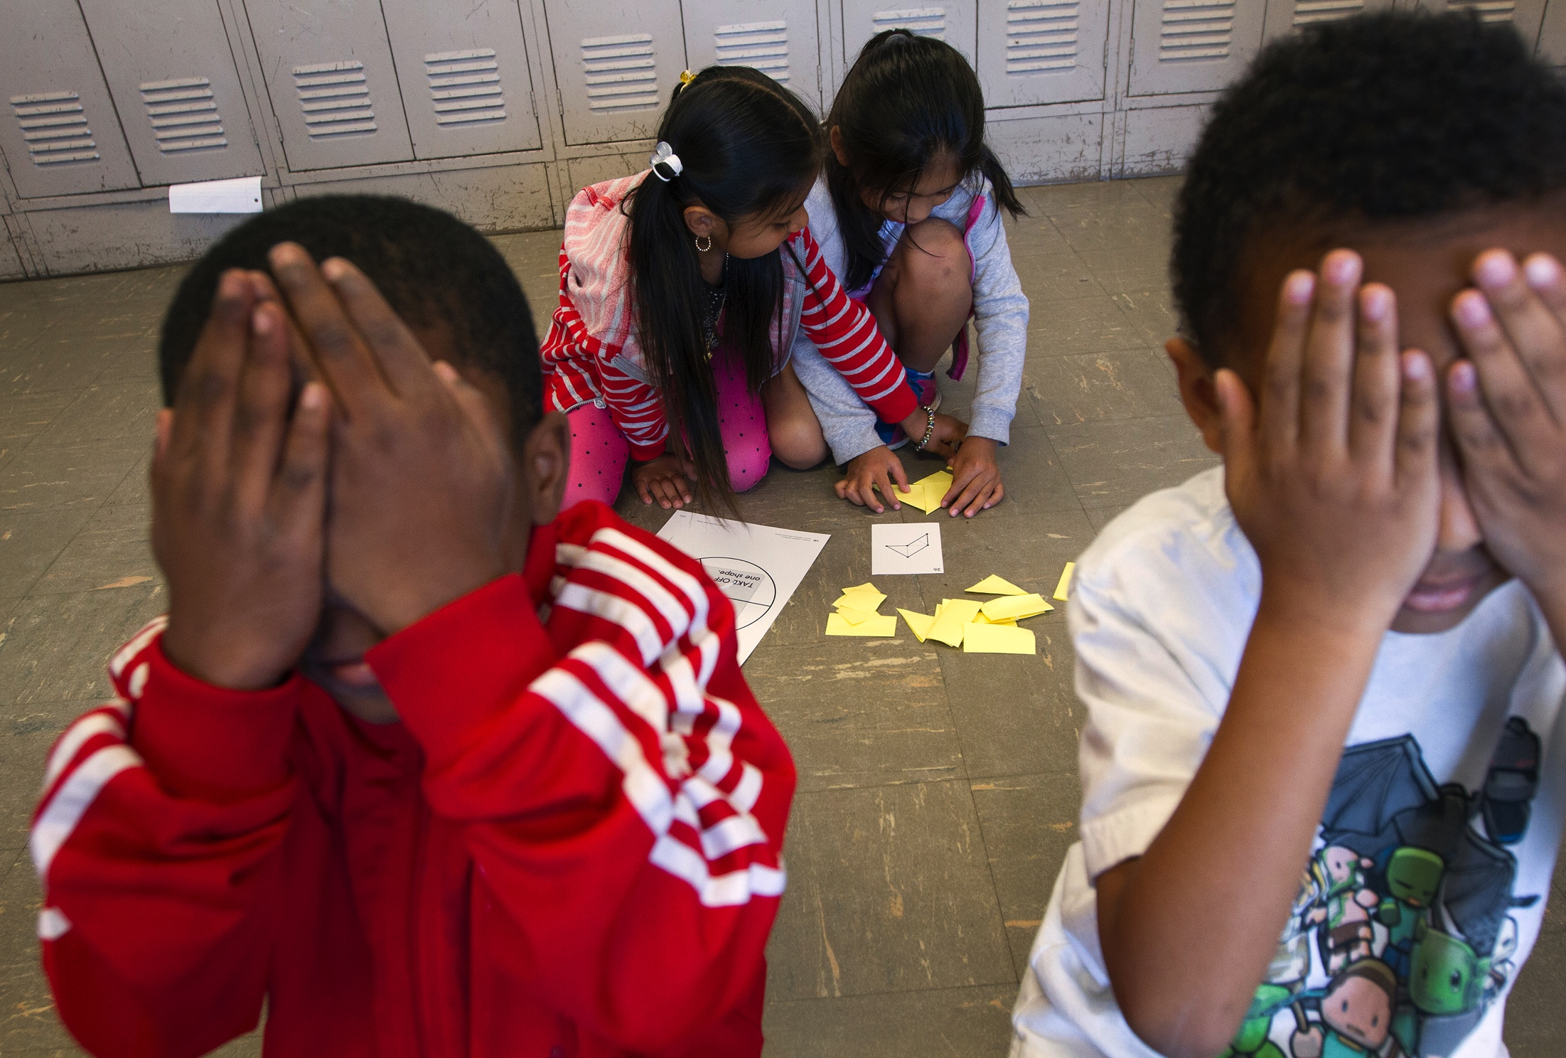
Mentoring Young Mathematicians

Slide 18
Empowering Parents
Increased communication
Computer access
Bilingual books
Parent Advocacy Training
Parent Coffees

Slide 19
Project RAP – Reaching Academic Potential
Implementation at five Jefferson County Public Schools
Range from 72%-89% Free/Reduced Lunch
37%-84% African American
Three have high ESL population.
Three have high special education numbers.

Slide 20
Our Implementation
Leadership from principals
Collaboration among teachers
Multi-dimensional Identification
Cluster Grouping
On-going PD
G/T Lead Teachers- Gifted Endorsement
Social Emotional Support
Summer Enrichment Camp
Parent Education

Slide 21
Current Results
School | Primary Talent Pool Numbers
Gilmore Lane | 28
King | 43
Shacklette | 32
Watson Lane | 36
Zachary Taylor | 34

Slide 22
What are the schools saying?
“Everything I have learned so far has taught me that having gifted students teach others does nothing for their education.”
“If I would have learned math this way, it would have changed my perspective.”
“Students will be thinking at higher levels, behavior will improve, and students will be more engaged.”

Slide 23
More Quotes
“I learned the importance of letting students know that they need to be making mistakes to learn. Mistakes show that they are challenging themselves. I plan to make this a big theme in my classroom this year.”
“Thanks so much for bringing this program to our school.” (Principal of a participating school)

Slide 24
Hoped for Results
More underrepresented students served as part of Gifted Education Services
Growing cultural competency among staff
Students identified for gifted services begin to mirror district demographics
Equal dedication/commitment to both talent development in high potential learners and talent development in high performing learners

