Slide 1
Department of Public Health
Award & Hooding Ceremony
May 11, 2018

Slide 2
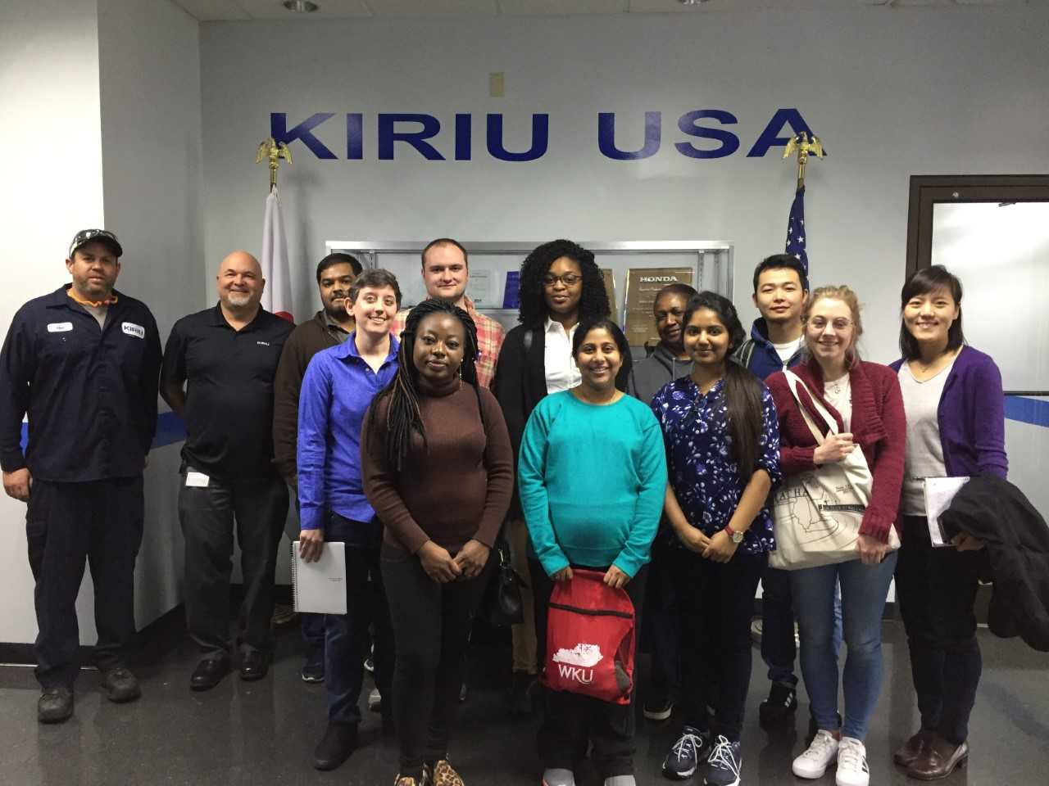
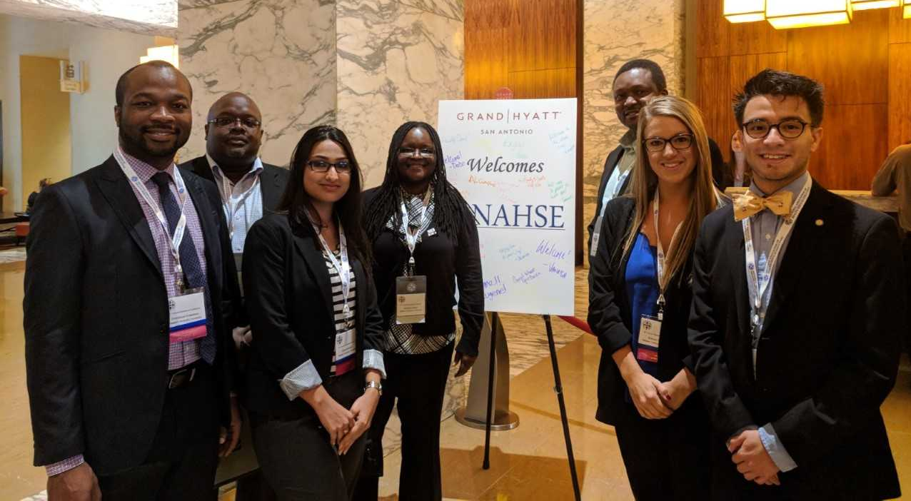
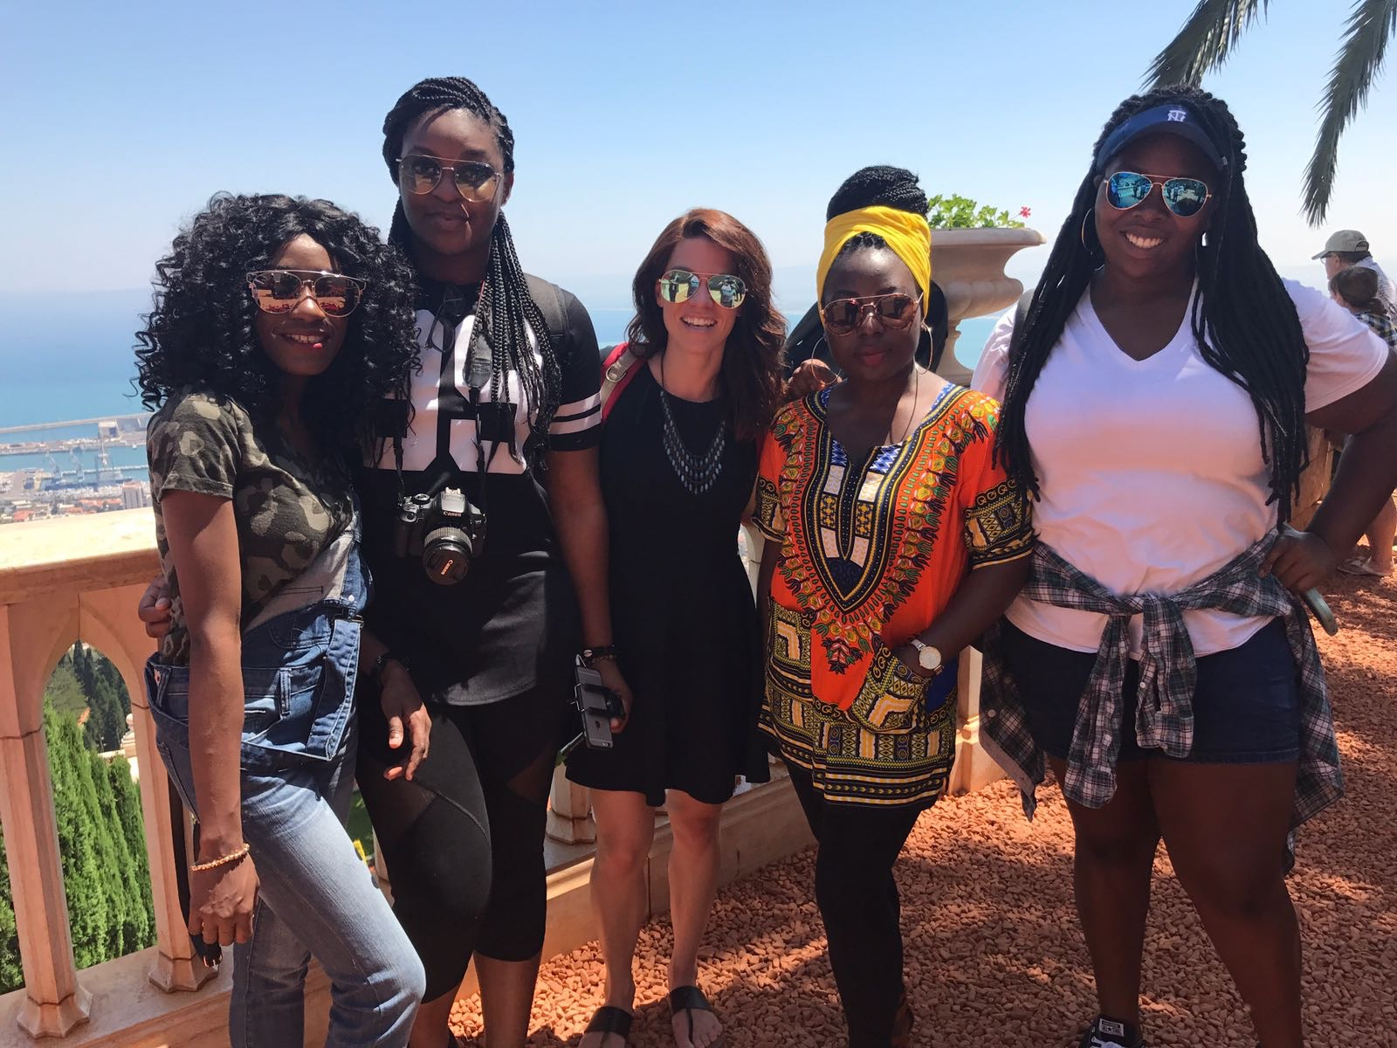
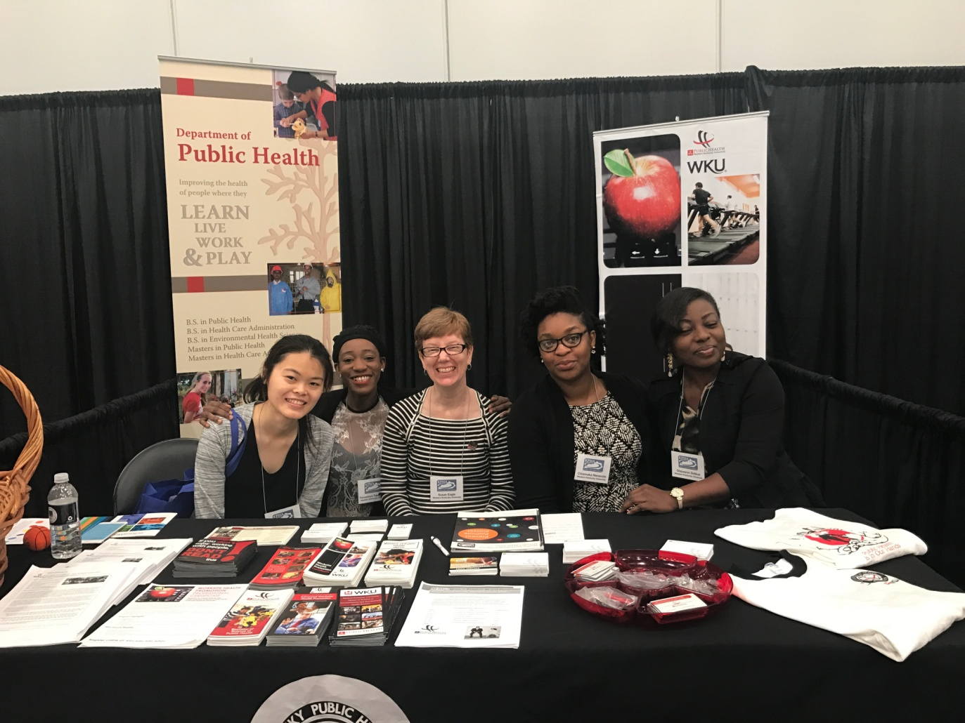

Slide 3
Master of Science Environmental & Occupational Health Science Graduates

Slide 4
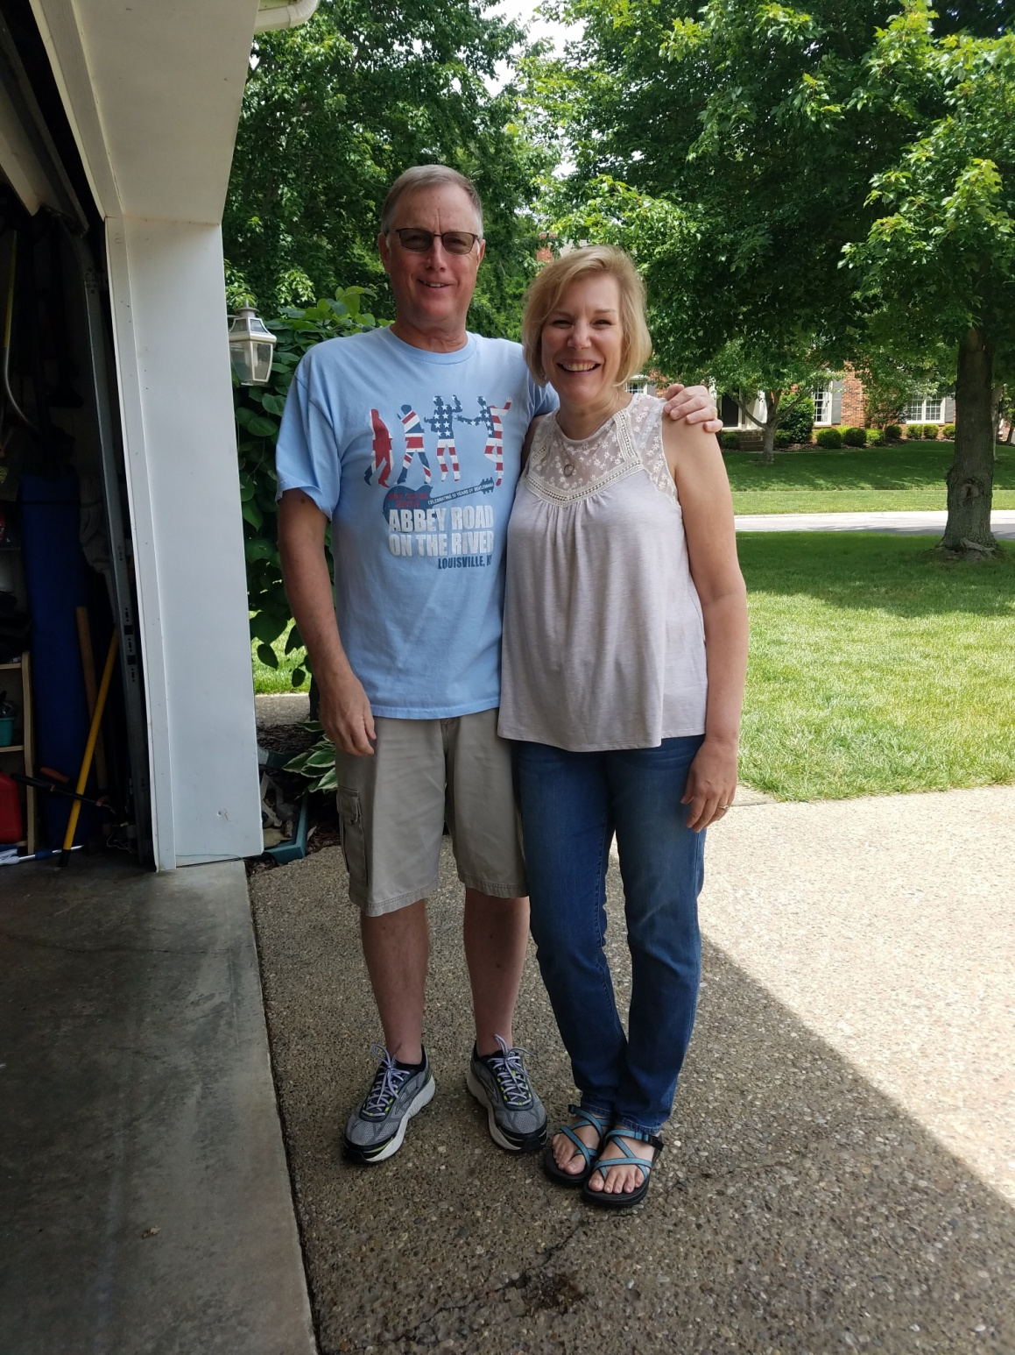
Jonathan C. Clements
Louisville, KY
“An investment in knowledge always pays the best interest.” —Benjamin Franklin

Slide 5
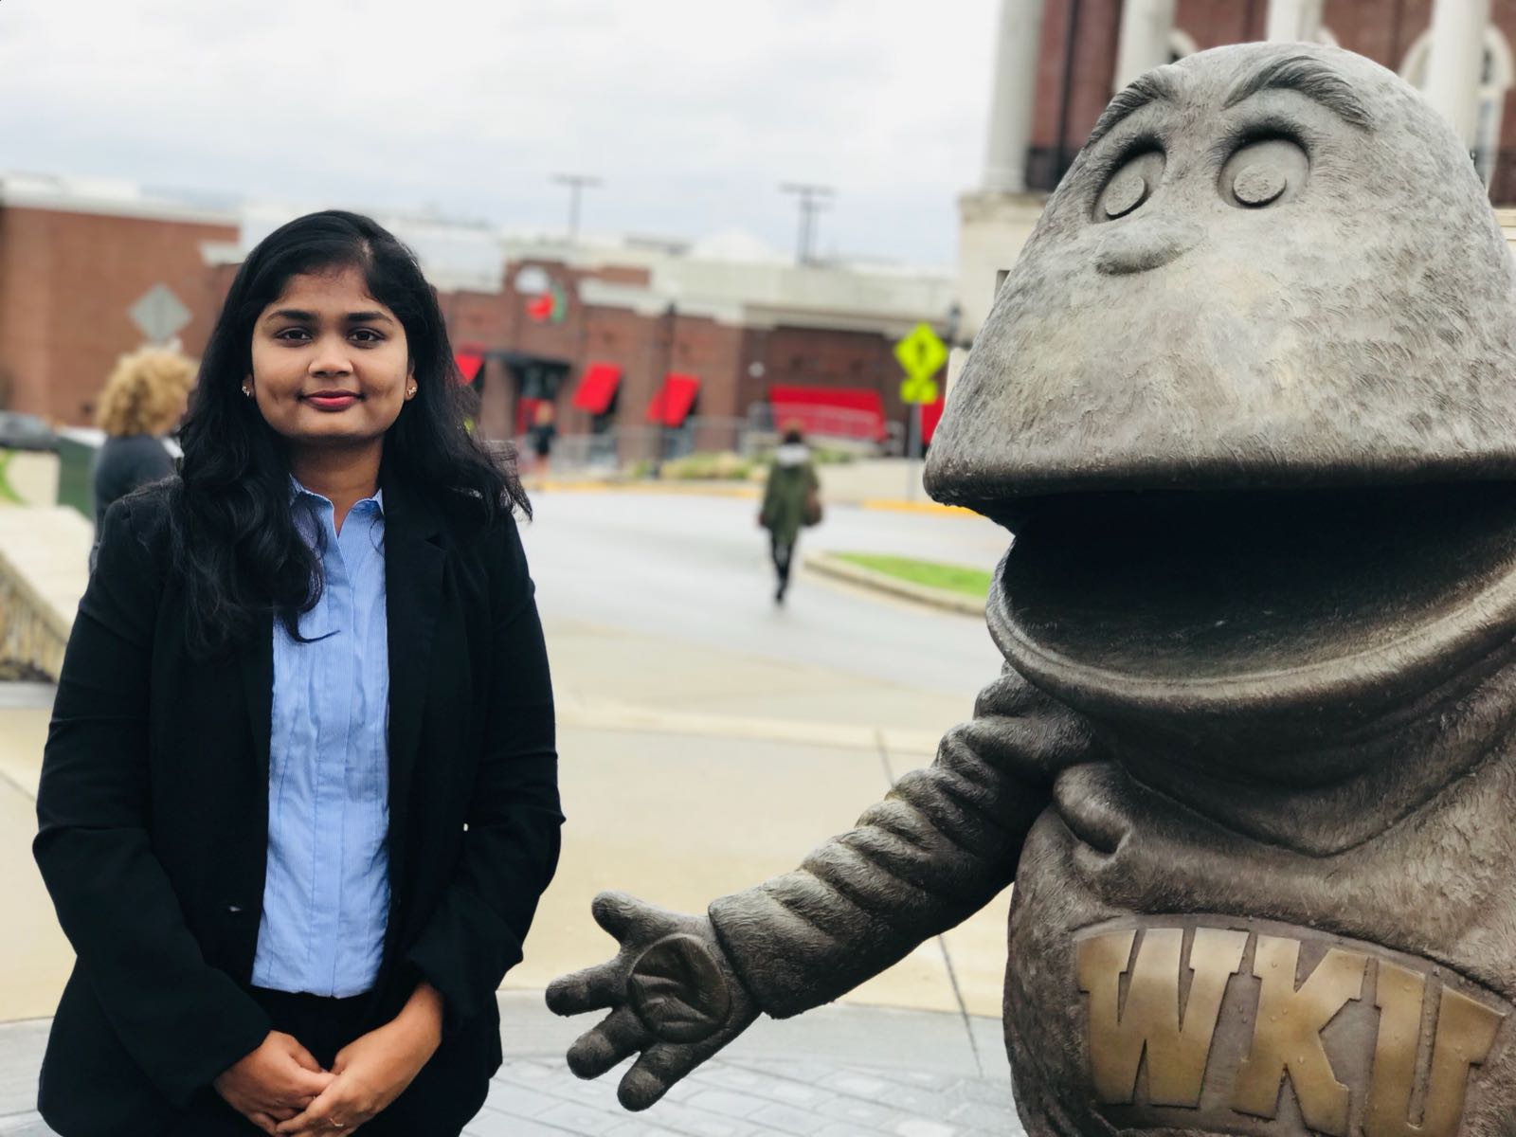
Divya Gadde
Hyderabad, India
WKU has enriched my life in many ways. College has given me chance to sharpen my skills and enabled me to become more successful in life.

Slide 6
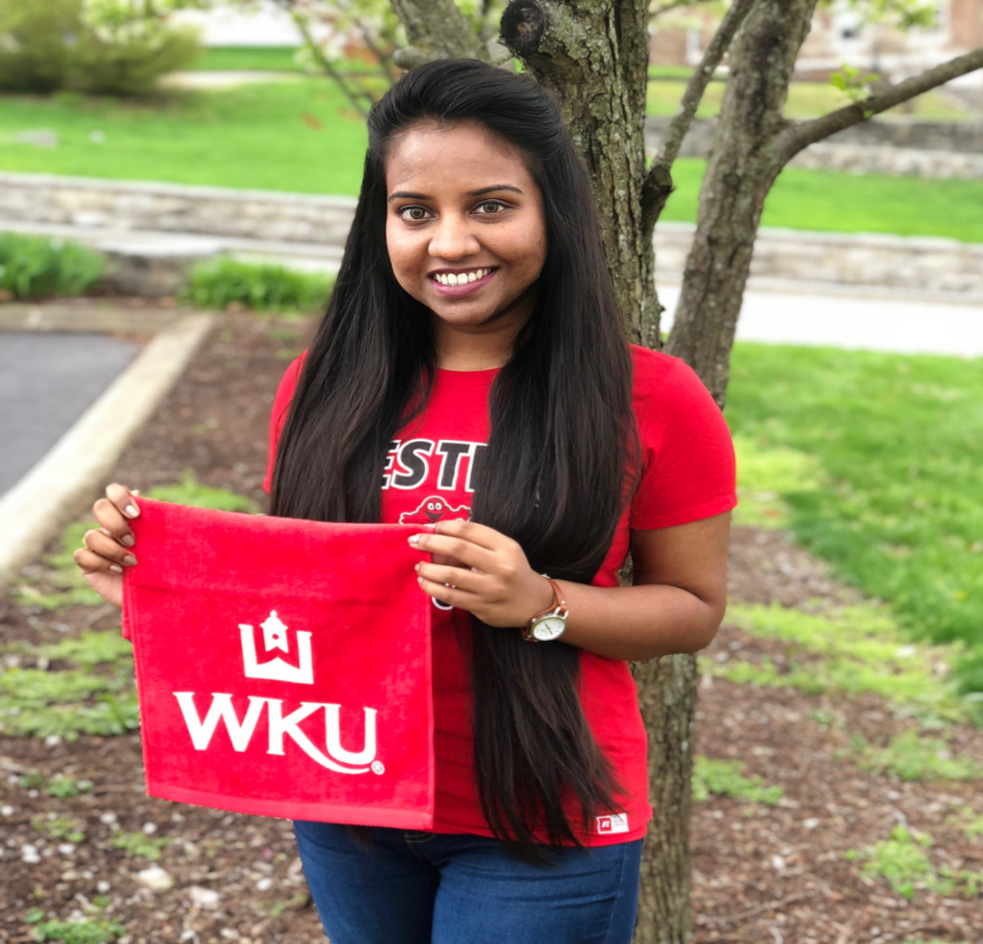
Harshitha Ponnala
Hyderabad, Telangana, India.
“It’s the possibility of having a dream come true that makes life interesting”
- Paulo Coelho
I thank you for helping me increase my possibilities and for your infallible presence in my journey. I will revere these moments evermore.

Slide 7
Master of Health Administration Graduates

Slide 8
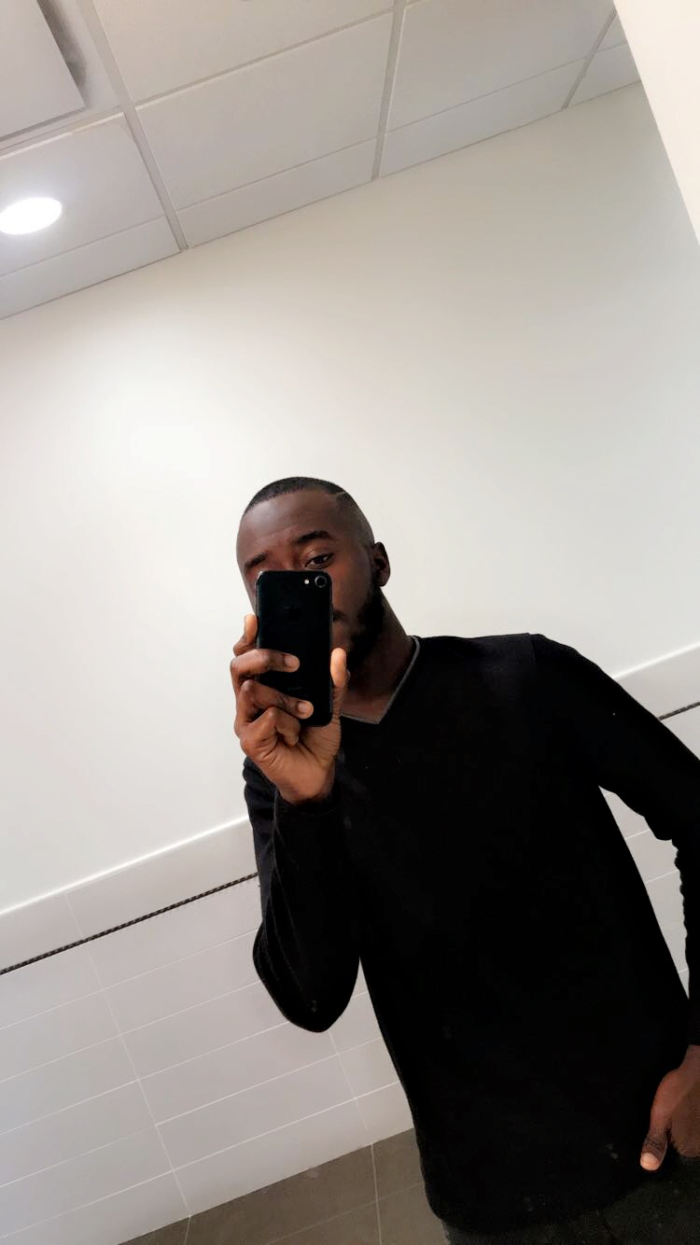
Akintunde Akinniyi
Insert an appropriate picture of yourself here
Lagos, Nigeria
Effort beats talent.

Slide 9
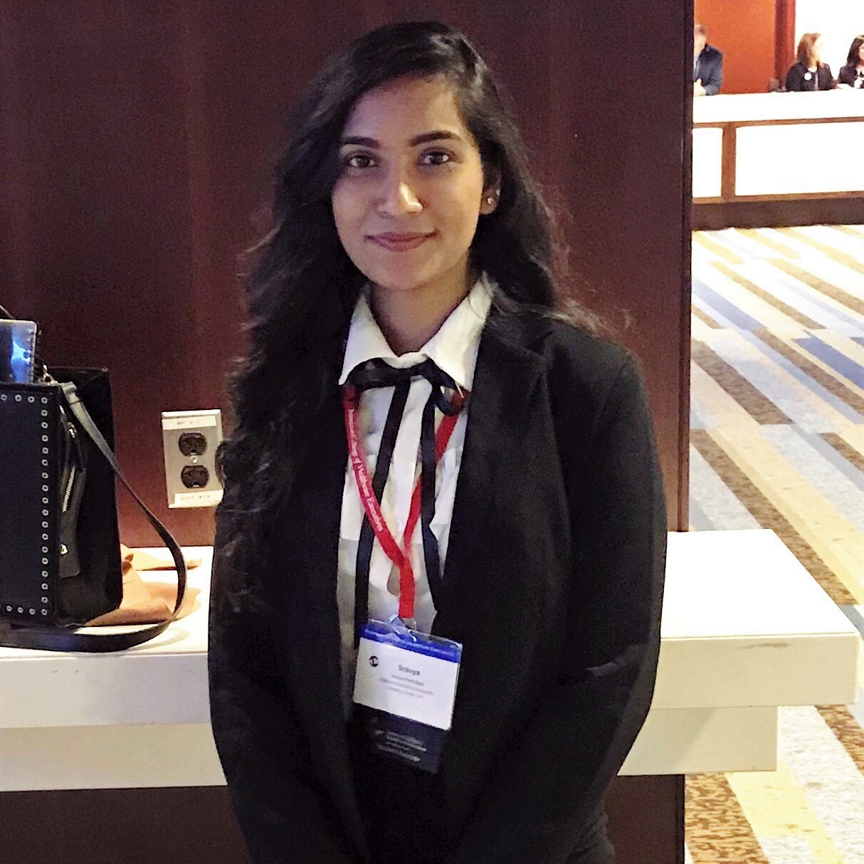
Sravya Patil Bagli
Hyderabad, India
Have the courage to get out of comfort zone where the future of magic begins.
LIVING THE DREAM!
Insert an appropriate picture of yourself here

Slide 10
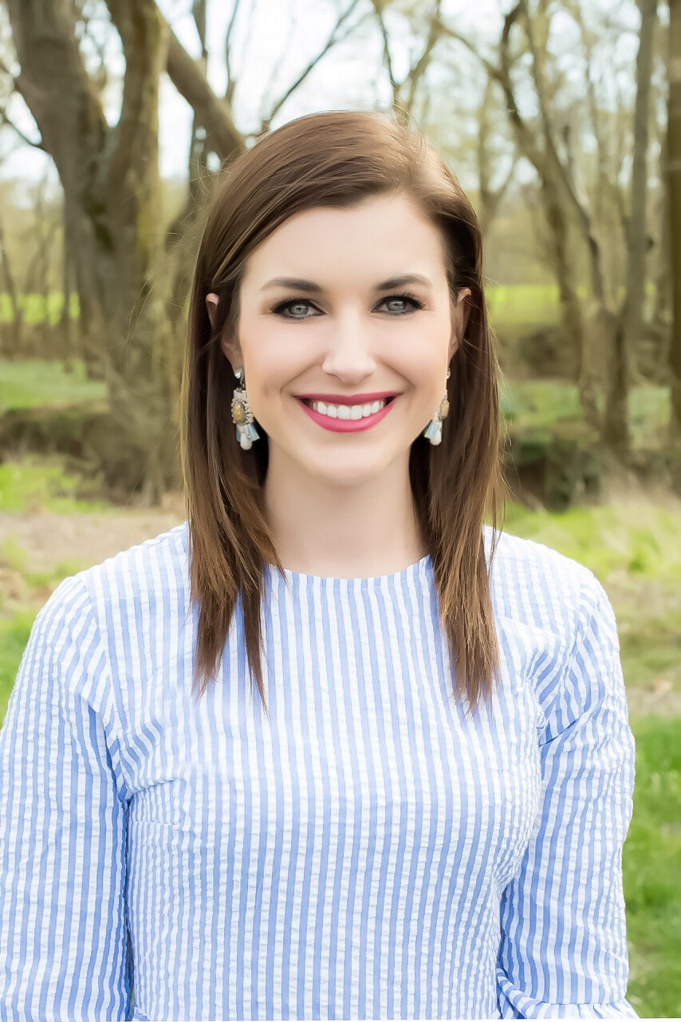
Ashley Brooks
Elkton, Kentucky
By His grace and for His glory.

Slide 11
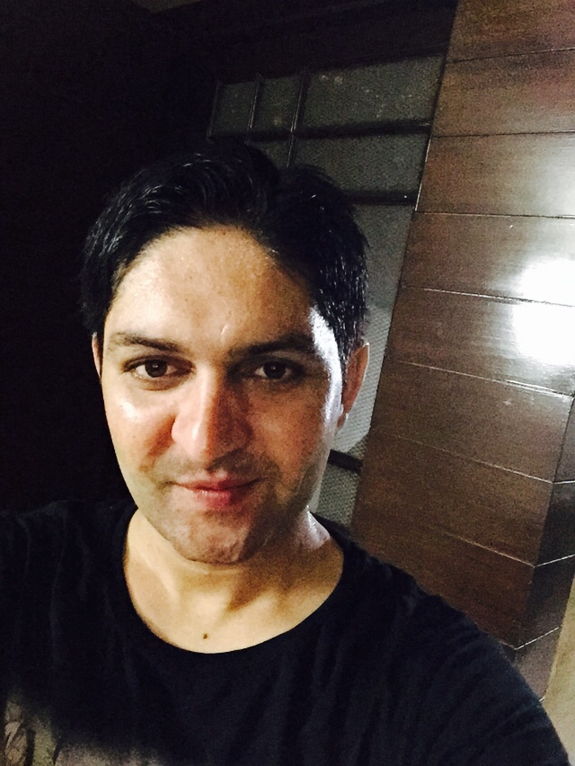
Parvesh Dahiya
Rohini, New Delhi, India.
Today is your Tomorrow.
Insert an appropriate picture of yourself here

Slide 12
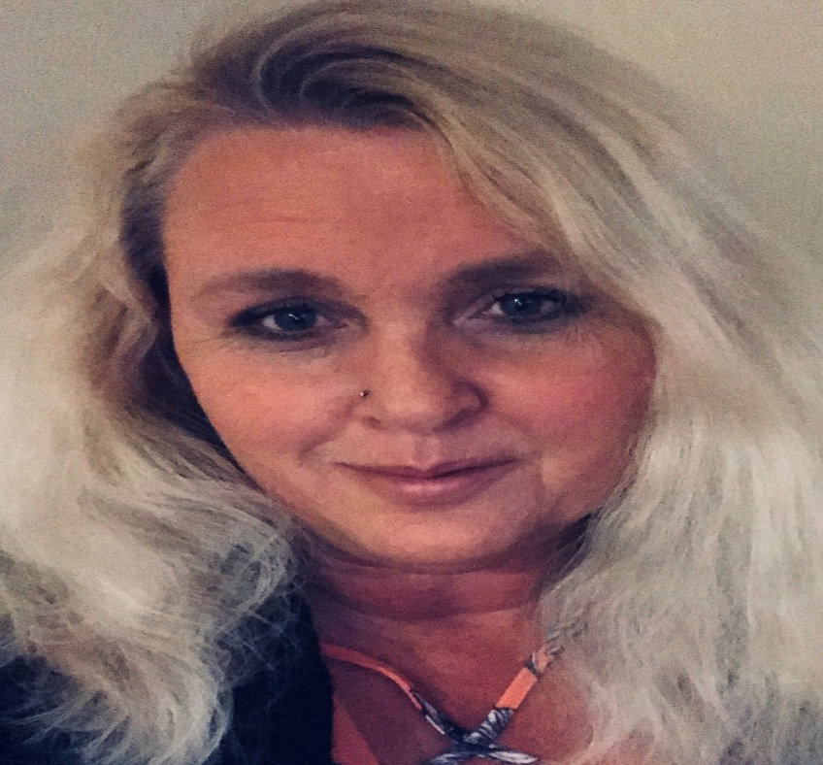
Tammy A Davis
London, Ky

Slide 13
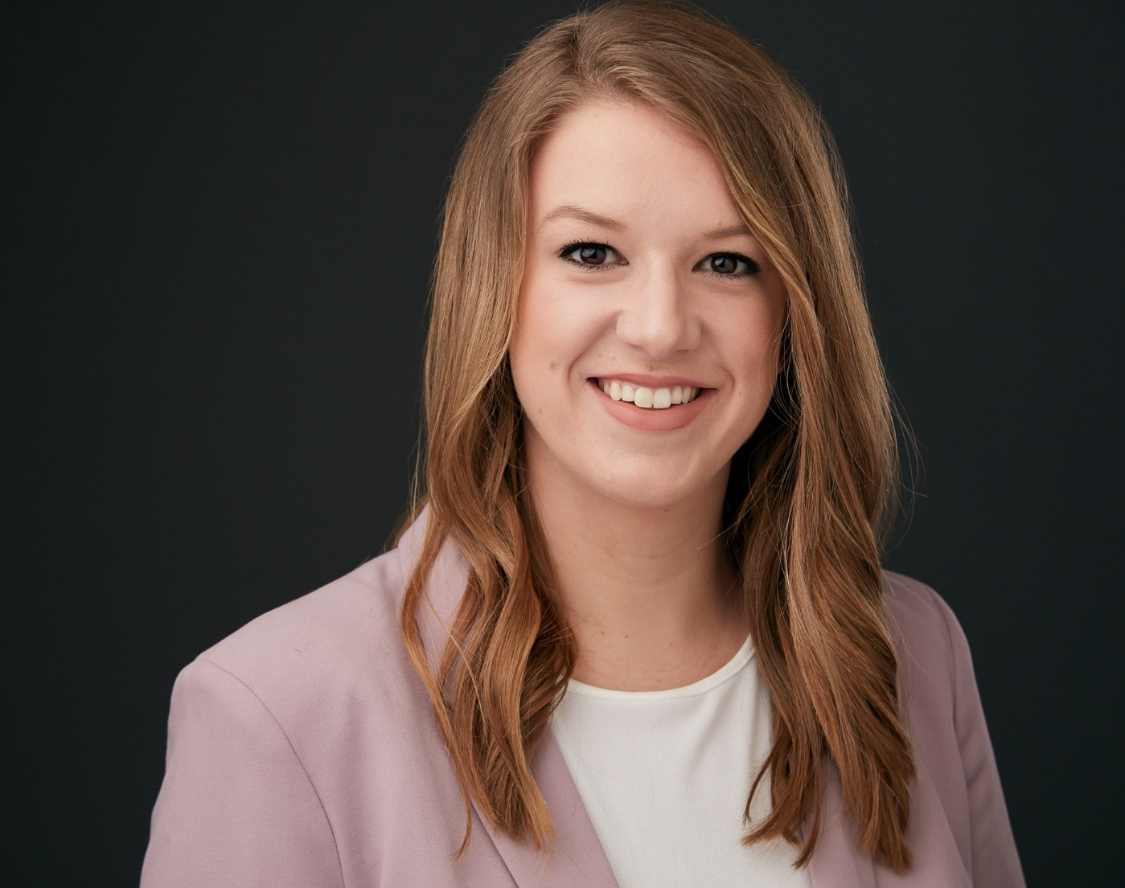
Brittney Gates
Princeton, Kentucky
“Nothing will work unless you do. “
– Maya Angelou

Slide 14
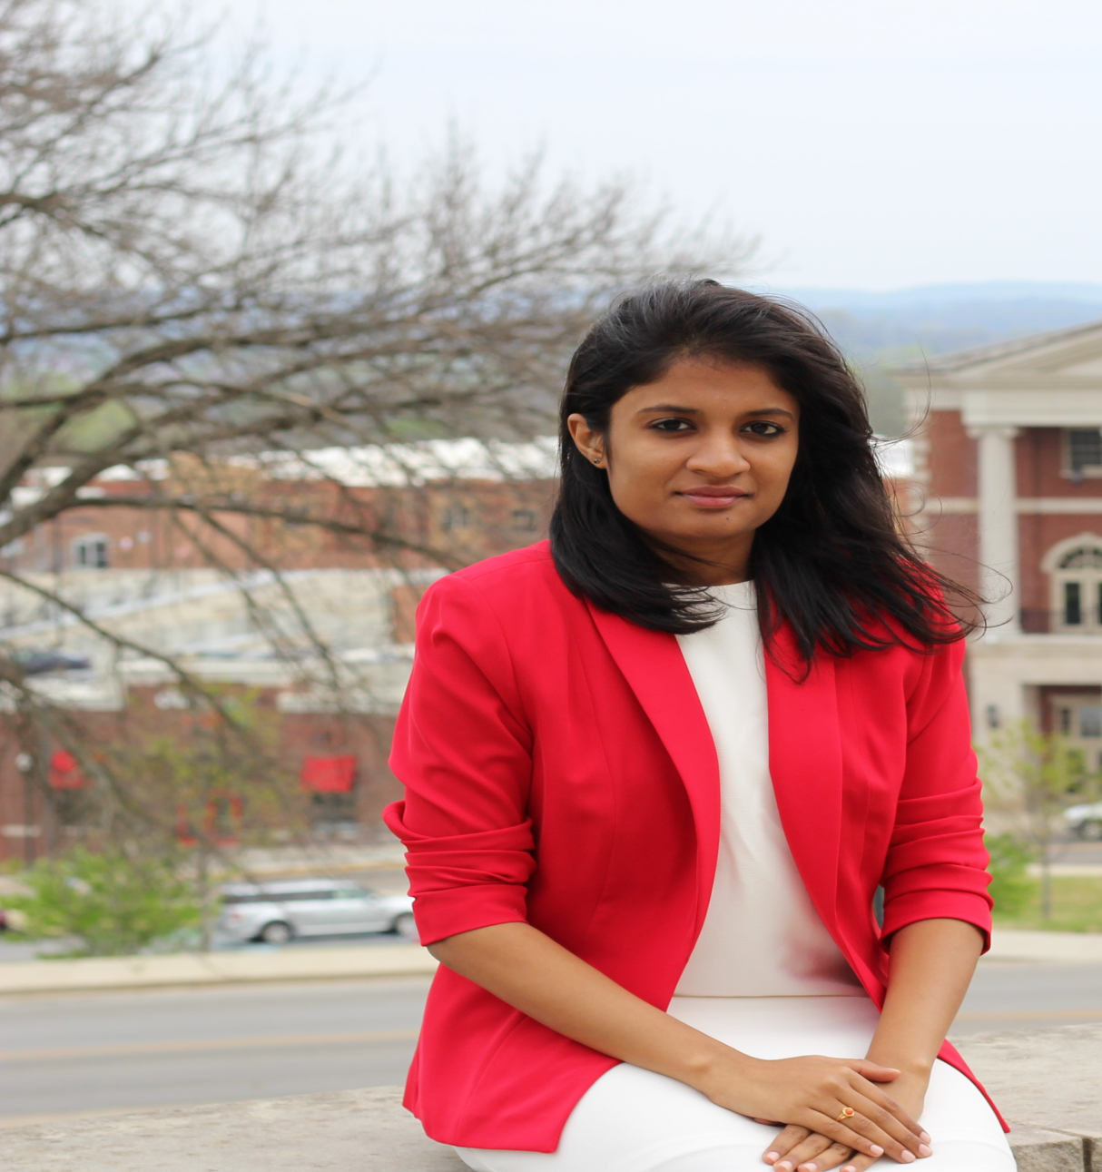
Divya Gangavelli
Insert an appropriate picture of yourself here
Hyderabad, India
Whatever you are be a good one

Slide 15
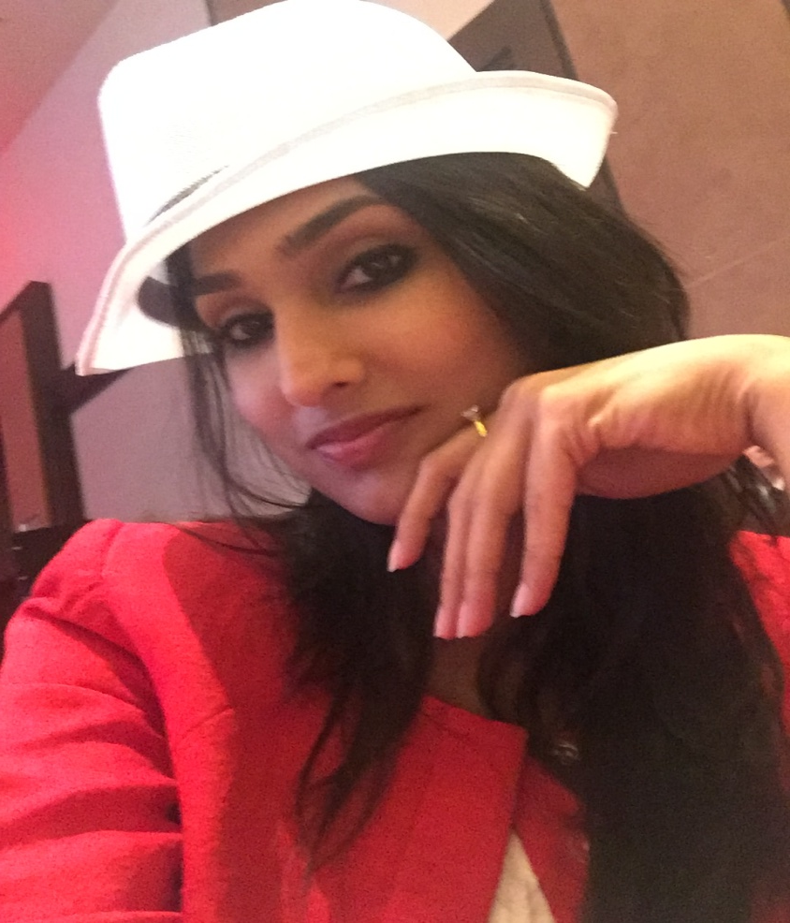
Zaiba A. Moledina
Mumbai, Maharashtra, India
Your largest fear carries your greatest growth.

Slide 16
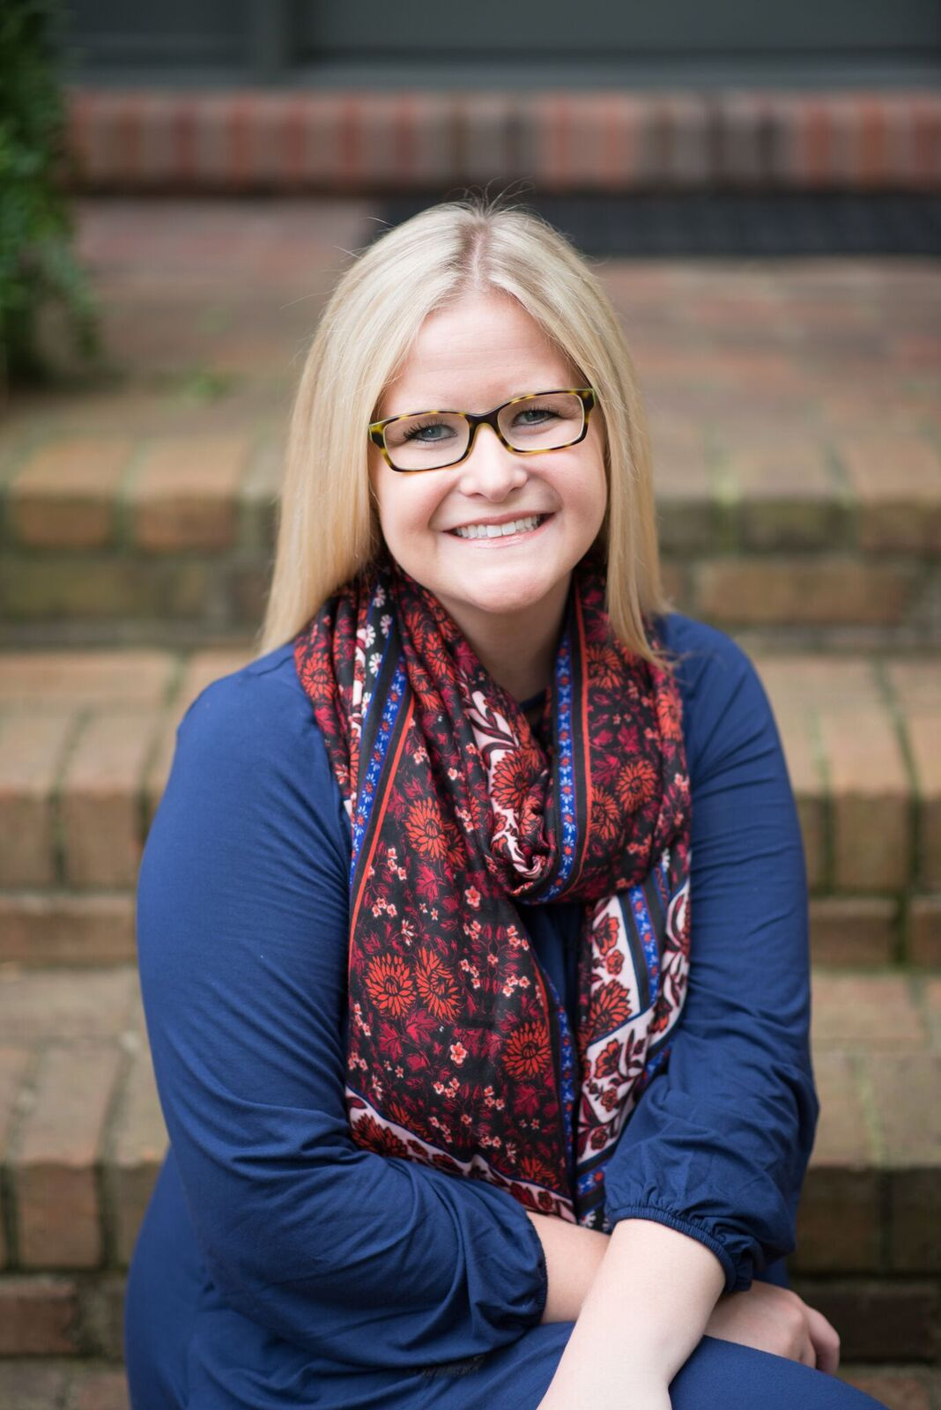
Mallory A. Perkins
Hopkinsville, Kentucky
Work hard, stay humble, be kind.

Slide 17
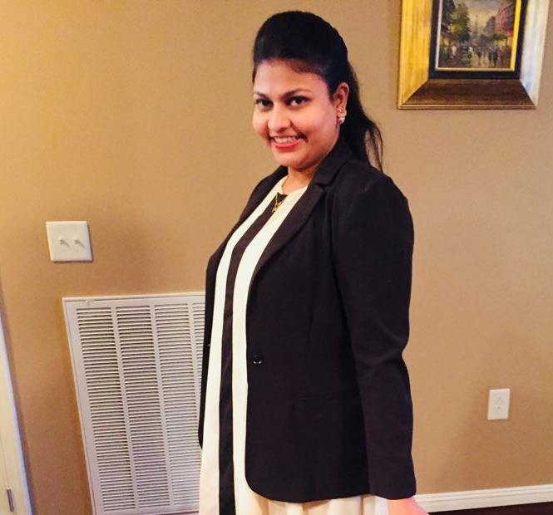
AISHWARYA POTLURI
Vijayawada, Andhra Pradesh, India
“The future belongs to those who believe in the beauty of their dreams”
- Eleanor Roosevelt
Insert an appropriate picture of yourself here

Slide 18
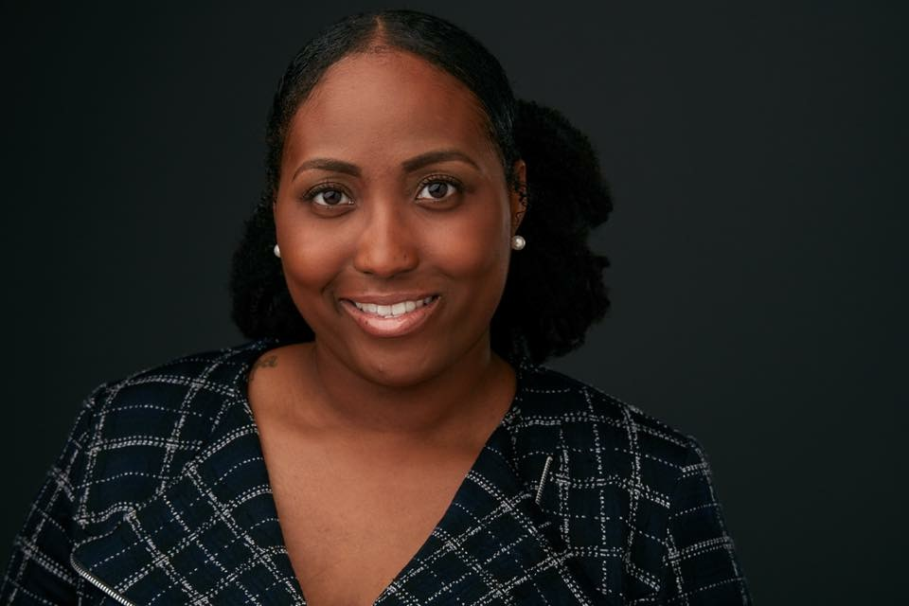
SHANTERA L. RICE
Munfordville, Kentucky, USA
“Leaving behind nights of terror and fear I rise, into a daybreak that’s wondrously clear. I rise, bringing the gifts that my ancestors gave, I am the dream and the hope of the slave. I rise, I rise, I rise…”
- Maya Angelou

Slide 19
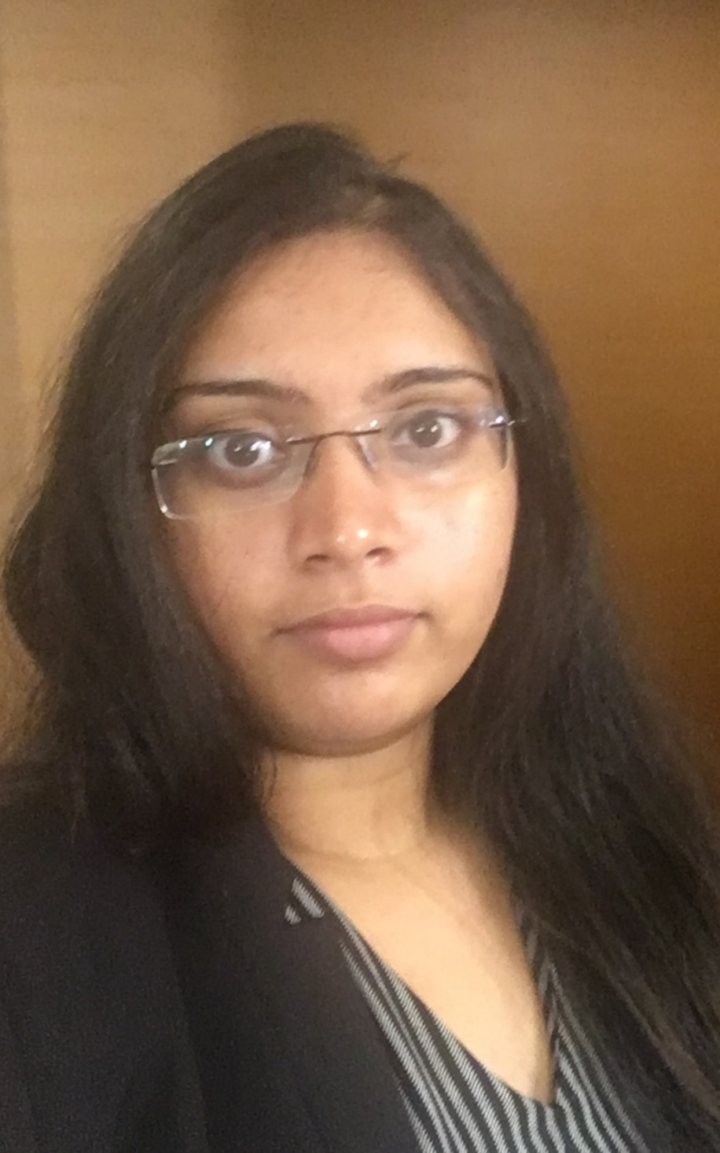
Harini Sandala
Hyderabad, Telangana, India
I am graduating as a better version of myself. Thank you friends and professors for your support.

Slide 20
Master of Public Health Graduates

Slide 21
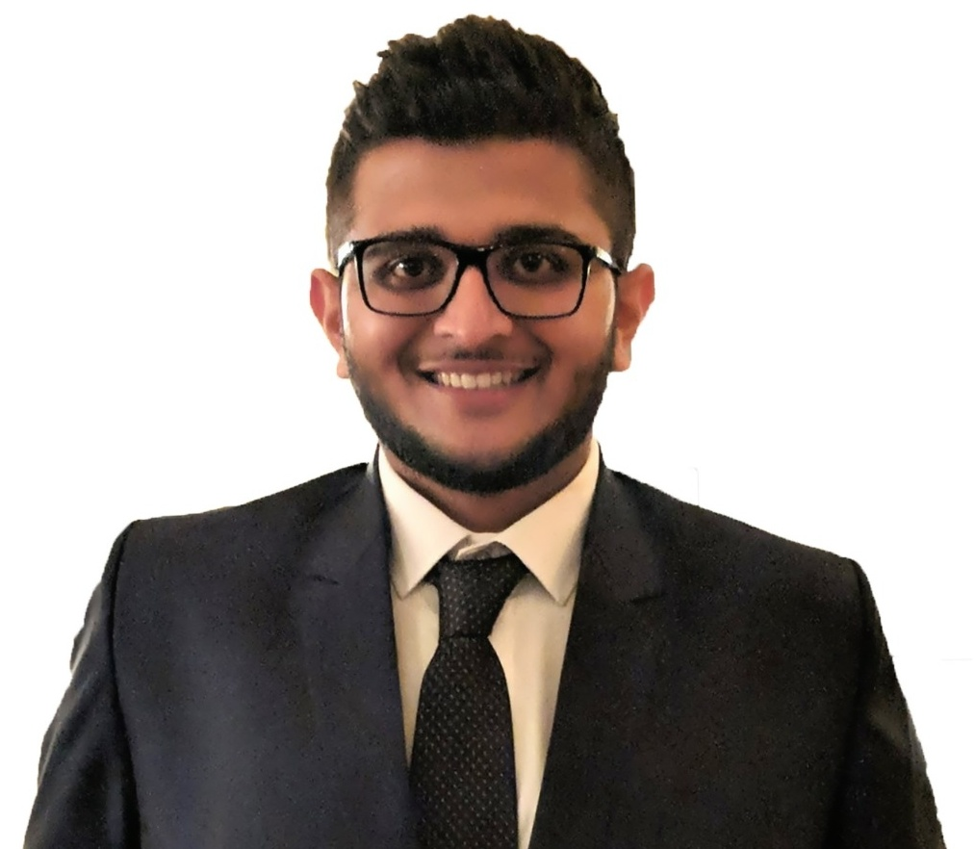
Parshad J. Dhaduk
Ahmedabad, Gujarat, India
“The future belongs to those who believe in the beauty of their dreams!”
-Eleanor Roosevelt
Insert an appropriate picture of yourself here

Slide 22
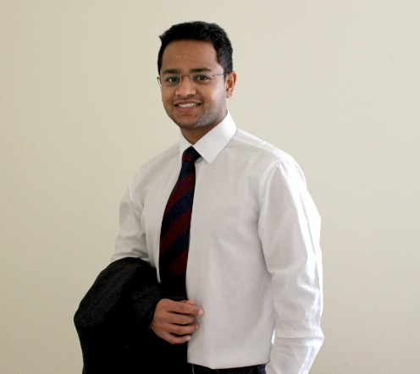
Akash Doshi
Vadodara, Gujarat, India
Being graduated is an exciting part of my life as I end this journey with memories to cherish, and also look forward to chase my dreams.

Slide 23
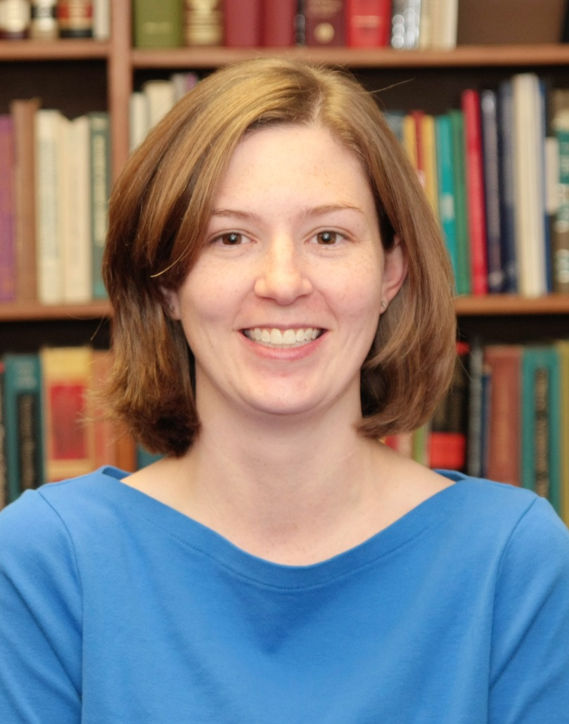
Rachel Hudson
Elkton, KY
“We are born makers.
We move what we’re learning
from our heads to our hearts
through our hands.”
–Brene Brown

Slide 24
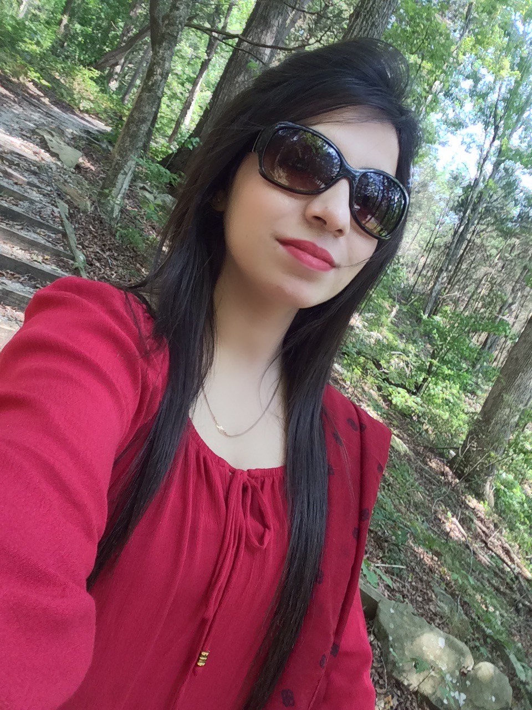
Tayyaba Iram
Pakistan
Nothing is impossible, the word itself says 'I'm possible!

Slide 25
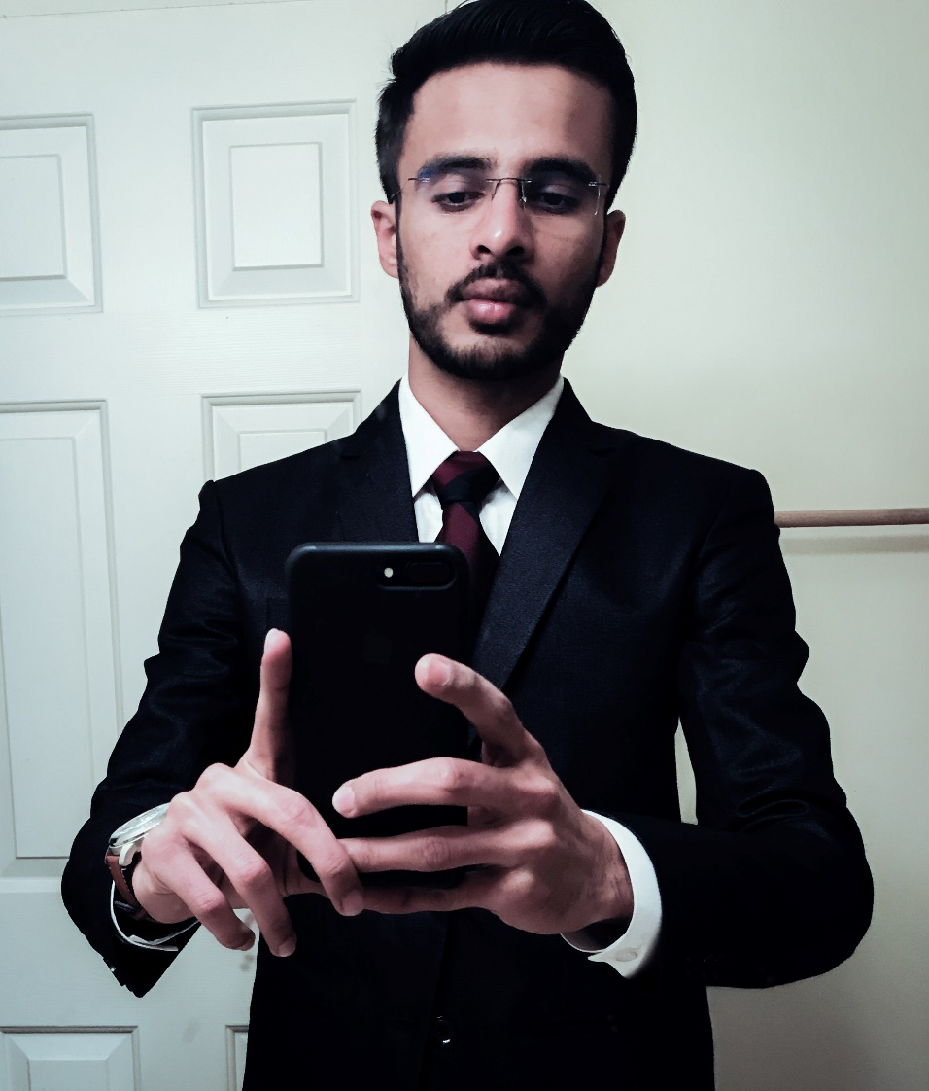
Gunjan Joshi
Junagadh, Gujarat, India
This voyage has been an opportunity for professional as well as personal diversification. However, I still remain the traveler of both time and space (as Led Zeppelin like to say) until I achieve the perfect paradise I covet.

Slide 26
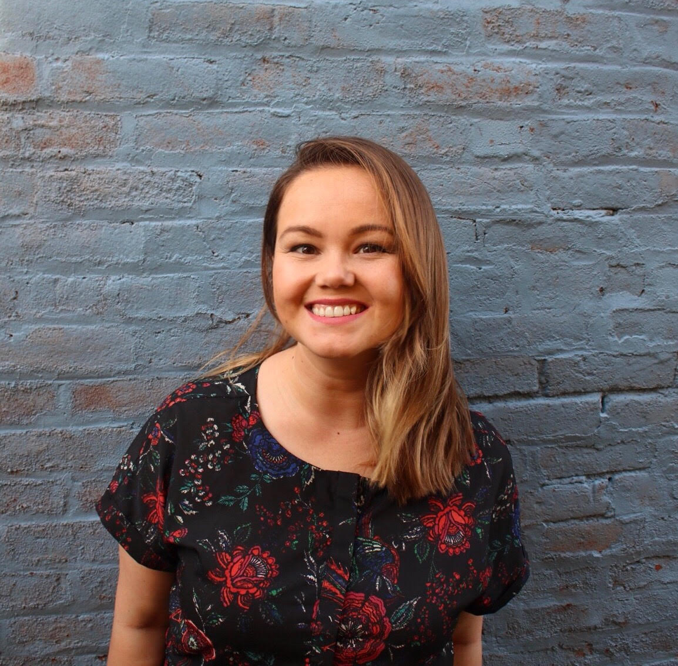
Irma Kocer
Lexington, Kentucky
"Our work should equip the next generation of women to outdo us in every field. This is the legacy we'll leave behind.“
- Rupi Kaur

Slide 27
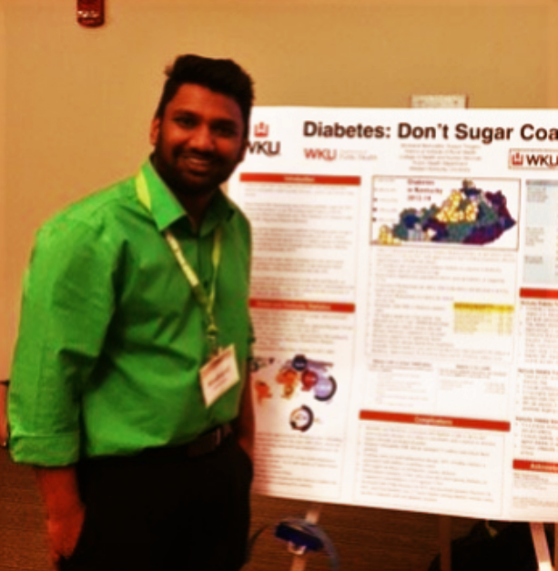
Musharaf Mohiuddin
Hyderabad, India
“When do you think people die? When they are shot through the heart by the bullet of a pistol? No. When they are ravaged by an incurable disease? No. When they drink a soup made from a poisonous mushroom!? No! It’s when… they are forgotten.”
― Dr. Hiriluk, One Piece

Slide 28
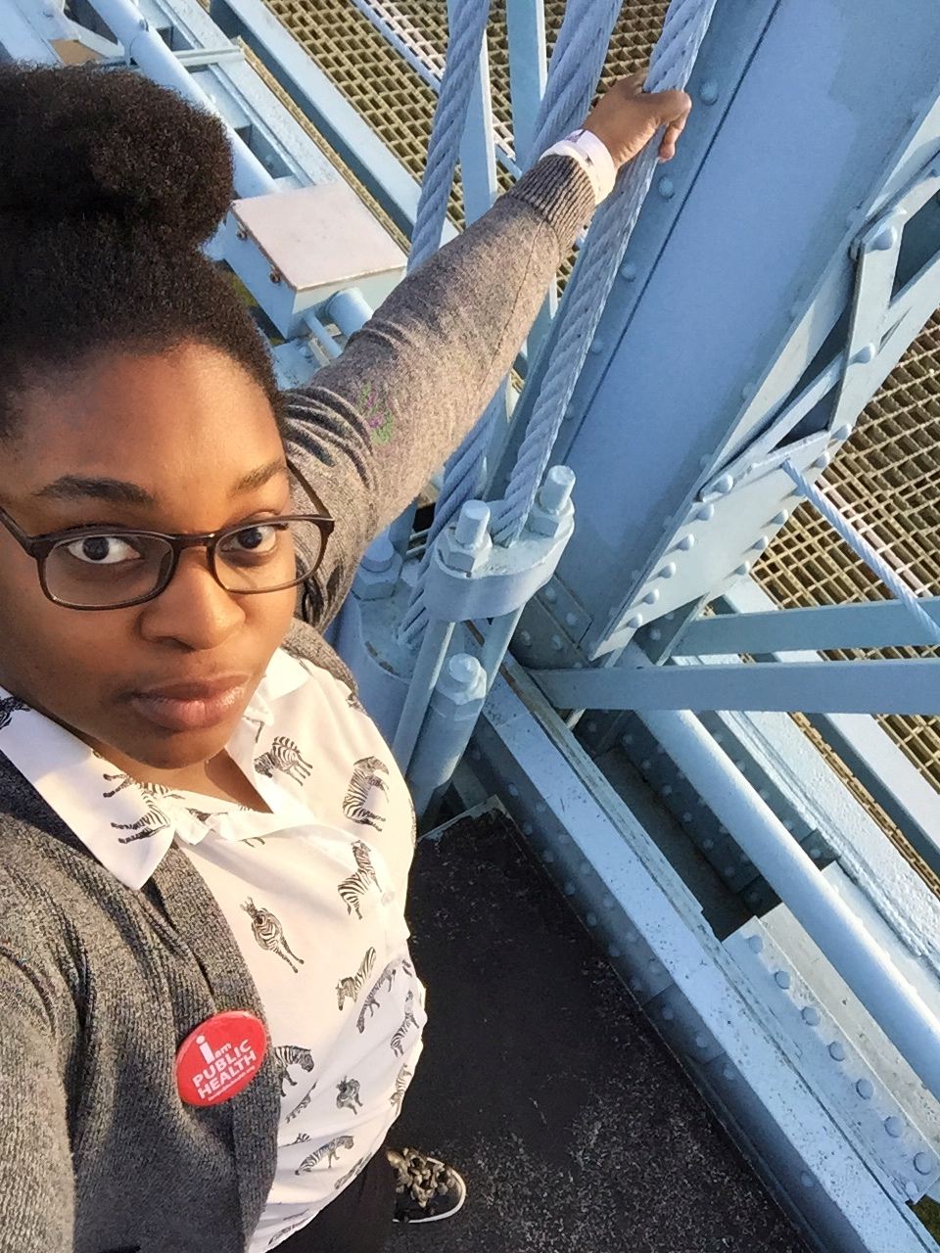
Chiamaka Nwazojie
Abuja, Nigeria
“The thing to do, it seems to me, is to prepare yourself so you can be a rainbow in somebody else’s cloud. Somebody who may not look like you. May not call God the same way you call God- if they call God at all. I may not dance your dances or speak your language. But be a blessing to somebody. That’s what I think.”
-Maya Angelou

Slide 29
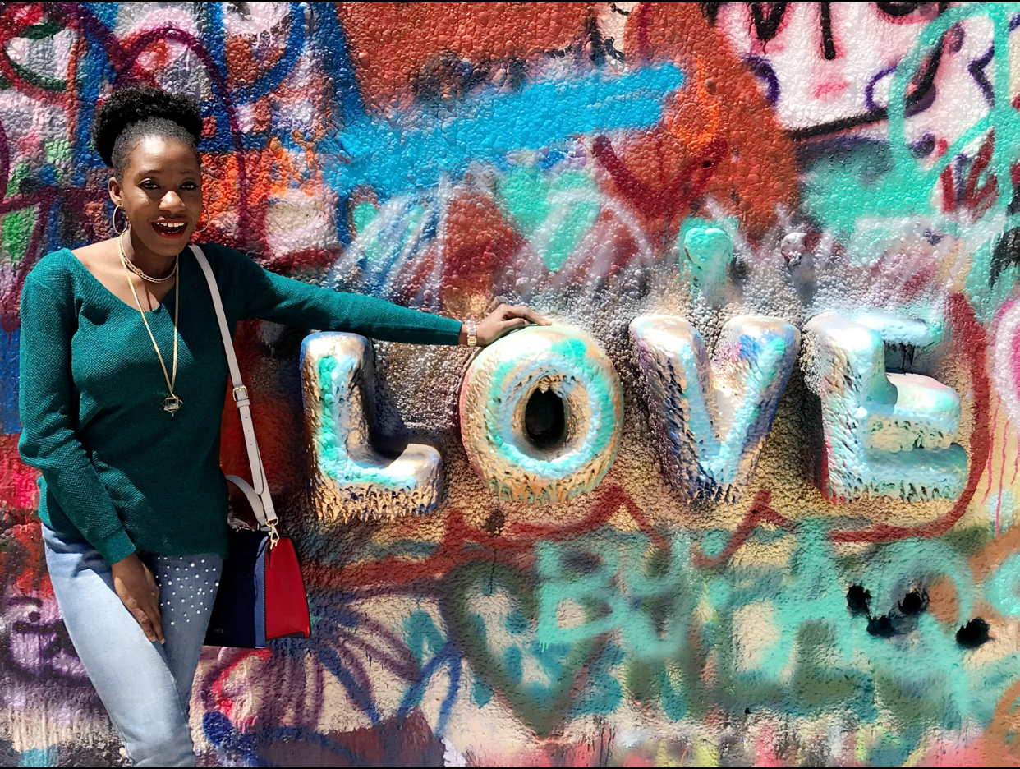
Temidayo Ogungbemi
Lagos, Nigeria.
Graduation is only a concept. In real life, you graduate everyday. It is a process that goes on until your last day on earth. So I say, do not let making a living prevent you from making a life you want.
Live well. Love much. Laugh often.

Slide 30
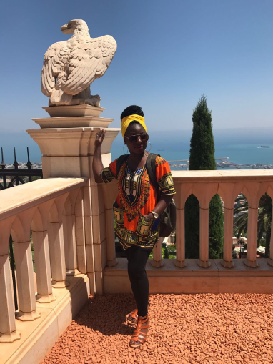
Sidikat Olanrewaju Olajuwon
Ijofin, Ogun State, Nigeria
“Life is not about how fast you run or how high you climb, but how well you bounce.”
- Vivian Komori

Slide 31
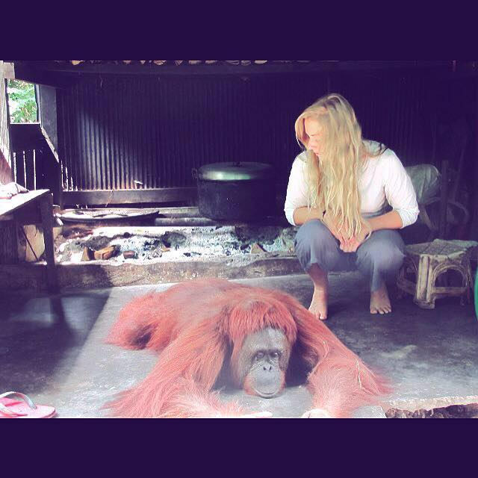
Victoria Peters
Louisville, KY
“The world is big and I want to have a good look at it before it gets dark.”
– John Muir

Slide 32
Neha Kishor Vora
Owensboro, KY
“The best way to find yourself is to lose yourself in the service of others.”
–Mahatma Gandhi

Slide 33
