Slide 1
Fall 2022 Annual Plan
**Subject to change based on availability**

Slide 2
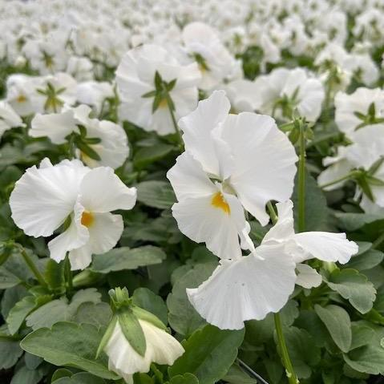
Roundabout
Triangles – Mix of red blotch and white Pansy (Heavier on white)
Center beds in front of WKU sign- White Pansy
**Exact look of the red pansy/panola/viola with a face will vary based on availability this is a generic photo**
*Red Pansy’s with a blotch/face are hardier and perform better in our area than solid red.**

Slide 3
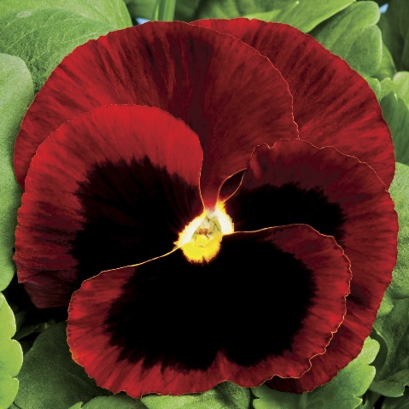
Avenue of Champions Islands
Alternating Islands of white and red pansy
**Exact look of the red pansy/panola/viola with a face will vary based on availability this is a generic photo**
*Red Pansy’s with a blotch/face are hardier and perform better in our area than solid red.**

Slide 4
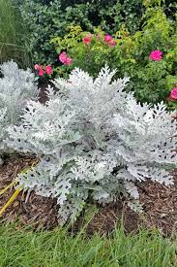
Cherry, Pylon & Minton Raised planters
Mix of Red Snapdragons and Dusty Miller

Slide 5
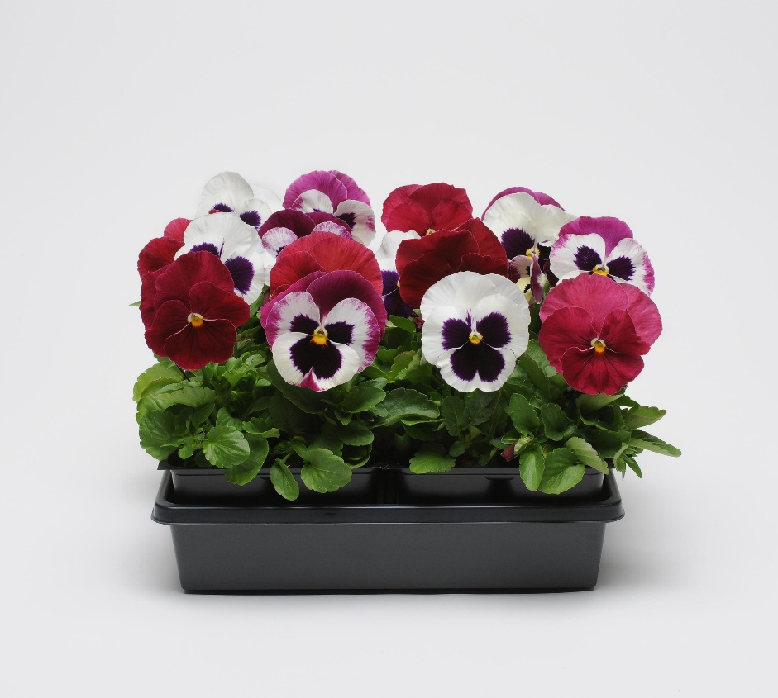
COHH Beds
Viola ‘Sorbet XP Raspberry Sundae Mix’

Slide 6
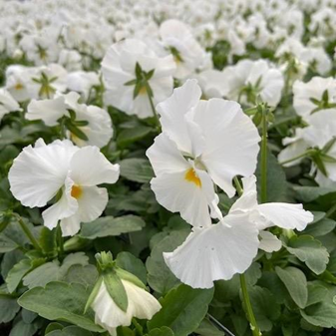
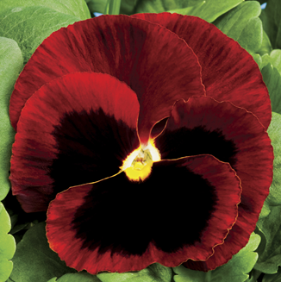
Big Red Statue, College Heights blvd entrance, Cemetery Road, Directionals, & Honors
White pansy and Red blotch pansy mixed
**Exact look of the red pansy with a face will vary based on availability this is a generic photo**
*Red Pansy’s with a blotch/face are hardier and perform better in our area than solid red.**

Slide 7
DSU Wave bed
Red Blotch Pansy

Slide 8
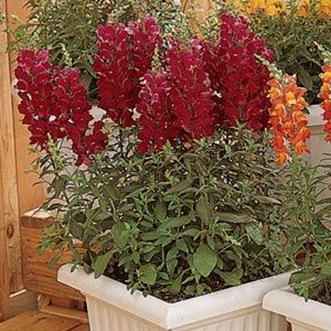
Planters around DSU
Mix of Snap dragons, pansy, and dusty miller

Slide 9
Trust Sculpture
Pansy Spring Mix

Slide 10
First Year Village
Dusty Miller ‘W’
Mix of red blotch and white pansy around ‘W’
**Exact look of the red pansy with a face will vary based on availability this is a generic photo**
*Red Pansy’s with a blotch/face are hardier and perform better in our area than solid red.**

