Slide 1
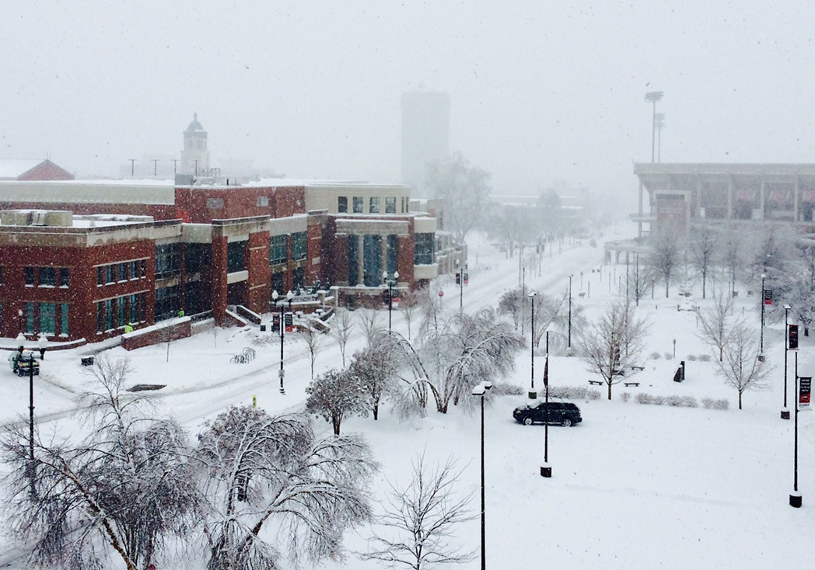
Western Kentucky University
Snow and Ice Response Plan
2016-2017
1

Slide 2
Procedures for Snow Removal:
The Intent of this snow plan is to standardize and document the Standard Operating Procedures taken by Facilities Management to combat a winter snow or ice storm. Every storm is different, with different starting times, temperatures, accumulations and durations. This plan indentifies the general Facilities Management staff resources, equipment resources, areas of responsibility and general strategies for managing any given storm.
Upon the determination that significant winter weather is imminent, a conference call with the Director of EHS, WKU Police, Facilities Management Director and the Manager of Campus Services (or their designee) will determine the risk of the conditions. Once the determination is made, they will inform the University Provost by 5:15AM regarding weather conditions, so that they can officially designate the school as open, late or officially closed.
The Facilities Management Director and the Manager of Campus Services will monitor the weather conditions during non-working hours and will call in the necessary grounds personnel as needed. Several products or actions may be used depending on the surface that is effected. This includes: pre-spraying of steps, closing of top floors of parking structures, barricading of entrances until safe.
WKU Facilities Management Snow Plan
2
Notes:
2

Slide 3
It is anticipated that completion of snow removal will be dependent on the total snowfall accumulation and subsequently the mechanical and chemical removal the snow from sidewalks, streets and parking lots. In the event of the following weather conditions:
1. Snow flurries
Power Sweep sidewalks and salt only as conditions require (minimum salt application rate)
2. Sleet
Power Sweep sidewalks and salt or calcium acetate mixture, minimum salt application rate, reapply as necessary. Use of DFM staff as needed.
  3. Freezing rain
  Manually scrape steps and handrails. Apply salt or acetate as necessary to street intersections, ramps
  walkways and high traffic corridors.
  4. 0” to 2” snowfall accumulation (End of storm)
  Power Sweep, plow and shovel as necessary. Apply salt or acetate as needed to street intersections, ramps walkways and high traffic corridors.
5. 2” to 6” accumulation
Power Sweep, Plow, Shovel to keep roadways and sidewalks open, Salt as necessary. If possible we will wait to salt large areas until snow has ceased. It is important to conserve as much salt as possible to ensure we have adequate stock for following storms. We will keep roads and main walks open, utilizing the Priority Route map and contracted assistance for major corridors and South Campus. Activate our contingency plan involving outside contractors with heavy equipment.
6. 6+” of accumulation
Continue to clear priority lots and walkways. NO chemicals will be deployed until the precipitation ceases as to not waste product. Activate our contingency plan involving outside contractors with heavy equipment.
WKU Facilities Management Snow Plan
3

Slide 4
Essential Personnel Call-in List
Maintenance
Mark Updegraff 270.784.1312
Herb Hess 270.427.8645
Joe Keith 270.991.3848
Danney Madison 270.784.9868
Ben Spitler 270.996.8537
Ben Deweese 270.535.7402
Clerical
Angie Jackson 270.799.8924
Kathy Bailey 270.202.4603
Phil Kinser 270.784.4963
Plant Operations
Dale Dyer 270.991.1523
Kayla Howard 270.532.1259
Rooks Howard 270.784.5163
Craig Austin 270.847.7419
Central Steam Plant 270.745.5828
Building Services
Kevin Gutierrez- 270-535- 9063
Rob Bradshaw- 270-303- 6027
Tammy Price- 270-784-1636
Todd Kitchens- 270-935-7220
Sue Barbour- (ride in with husband)- 270-246-0398
Johnny Brown- 270-779-4734
Janice McDonald- 270-799-1607
Heather Miller- 270-421-3831
Terri Williams- (DSU only) 270-996-7240
Taylor Allen- 270-421-5384
Betzabel Rodriguez- 270-320-8166
Claudette Cravens- 270-996-6282
Larry Cardwell- 270-784-0814- farm
Justin Potter- 614-260-3215
Sue Ferrell- 270-783-8755
Sebastian Stanley (270) 590-4592
Brenda Gillon- 270-202-9554
Quentae Massey- 419-699-4576
In the event the campus is officially closed
In the event that the university is officially closed the following “WEATHER ESSENTIAL PERSONNEL” designated are to report to work. Coordination of this crew will be under the direction of our Facilities Management Director and the Manager of Campus Services and assisted by all other managers. Staff should come prepared and bring the appropriate outdoor clothing, headgear and footwear to work in outside conditions.
  Campus Services personnel are required to report
  Designated Maintenance and Plant Operations employees are to report to their designated buildings and areas to check for building operations and to assist with the entrances to their buildings
  Clerical staff as designated by FS manager, to direct calls and radio communications
  One employee from the stockroom designated by the FS manager to handle supply issues
  All Building Services employees are to report and maintain safe access and minimize snow melt inside buildings and mop salt to prevent slips trips and falls

Slide 5
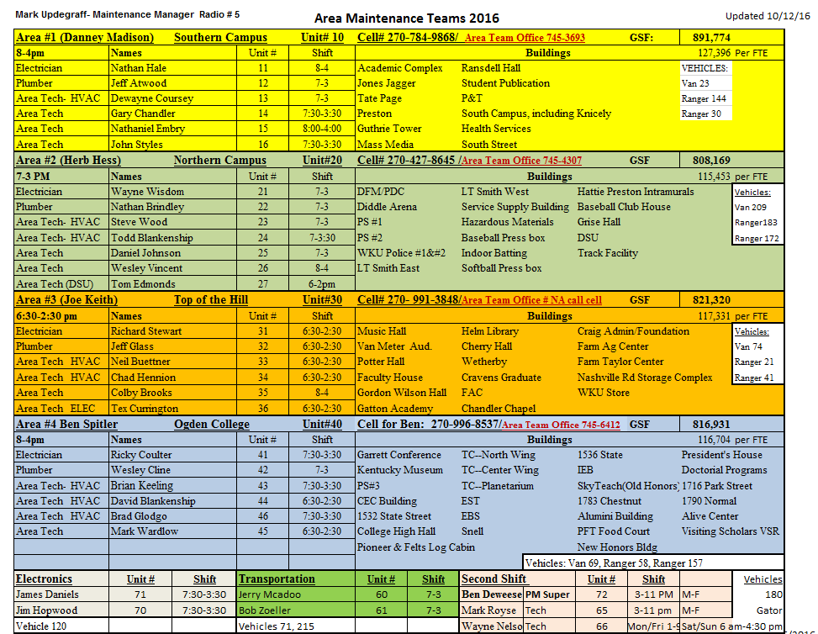

Slide 6
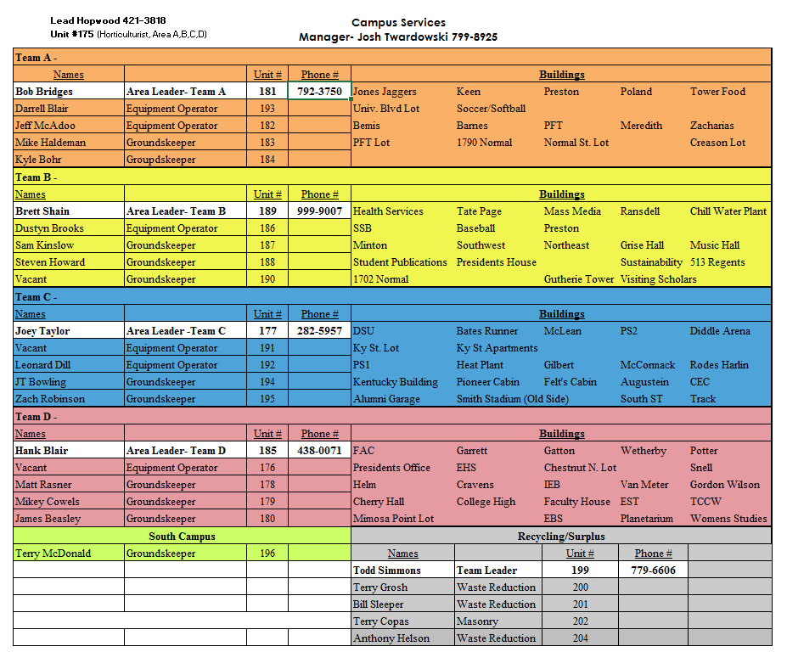

Slide 7
Standard Operating Procedures for Snow Removal
All Campus Services personnel are to report to the Grounds Shop. The following assignments/routes will be given out for the following:
MAIN CAMPUS
  Josh Twardowski Campus wide Supervision
  Leah Hopwood Radio Dispatch/assignments
  Terry Copas Bobcat with Snow Pusher
  Dustyn Brooks Case Backhoe
  Bob Bridges #56 F250 salt truck with blade
  Jeff McAdoo #199 3500 salt truck with blade
  Brett Shain #176 F550 with blade and spreader
  Jeremey Bowling G1 with blade and salt hopper
  Joe Taylor G2 with blade and salt hopper
  Henry Blair G3 with blade and salt hopper
  Todd Simmons G4 with blade and salt hopper
  Zach Robinson G5 with blade
  Anthony Helson Grasshopper with broom
  Sam Kinslow Grasshopper with broom
  SOUTH CAMPUS
  Terry McDonald - John Deere Plow/back up equipment and shovel
WKU Facilities Management Snow Plan
6

Slide 8
Priority Areas to Be Cleared
Parking structure 1, 2 and 3
Police Department
Sidewalks marked in BLUE on the priority map
Downing Student Union
Bates Runner Subway
Tower Food Court
Medical Center GGC
All parking lots and bus stops marked in RED on the priority map
Services drives and all dumpster locations
All access to resident halls
Garrett Food court
All parking lots and bus stops marked in ORANGE on the priority map
All parking lots and bus stops marked in YELLOW on the priority map
All parking lots marked in GREEN on the priority map

Slide 9
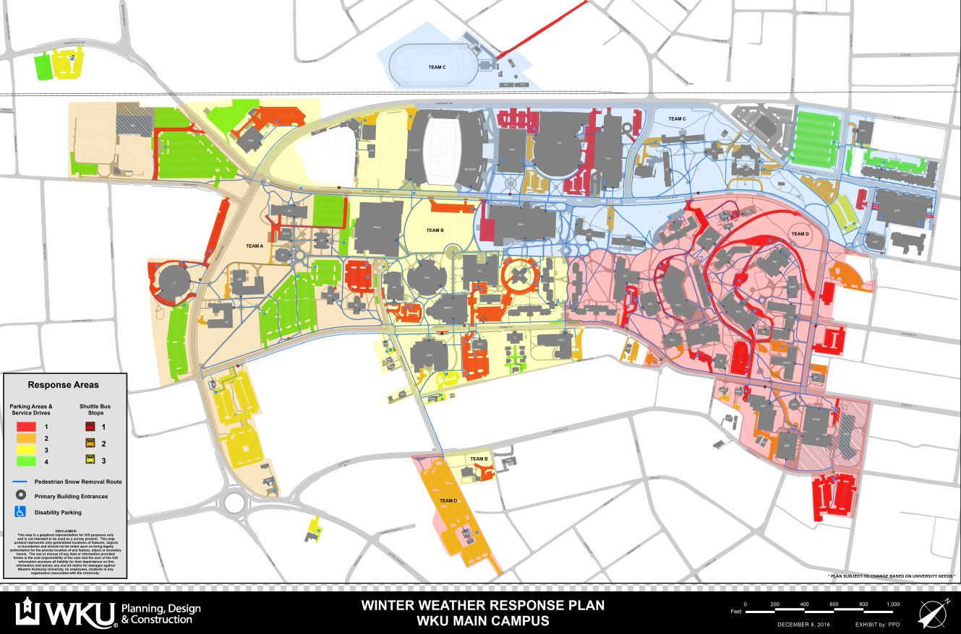
Snow Priority Route Map

Slide 10
In Summary:
The university salt storage facility is located at South Street with a capacity of approximately 100 tons of salt. The Campus Services Manager and/or the grounds supervisor are responsible to monitor deicing chemicals and order materials as required.
The Manager of Campus Services and the Grounds Supervisor will review deicing chemical usage after snow removal to assist with inventory of supplies and to monitor the efficient and consistent use and application of deicing chemicals.
At the end of each snow event, the Facilities Management Director and the Manager of Campus Services will review procedures taken and provide a summary of events and cost analysis to include both labor and materials.
Consistent with our goals, to continually improve our work processes, we will routinely review the results of this plan and make revisions to improve the effectiveness of our snow and ice control efforts.
WKU Facilities Management Snow Plan
12

