Slide 1
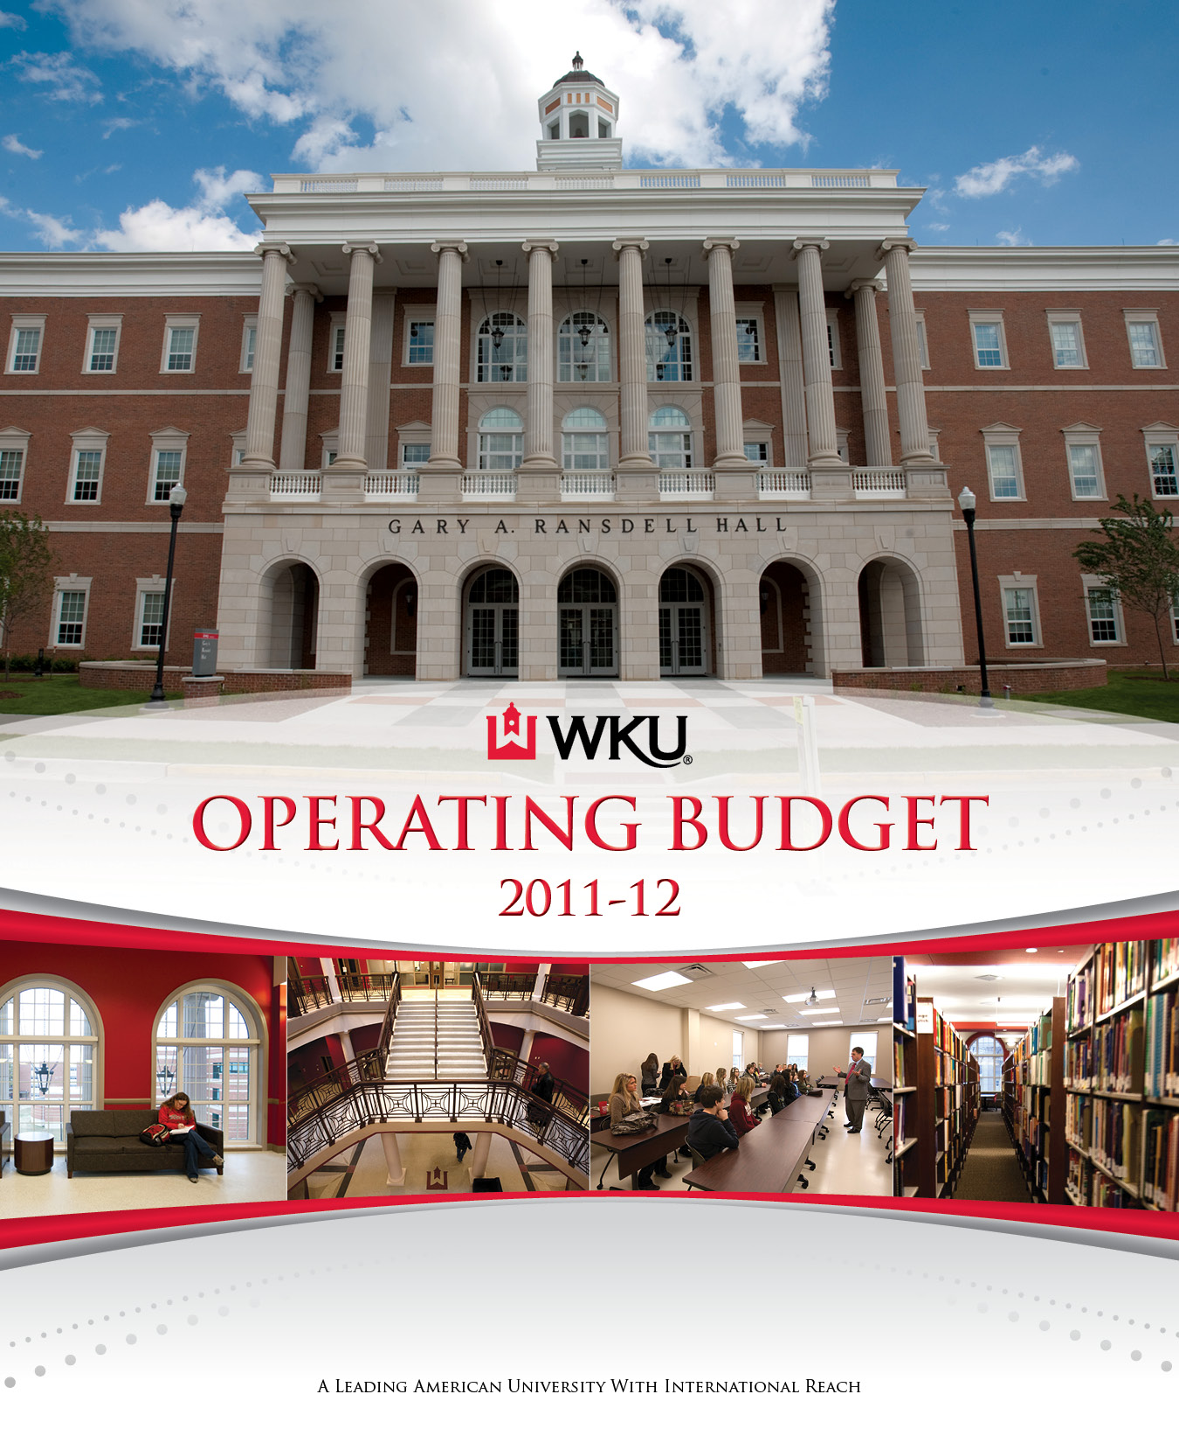

Slide 2
FY2011-12 Budget Documents
Executive Summary
Recurring Reduction Implementation Plan
Narratives
Revenue Summary
Expenditure Summary by Organizational Area
Capital Budget

Slide 3
FY2011-12 Operating Budget
 | 2011-12 Budget | Dollar Increase | Pct Increase
Total Budget | $385,047,000 | $3,324,000 | 0.9%
Total E&G | 359,993,000 | 1,308,000 | 0.4%
Unrestricted E&G | 288,092,000 | 17,193,900 | 6.3%
Restricted E&G | 71,901,000 | (15,885,900) | (18.1%)
Total Auxiliary Enterprises | 25,054,000 | 2,016,000 | 8.8%

Slide 4
FY2011-12 Revenue by Source (in Millions)

Slide 5
Changes in State Appropriation FY 2010-11 Approved vs. FY 2011-12
FY 2011 State Appropriation | $74,297,800
Add: Federal State Fiscal Stabilization Funds | 4,410,900
FY 2011 Total | 78,708,700
Increase in State Appropriation | 3,629,300
Reduction in Debt Service, Existing Bonds | (549,800)
Reduction in Federal State Fiscal Stabilization Funds | (4,410,900)
FY 2012 State Appropriation | 77,377,300
Percent Change in Operating Funds | (1.0%)

Slide 6
Revenue Sources for Unavoidable Cost and Commitment Allocations
Tuition Increase (fall, spring) | $6,585,000
Summer Tuition | 382,000
DELO | 550,000
DELO Permanent Distribution to Colleges | 1,358,000
Total | $8,875,000

Slide 7
Unavoidable Cost and Commitment Allocations
Total
$8,875,000
Personnel
$5,803,000
Operating
$3,072,000

Slide 8
Fixed Cost Increases
Library Books and Subscriptions Inflationary Adjustment | $128,000
Contractual Obligations | 202,000
Faculty Promotions | 251,000
Retirement Systems Rate Increases | 562,000
Life Insurance (increase benefit from $15,000 to $30,000) | 45,000
Faculty/Staff Health Insurance (fully fund FY 2011 increase) | 641,000
Maintenance and Operations/Utilities Costs | 1,242,000
Financial Aid/Faculty & Staff Tuition Assistance Benefit | 1,955,000
Total | $5,026,000

Slide 9
Other Commitments
Graduate Assistantships Tuition Rate Increase Offset | $31,000
1% Salary Adjustment (including benefits) | 1,250,000
Restricted Tuition Programs (Technology, Health Svs, SGA/Programming) | 17,000
Parking & Transportation Revenue Allocated to P&T (Year 10 of 10) | 58,000
Honors College Staffing Plan | 149,000
Fellowship Support in Graduate Studies Office | 45,000
DELO Distribution (Online, Contracts, Dual Credit & Independent Learning) | 550,000
DELO Distribution (permanent funding for part-time faculty salaries) | 1,358,000
Summer School | 391,000
Total | $3,849,000

Slide 10
FY2011-12 Budgeted Expenditures Unrestricted E&G (in Millions)

Slide 11
Capital Budget
$74.6M in authorized projects
Projects may be funded at less than legislatively authorized amount depending on availability of funds

Slide 12
Capital Budget (in Millions)
Under Construction: |  |  | Planned:
Bowling Green Data Center | $1.1 |  | Property/Campus Expansion | $3.0
Greenhouse/Headhouse | $1.7 |  | Capital Renewal Pool | $10.0
Underground Electrical | $3.2 |  | Fit-out of Leased Space (Block12) | $4.2
Music Hall Ivan Wilson Center | $9.1 |  | DUC Renovation | $37.5
Parking Structure I | $1.8 |  | Alumni Center (Block 12) | $2.0
Install Bike Paths | $1.0 |  | Total Capital Budget | $74.6

Slide 13
“I have learned that success is to be measured
not so much by the position that one has reached in life
as by the obstacles which he has overcome
while trying to succeed.”
-- Booker T. Washington
African-American Leader and Educator (1856-1915)

