Slide 1
Finding Potential in Our Students
Mary Evans and Tracy Inman
The Center for Gifted Studies Western Kentucky University
mary.evans@wku.edu
tracy.inman@wku.edu

Slide 2
Kentucky Accountability System – Equitable Access
The percentage of students belonging to the federally-required student groups* assigned to Gifted and Talented (grades 4 and 5) is equal to or greater than the total percentage of the same demographic group enrolled at the school.
*African American, Hispanic, Asian, Hawaiian/Pacific Islander, Native American, two or more races, EL, 2e, Free/Reduced meal eligible

Slide 3
School ABC
English Learners 15%
Free and/or Reduced Lunch 66%
Special Education 10%
African American 12%

Slide 4
Two Major Goals
Find children with advanced academic potential from poverty as well as from diverse cultural, ethnic, and linguistic backgrounds at an early age.
Provide an educational setting to nurture their potential and prepare them for challenging coursework in upper grades.
Notes:
Short term goal/long term goal
Early identification coupled with early intervention

Slide 5
Identification
The Referral Problem
Notes:
Children of poverty, minority children, English learners, twice-exceptional students

Slide 6
The Problems
Under-referral of ELL students, students of color, students from poverty
Lack of awareness that students can be twice exceptional
Lack of parental awareness of gifted programming options or lack of language skills necessary to refer their children
Standardized verbal IQ test bias
Notes:
We have learned that teachers tend to nominate high achieving, well behaved children unless they have had training.
A lack of basic skills may mask potential. Our teacher bias may blind us to see gifts and talents in certain populations.
Parents of low income children or minority children tend to underscore on inventories/rating scales.
IQ Tests were created to measure intelligence of middle class, white children, limits students with weaker English language skills.

Slide 7
A Better Method
Screen all children.
Use a nonverbal test.

Slide 8
Naglieri Nonverbal Ability Test
30 minutes on-line
Given to all first graders
Notes:
Nonverbal screening test for All students

Slide 9
A Better Method
Screen all children.
Use a nonverbal test.
Utilize a multi-dimensional approach.

Slide 10
Multi-dimensional
Achievement Test – MAP/STAR – Reading and Math – F,W,S
Classroom observations
Work Samples
Conversations
Progress Reports
Anecdotal notes
Response Lessons
Gifted Behaviors Rating Scale
Portfolios
Notes:
Intelligence is complex. It is not how much you know. It is how you behave when you don’t know the answer.
Students may not have the verbal and math skills to do well on traditional tests. When you start to listen to them talk and give them problems to solve, you start to see what amazing thinkers they are.

Slide 11
A Better Method
Screen all children.
Use a nonverbal test.
Utilize a multi-dimensional approach.
Use local norms.

Slide 12
Local Norms
“Students are compared with other students from their local educational setting, ideally using assessments that are universally administered to an entire grade level.”
Plucker & Peters, 2016
Notes:
Tracy

Slide 13
•More than two-thirds of elementary and middle schools have gifted programs.
•Overall, high-poverty schools are just as likely as low-poverty schools to have them.
•Yet students in low-poverty schools are more than twice as likely to participate in such programs.
•Even when black and Hispanic students have gifted programs in their elementary and middle schools, they participate at much lower rates than their peers.
Notes:
Tracy

Slide 14
Notes:
Tracy

Slide 15
An Athletic Example
-Kentucky high schools use national norms to select players (top 10% nationally in basketball ability)
-Some schools have more qualified players than spots
-Majority of schools do not have enough to field a team
Notes:
Tracy

Slide 16
A Better Method
Screen all children.
Use a nonverbal test.
Utilize a multi-dimensional approach.
Use local norms.
Curriculum becomes the identifier of talent.

Slide 17
Curriculum as the Identifier of Talent
Response Lessons
Teach a lesson.
Classroom teacher observes and takes notes.
Designed to draw out gifted behaviors
Gifted Behaviors Rating Scale
Developed by Fairfax Co. Schools
Culturally Responsive Indicators
Comparing children to other children like them – are they exceptional for their background?
Notes:
Not something more to do – just a different way to engage in the curriculum you already teach.
Designed to draw out gifted behaviors – higher level thinking
Not comparing children to each other – Are they exceptional for their background?

Slide 18
Gifted Behaviors Rating Scale
Exceptional Ability to Learn
Exceptional Application of Knowledge
Exceptional Creative/Productive Thinking
Exceptional Motivation to Succeed
Notes:
4 categories – 8 indicators – rarely to consistently

Slide 20
Exceptional Ability to Learn
Example: An EL 4th grade student was able to read Green Eggs and Ham after only two weeks learning English
A child who learns how to play a new game very quickly, particularly one that requires strategy
Makes connections without formal instruction
Notes:
1st grader who wrote a topic sentence and a summarizing ending sentence before taught that.

Slide 21
Exceptional Application of Knowledge
Boy making a submarine out of junk materials - explaining balance – he read that if an eagle loses a feather on one wing, will also lose one on the other side

Slide 22
Example of Application of Knowledge

Slide 23
Exceptional Creative or Productive Thinking
Invents a way to do something different – special kind of way to pick up blocks
Makes a detailed map of a fictional island
Good at brainstorming – very fluent and flexible in thinking

Slide 24
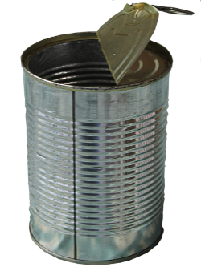
James’ Uses For An Empty Can
Hold pencils
Hold flowers
Hold rocks
Hold water
Hold food
Plant a flower in it
Put nails in

Slide 25
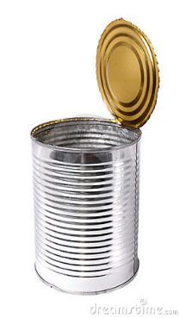
Tahj’s Uses For An Empty Can
A drum
Walk on to make taller
Look through it
Listen through it
Roll things flat
Wrap things around it
Draw around it to make round
Stamp out things
Kill bugs
A home for bugs
Prop up things

Slide 26
Tahj’s Ideas continued
Curlers
Wheels
Roll things on
Spit in
Mix paint in
Drink out of
Cut biscuits

Slide 27
Exceptional Motivation to Succeed
Shows leadership
Sees a project to completion
Makes up and organizes games, plays

Slide 28
GBRS Tips
Looking for frequency and consistency
Displaying all descriptors once would score a 1.
Displaying a few descriptors frequently/consistently would score a 4.
Are they exceptional for their background?
Err on the side of strengths.

Slide 29
Gifted Behaviors Rating Scale
12 or higher – yes for Talent Pool
10 or 11 – watch, monitor
Pay close attention to Ability to Learn
Probably refer 2-4 in your class.

Slide 35
Response Lessons
Provide an opportunity for higher level thinking
Designed to draw out gifted behaviors
Open ended – not looking for “one” answer
Children work independently (don’t help them).
Doesn’t matter if they follow directions
Do same lesson for a grade level – which ones stand out?

Slide 37
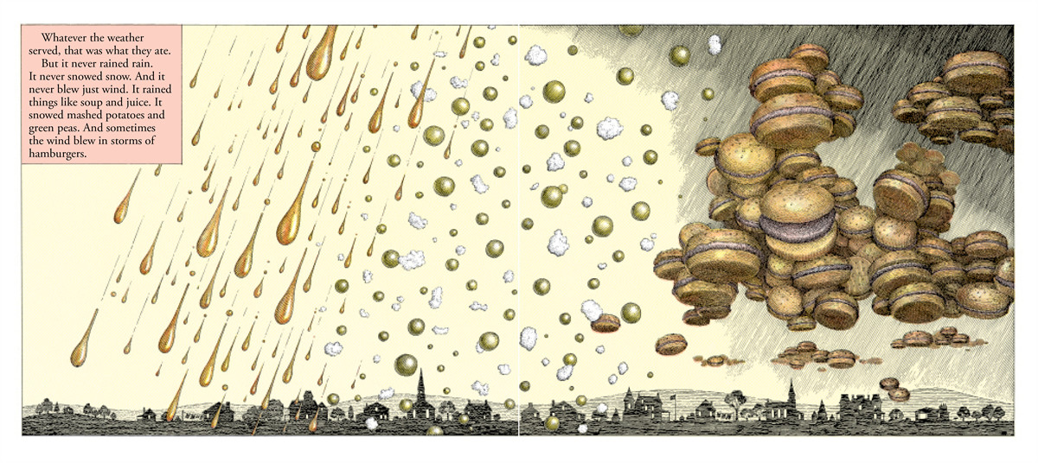
Add slides
Cloudy book sample pages

Slide 39
Activity

Slide 40
Instructions
Form groups of five; each group needs a packet
Familiarize yourself with the lesson plan
Review Gifted Behaviors Rating Scale
Examine the samples
Use the Observation sheet to make notes
Categorize the samples into groups:
Probably
Probably not

Slide 41
FOOD

Slide 42
FOOD

Slide 43
FOOD

Slide 44
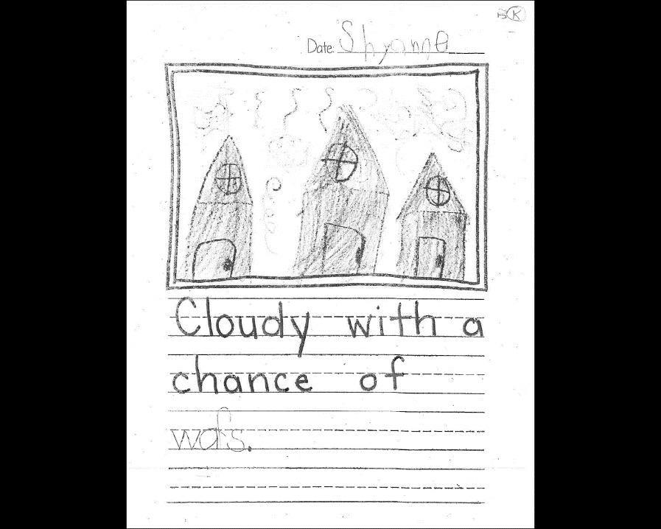
FOOD

Slide 45
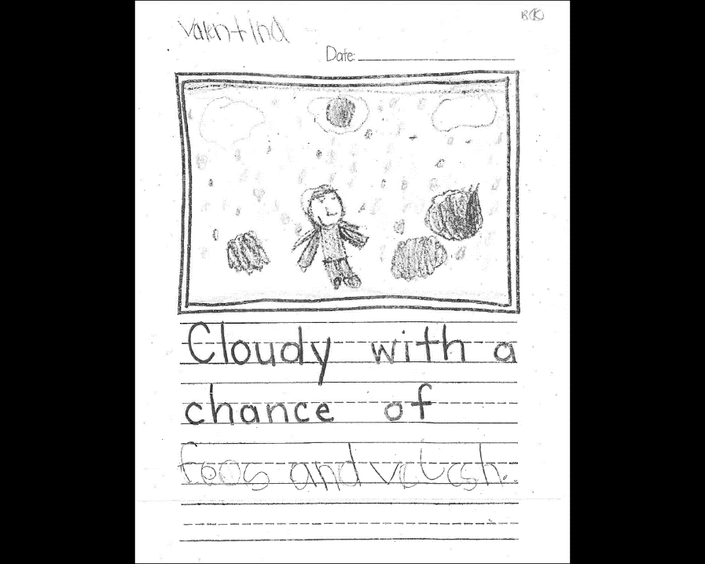
FOOD

Slide 46
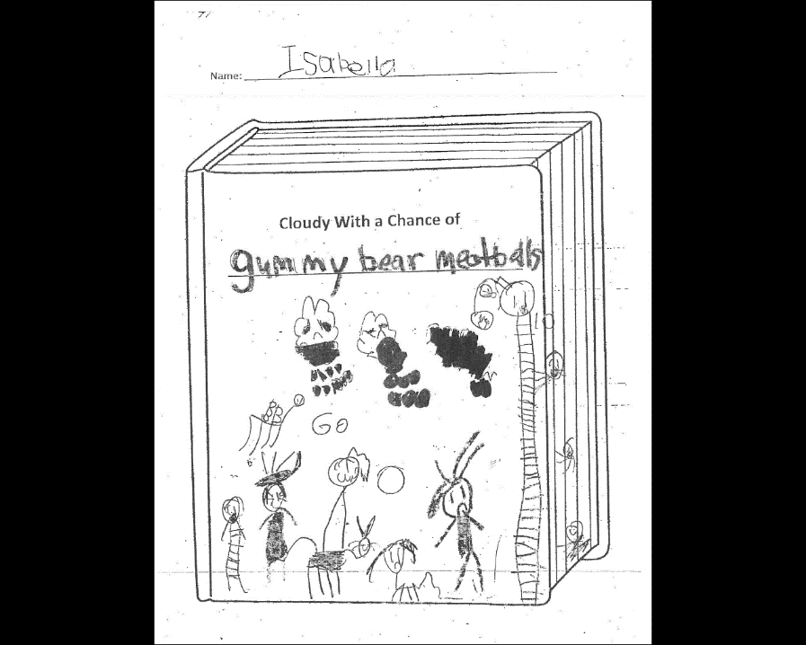
But the drawings
are intricate
FOOD

Slide 47
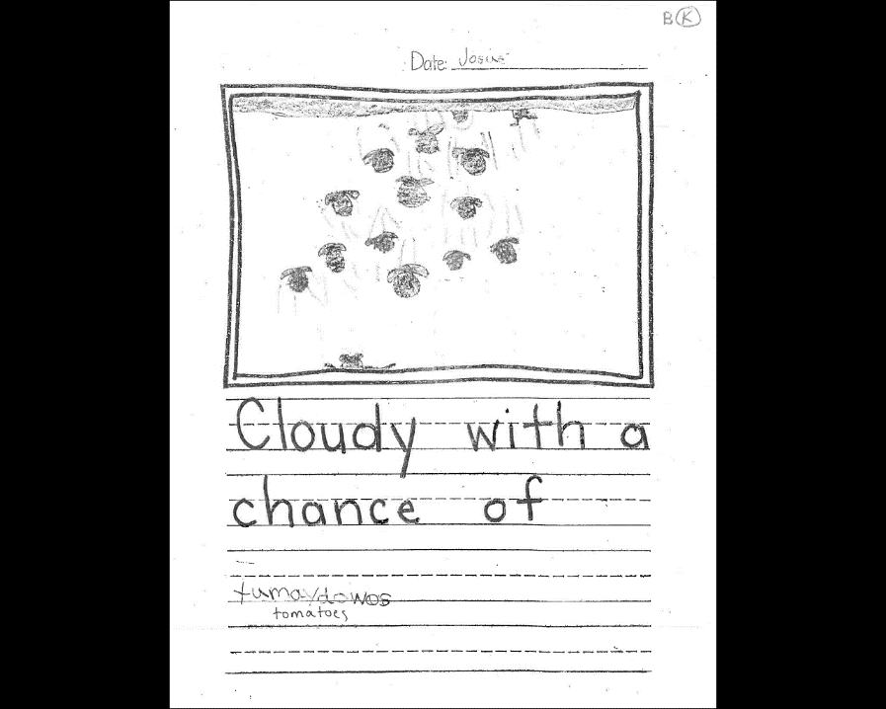
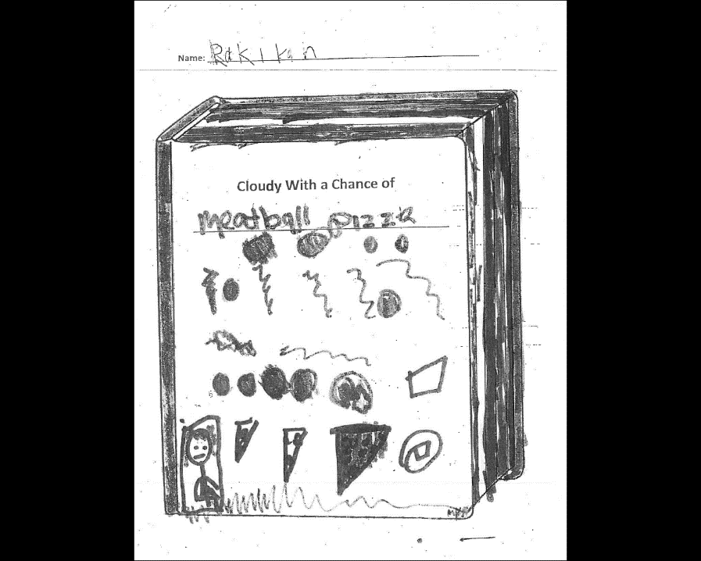
But the tomatoes
have leaves, one
is squashed, and there
is movement.
FOOD

Slide 48
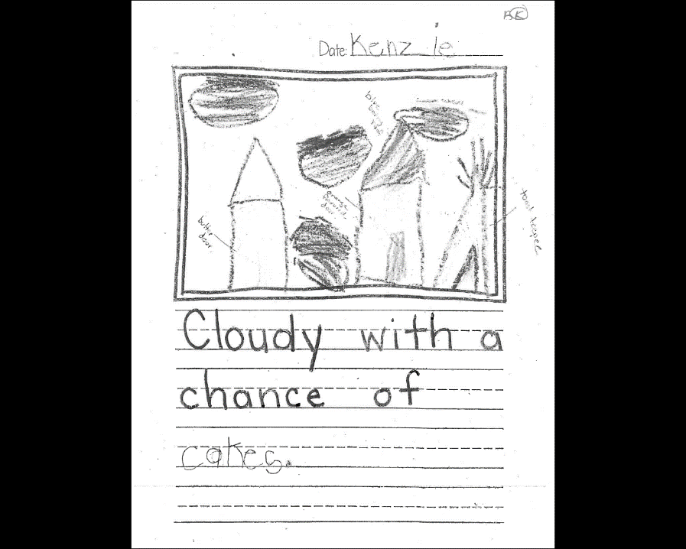
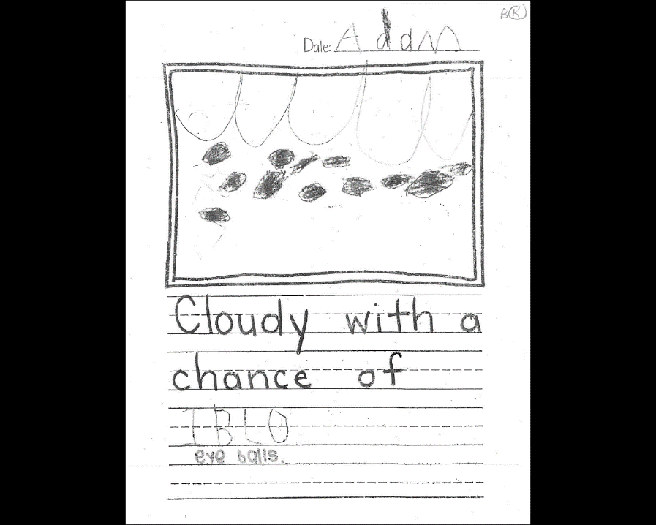
ORIGINAL TOPIC
But little detail or
development

Slide 49
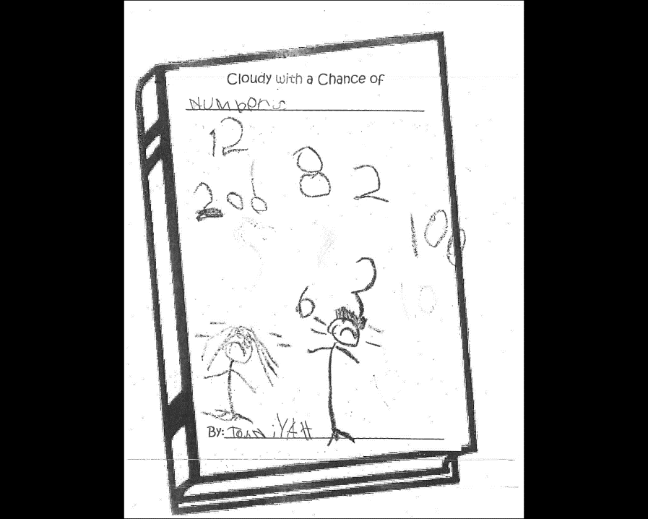
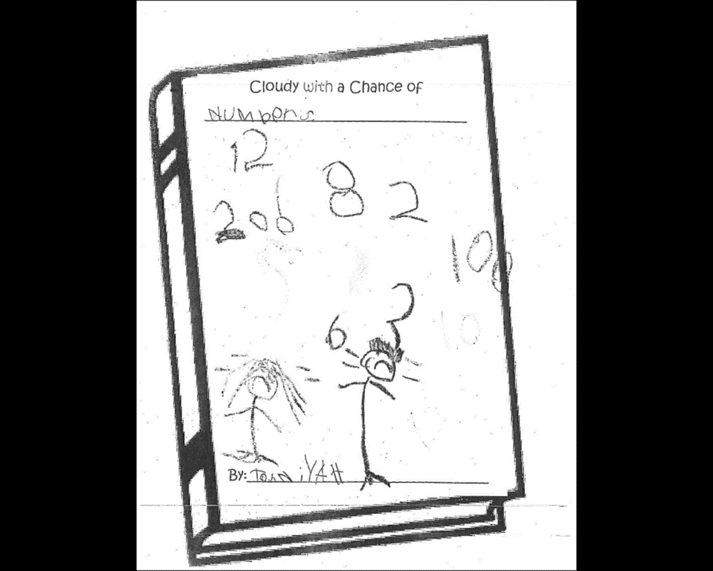
And the people have
expressions – the numbers
hurt when they hit them!

Slide 50
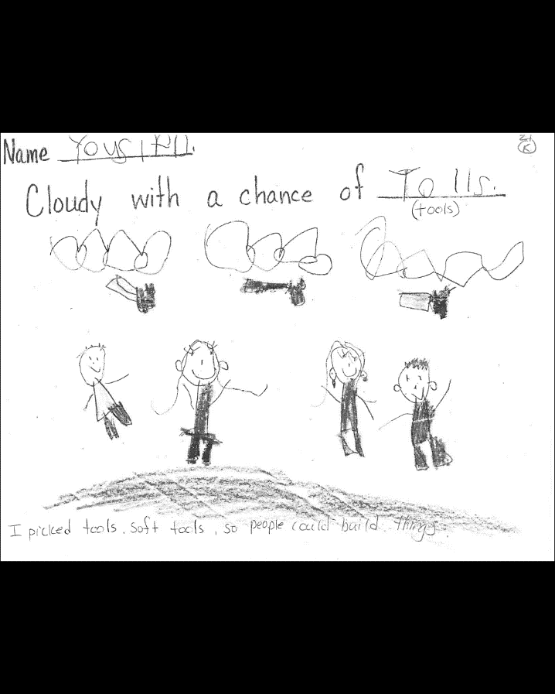
Detailed, different
clothing and tools
Important reasoning

Slide 51
Detailed

Slide 52
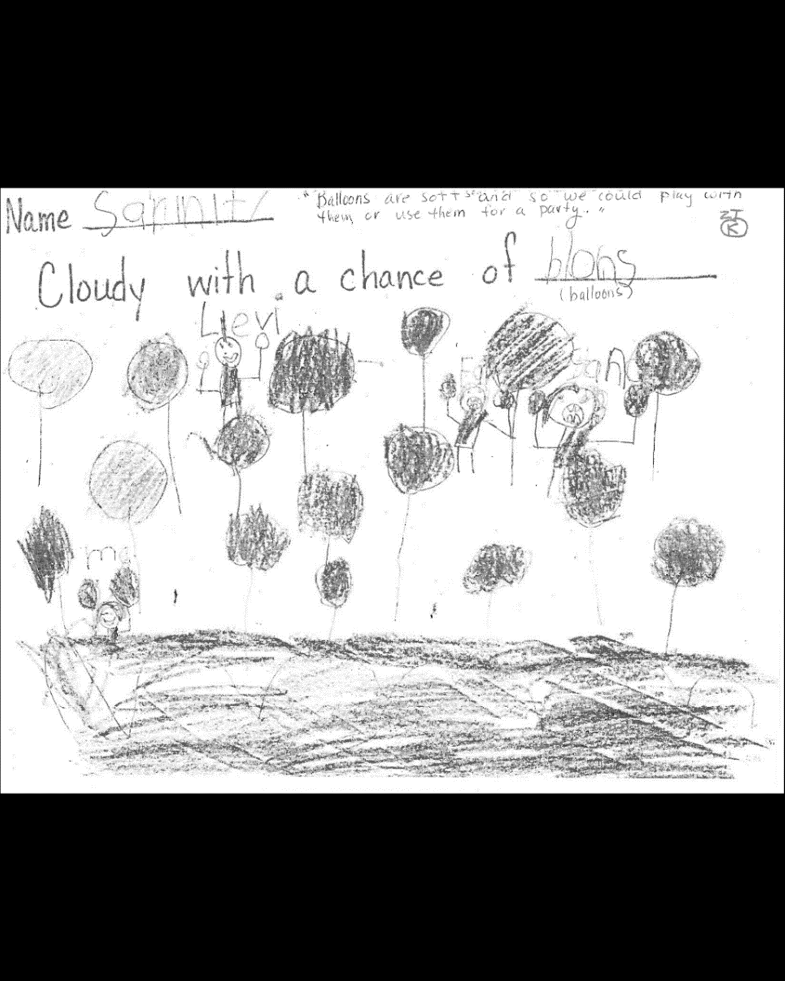
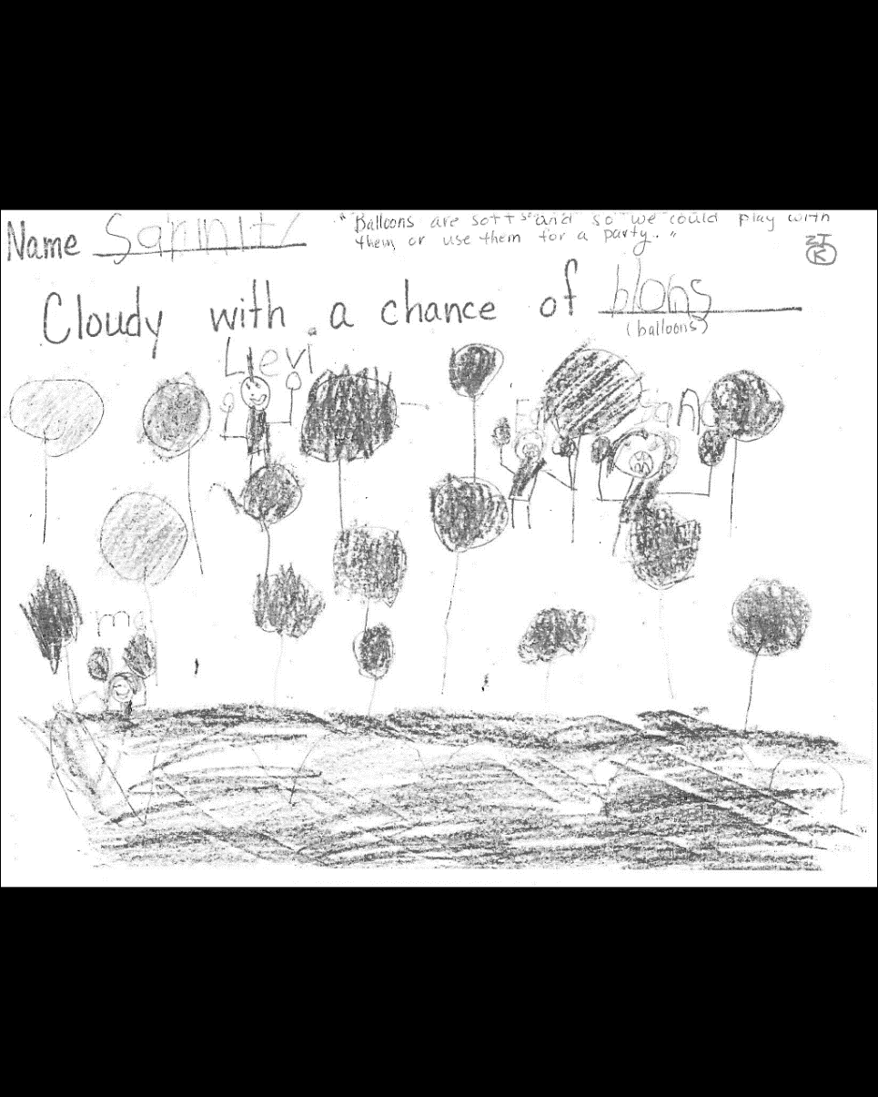
Varied expressions

Slide 53
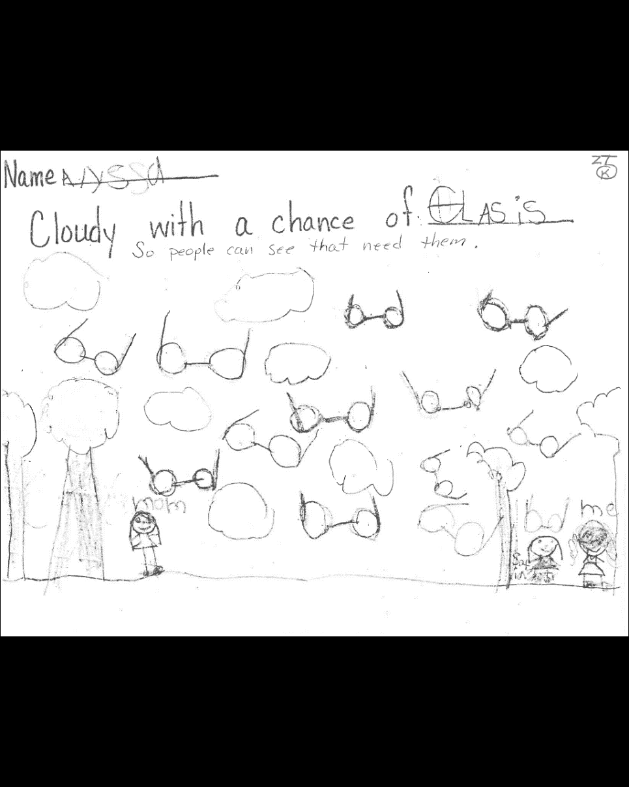
Detailed, labeled,

Slide 55
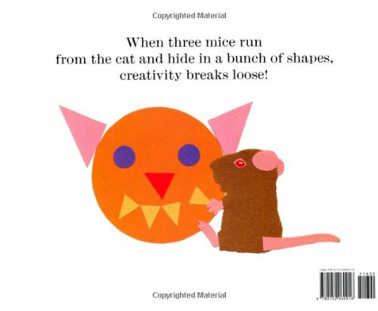
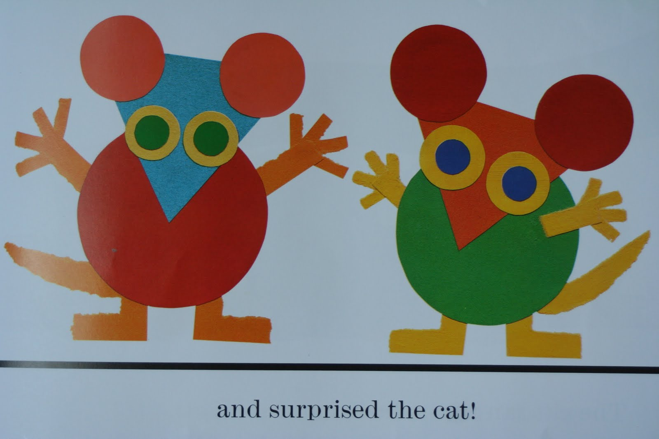

Slide 59
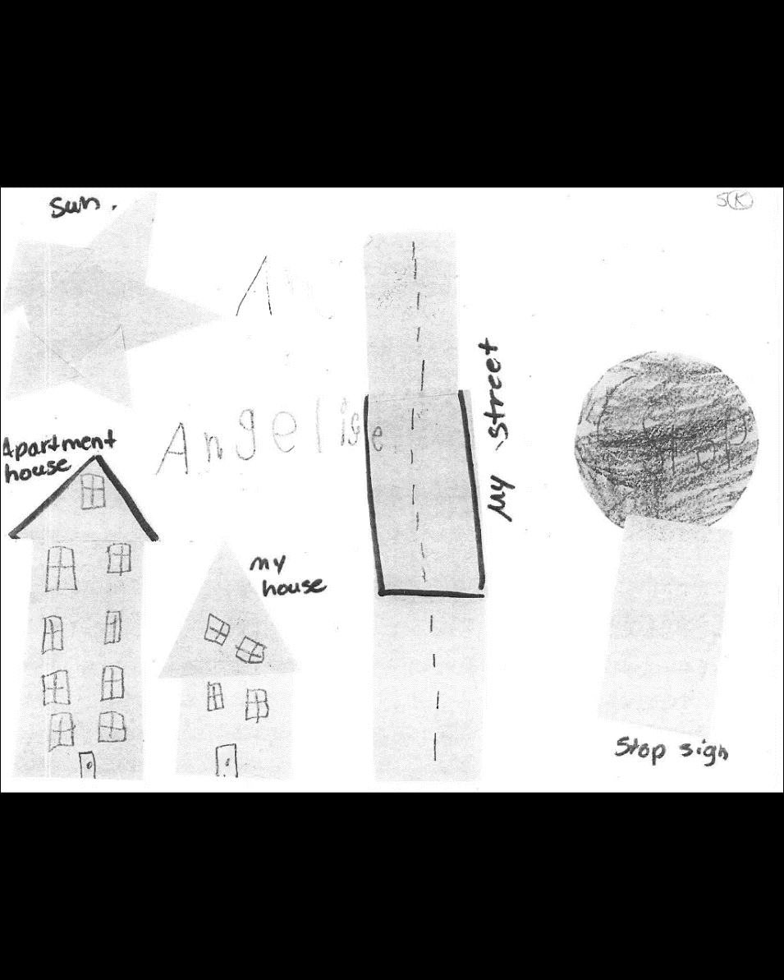

Slide 64
To Access Online Resources:
https://www.wku.edu/gifted/rap/responselessons.php
http://www.spark.uconn.edu/
Resources – Comparison School Educators
Password: project
Response Lessons

Slide 65
Project RAP – Reaching Academic Potential
Implementation at five Jefferson County Public Schools
Range from 72%-89% Free/Reduced Lunch
37%-84% African American
Three have high ESL population.
Three have high special education numbers.

Slide 66
Pre-Project RAP PTP Numbers
Less than ten!

Slide 67
Current Results
School | Primary Talent Pool Numbers
Gilmore Lane | 26
King | 41
Shacklette | 27
Watson Lane | 32
Zachary Taylor | 45

Slide 68
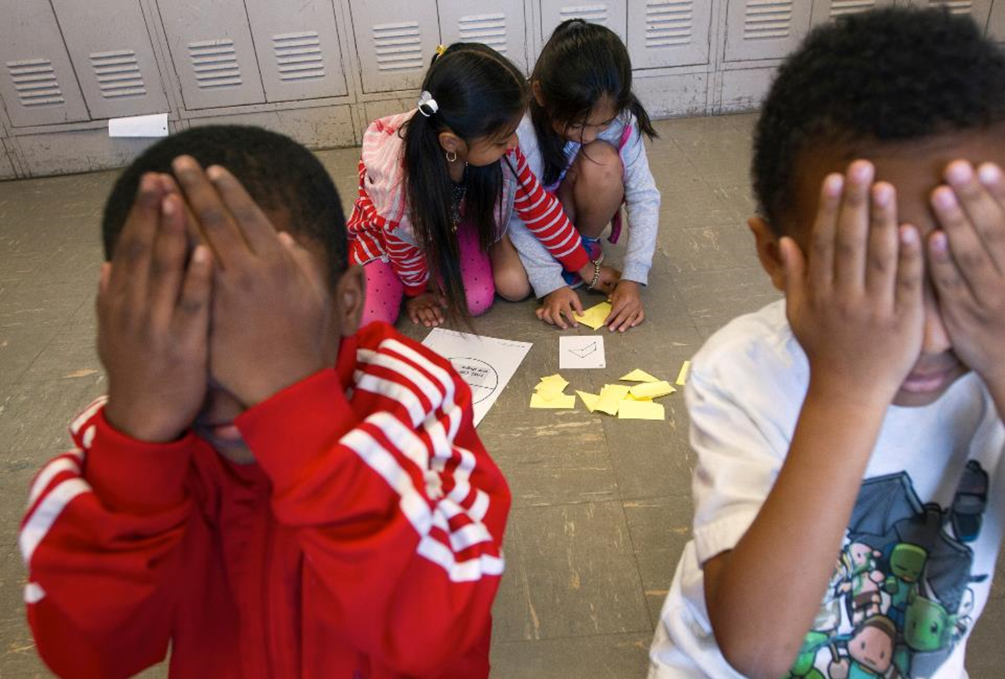
“We need to cast a wide net to include, not exclude in order to develop potential.”
Project RAP teacher

Slide 69
Hoped for Results
More underrepresented students served as part of gifted education services
Growing cultural competency among staff
Students identified for gifted services begin to mirror district demographics
Equal dedication/commitment to both talent development in high potential learners and talent development in high performing learners

