Slide 1
Debunking the Myths about Gifted Children: They Really Are Exceptional Children
Tracy Inman and Julia Roberts
The Center for Gifted Studies at Western Kentucky University
tracy.inman@wku.edu julia.roberts@wku.edu

Slide 2
If during the first five or six years of school, a child earns good grades and high praise without having to make much effort, what are all the things he doesn’t learn that most children learn by third grade?
Notes:
See the article “What a Child Doesn’t Learn” by Tracy Inman (in Toolkit) for discussion of the question.

Slide 3
P O P Q U I Z

Slide 4
1. Gifted children thrive with more work.
False
Notes:
Gifted children do not need more work; they need different work. No one wants to do all the odd numbers of an assignment quickly just to be burdened with the even ones on top of it. No one wants to write a paper in addition to the project when everyone else just does the project. Soon no one will want to be gifted!

Slide 5
ACT data show that fewer than two in ten eighth graders are on target to be ready for college-level work by the time they graduate from high school.
The Forgotten Middle, 2009

Slide 6
How a person views the origin of talent is important!
If you see talent as something you demonstrate…
Fixed Mindset
If you see talent as something to be developed…
Growth Mindset
Carol Dweck, Mindset: The New Psychology of Success

Slide 7
“Success is about being your best self, not about being better than others; failure is an opportunity, not a condemnation; effort is the key to success.”
(Dweck, 2007, p. 44).

Slide 8
2. Allowing a gifted child to tutor another child is usually a very effective service option. You really learn something when you teach it.
False
Notes:
All too often well-meaning educators pair the gifted child with the struggling child. Educators get master’s degrees in order to learn best practice and hone teaching skills, yet somehow they think something magical will occur when pairing the child who gets it with the child who doesn’t. Research on motivating students tells us not to “pair struggling students with students of higher ability or greater knowledge and skills, as this may result in students becoming dependent (rather than independent) learners. Unless high ability students are trained to work as positive tutors, motivation to learn can suffer (e.g., Harter, 2006; King, Staffieri, & Adelgais, 1998; O’Donnell, 1999)” (McCombs, 2010, p. 2). The goal of learning is continuous for all learners, so we certainly don’t want to do anything to discourage independent learning and motivation.

Slide 9
3. Just because a child is gifted in one area does not mean he is gifted in all areas.
True
Notes:
Students may be exceptional in one or more areas. Just because a child is three grade levels ahead in math does not mean he is three grade levels ahead in reading. He may be right at grade level or even reading below grade level.
Kentucky identifies children in five areas of giftedness: General Intellectual, Specific Academic, Leadership, Creativity, and Visual and Performing Arts. (704 KAR3:285 Programs for the gifted and talented)

Slide 10
4. Do not expect gifted students to be model students.
True
Notes:
Many gifted children have not been challenged in the classroom. For some of them, their characteristics have been misunderstood as behavioral issues. Therefore, they have learned coping skills: boredom, sleep, disruption, being off task (e.g., reading a novel in math class), daydreaming, etc. Many have become underachievers. See Rimm (2008) for specific strategies to reverse underachievement.
Students can also have multiple exceptionalities: a child may be gifted in Language Arts but have bioploar disorder; she may be a gifted singer who is also blind; he may have an IQ of 150 accompanied by a reading disability – the list continues. These children struggle so in school. Often they are never identified as gifted because their other exceptionality masks their giftedness. Sometimes they are never identified through special education because they have developed effective coping skills to deal with the exceptionality. “Perhaps the most at-risk subpopulation of gifted students is the twice-exceptional. These students face difficult problems and challenges throughout their schooling that make it difficult for them to be successful academically, much less to fully develop their talents” (Moon, 2009, p. 275).

Slide 11
5. Gifted students are not at risk. If they really have high ability, they can get by on their own.
False
Notes:
All children need guidance in their learning. Yes, gifted children seem to absorb information. Yes, they make connections others don’t. Yes, they can readily comprehend materials. But in order to thrive and develop their talents, they need explanation, discussion, questioning.
Intellectually gifted students learn at a faster pace than their classmates, sometimes, for example, needing two repetitions of a math concept instead of 30. Not only do they process concepts more quickly, but they also make complex connections. In fact, their brains physiologically differ from others – from the speed of internal connectivity in the brain to even what parts of the brain are used (Jensen, 2006).
Perhaps this analogy clarifies. How do you keep your heart healthy? In addition to eating right, you must exercise aerobically – you need to give your cardiovascular system a workout complete with increased heart rate and intense breathing. You need to break a sweat. How do you keep your brain healthy? You need to break an “academic sweat” (Roberts & Inman, 2009, p. 10). To exercise the brain, it needs novelty, challenge, and complexity; it must think. When we leave gifted kids on their own to read, to do worksheets, etc., we do not encourage that deep thinking so necessary for growth. Educators must be the academic coaches who assess the strengths and skills of their academic athletes, then design rigorous workouts so they have continuous growth.

Slide 12
6. Giftedness can easily be measured by intelligence tests and tests of achievement.
False
Notes:
Tests and other measures can be wonderful tools that provide information about your child’s ability or achievement levels, but they are simply tools. No one number defines a child. In fact, a child can take the same test several times, scoring differently each time. Was she sleepy? Did he have breakfast? Was the room too cold or hot? Did the child next to her click his pencil on the desk? So many factors – aside from ability or achievement level – affect a test’s outcomes. Measurement error should be taken into account. A student, then, who scores a 120 on the Wechsler Intelligence Scale for Children - Fifth Edition (2014), a commonly used IQ assessment, may very well be gifted even though she doesn’t hit the magical 130. That 120 score should only be one indicator. “It is clear that no single score allows us to make the most accurate predictions about outstanding performance, even in the academic domains….Outstanding accomplishments by children and adults are multivariate in nature and require multivariate explanations” (Worrell, 2009, p. 244). Best practice dictates multiple measures being used for identification in any of the five areas.

Slide 13
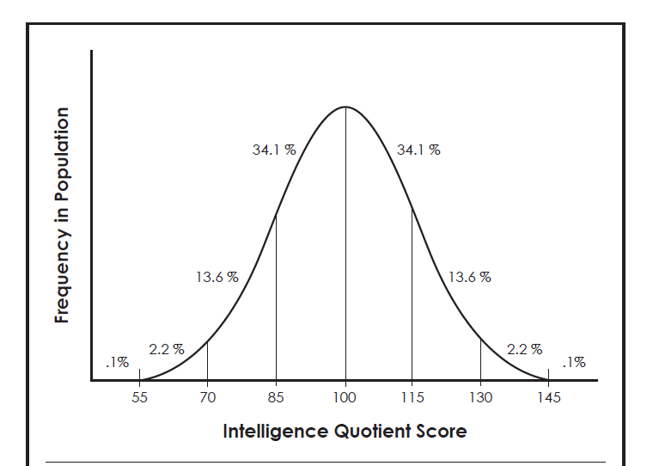
Notes:
This shows a normal curve for IQ. Taking 100 as the normal or average, if you look at one standard deviation each way (in this case, that is 15 IQ points), people with 85 to 115 IQ have average IQs – roughly 68% of the population. Moving left, two standard deviations take us to 70; approximately 13.5% of the population have IQs that fall between 70 and 85. Only a little more than 2% score between 70 and 55. Students who have IQs below 70 qualify for special education with substantial federal funds. People with IQs of three standard deviations (i.e., 55) and beyond (i.e., .1% of the population) are rarely in a regular classroom and have significant assistance, sometimes a one-on-one aide. Now move to the right side of the 100. The numbers parallel: 13.5% score between 115 and 130 while 2% score between 130 and 145 which is two standard deviations from the norm; 130 IQ is typically considered the cut-off point for giftedness. Note that less than .1% scores above 145. In total, less than 3% of the population falls into this category which, on the graph, is two or more standard deviations. However, unlike the mirrored image counterparts (the 2-plus% scoring 70 or below), there is no federal funding for direct services to these children. (Services are educational options designed to address the needs, interests, and abilities of the student; these include everything from differentiation in the regular classroom, acceleration, dual credit, independent study, and more.) The vast majority of the children are sitting in a regular classroom without significant modifications and services.

Slide 14
7. A good teacher can teach any student, because if good teaching is used, that is all that is needed.
False
Notes:
Too few educators are trained to address the needs of this unique population. Although good teaching practices are a strong foundation, this population differs from the norm in multiple ways. The Pre-K-Grade 12 Gifted Education Programming Standards (NAGC, 2010) serves as a framework in teaching gifted students. It outlines six main standards: learning and development, assessment, curriculum and instruction, learning environments, programming, and professional development. Divided into specific student-based outcomes, these standards also describe evidence-based practice recommended for educators to reach these outcomes. For instance, under Curriculum and Instruction’s section on Curriculum Planning, Student Outcome 3.1 reads “Students with gifts and talents demonstrate growth commensurate with aptitude during the school year” (p. 4). The evidence-based practices for educators include such tasks as “Educators design differentiated curricula that incorporate advanced, conceptually challenging, in-depth, distinctive, and complex content for students with gifts and talents” (p. 4) and “Educators use pre-assessments and pace instruction based on the learning rates of students with gifts and talents and accelerate and compact learning as appropriate” (p. 4). Read the Standards on NAGC’s website. Although not a lengthy document, these standards prove foundational to best practice for your child’s teachers. Imagine what could happen in a school that focuses on student growth based on aptitude alone – much less the other student outcomes!

Slide 15
8. Even if the curriculum is accelerated for all students, services are still needed for gifted learners.
True
Notes:
These students are abstract thinkers and problem-solvers who thrive on complexity and challenge and who need little repetition of concepts. They learn at a much faster pace than their age peers. Since these exceptional students learn differently from their age peers, schools must provide a variety of services to address their needs. Remember that the goal is continuous progress.
Kentucky mandates multiple services for each identified gifted child. The Gifted Student Service Plan is an individual education plan outlining services, people responsible, and time frames so that the child has continuous progress in his learning.
Services for students with gifts and talents typically fall into two main categories: acceleration and enrichment. In short, acceleration involves a student moving more quickly through content which may equate to finishing school before students of the same age. Enrichment involves the student going into greater depth or breadth. At times, these may overlap, so do not get overly concerned with which service falls into which category. The goal is to understand the variety of services that schools should offer to help your child make continuous progress.

Slide 16
Service Options
Acceleration
Advanced Placement and Honors Courses
Collaborative Teaching and Consultation Services
Competitions
Concurrent College Enrollment/Dual Credit
Differentiated Study Experiences for Individuals and Cluster Groups in the Regular Classroom
Distance Learning/Internet Courses
Enrichment Service During the School Day
Independent Study
International Baccalaureate
Magnet Schools/ Self-contained Classrooms
Mentorships
Seminars
Special Counseling Services: Group and Individual
Summer Programs
Travel Study Options

Slide 17
9. All children are gifted.
False
Notes:
This is a tough one because those who refute it sound elitist. The simple truth is that all children are not gifted based on the federal definition:
“The term ‘gifted and talented', when used with respect to students, children, or youth, means students, children, or youth who give evidence of high achievement capability in areas such as intellectual, creative, artistic, or leadership capacity, or in specific academic fields, and who need services or activities not ordinarily provided by the school in order to fully develop those capabilities” (Every Student Succeeds Act. 2015; Title IX, Part A, Definition 22).
All children are indeed special. All children possess strengths and weaknesses. All children have potential. All children are certainly worthy – worthy of love and worthy of learning. All children deserve to be appropriately challenged in school, to learn something new every day. However, children with gifts and talents learn very differently from the norm; they “need services or activities not ordinarily provided by the school in order to fully develop those capabilities.”

Slide 18
Many states have their own definitions/categories of giftedness.
Kentucky Law (KRS 157.200 l n) includes five categories of gifted within exceptional students:
General Intellectual
Specific Academic
Leadership
Creativity
Visual and/or Performing Arts

Slide 19
10. Most children suffer emotionally and socially when grade accelerated.
False
Notes:
Acceleration, the process where students move at a faster pace through a specific content or grade level than age-based peers, may be one of the most misunderstood concepts in gifted education. “Historically, the great paradox of acceleration has been that the beliefs and practices of educators (and the general public) did not align with the research evidence” (Cross & Betts, 2015, p. vii). In 2004, the Templeton Foundation funded a meta-analysis (a synthesis of known research on a topic) on acceleration in their landmark study A Nation Deceived: How Schools Hold Back America’s Brightest Students (Colangelo, Assouline, & Gross, 2004). In short, the 50-plus years of research argued that there was no more effective service for gifted students – and most cost effective for schools – than acceleration when properly administered. And, instead of being socially and emotionally damaging, appropriate acceleration provided the venue for healthy social and emotional development. The follow-up work A Nation Empowered: Evidence Trumps the Excuses Holding Back America’s Brightest Students, Vol. 1 (Assouline, Colangelo, & VanTassel-Baska, 2015) not only added scholarly insight and research, but it also told the stories of those accelerated. Additionally, it listed 20 different types of acceleration from grade-skipping to early entrance to kindergarten to curriculum compacting. “All students deserve to learn something new each day, and if academically talented students desire to be accelerated and are ready for it, the long-term evidence clearly supports the intervention” (Wai, 2015, p. 73).

Slide 20
How do we know this?
A Nation Deceived: How Schools Hold Back America’s Brightest Students (2004)
www.accelerationinstitute.org/nation_deceived/
A Nation Empowered: Evidence Trumps the Excuses Holding Back America’s Brightest Students (2015)
www.accelerationinstitute.org/nation_empowered/Institute for Research and Policy Acceleration
The Connie Belin & Jacqueline N. Blank International Center for Gifted Education and Development, The University of Iowa
www.accelerationinstitute.org/

Slide 21
11. The brightest students tend to make the lowest achievement gains in school.
True
Notes:
As the United States devoted decades to getting children to proficiency under No Child Left Behind, so many high ability and gifted children languished. The Fordham Institute’s study High-Achieving Students in the Era of NCLB (Loveless, Farkas, & Duffett, 2008) found the achievement gap was indeed lessening in the almost ten years of the law – by the low achievers moving up to meet the almost stagnant top achievers. This same report indicated that teachers tend to spend the majority of their time with the lowest achieving students, in spite of the fact that they believe all children deserve attention. It also stated that teachers “believe that academically advanced students are not a high priority in their schools” (p. 51).
In a pioneering study of the effects of teachers and schools on student learning, William Sanders and his staff at the Tennessee Value-Added Assessment System put it this way: ‘Student achievement level was the second most important predictor of student learning. The higher the achievement level, the less growth a student was likely to have.’”
“Mr. Sanders found this problem in schools throughout the state, and with different levels of poverty and of minority enrollments. He speculated that the problem was due to a ‘lack of opportunity for high-scoring students to proceed at their own pace, lack of challenging materials, lack of accelerated course offerings, and concentration of instruction on the average or below-average student. While less effective teachers produced gains for lower-achieving students, Mr. Sanders found, only the top one-fifth of teachers were effective with high-achieving students. These problems have been confirmed in other states. There is overwhelming evidence that gifted students simply do not succeed on their own” (DeLacy, 2004).

Slide 22
High Achieving Students in the Era of NCLB Thomas B. Fordham Institute
“While the nation’s lowest-achieving youngsters made rapid gains from 2000 to 2007, the performance of top students was languid. Children at the tenth percentile of achievement (the bottom 10 percent of students) have shown solid progress in fourth-grade reading and math and eighth-grade math since 2000, but those at the 90th percentile (the top 10 percent) have made minimal gains.”

Slide 23
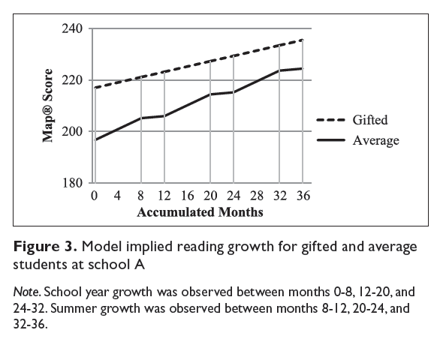
(McCoach, Rambo, & Welsh, 2012, p. 8)

Slide 24
Talent on the Sidelines: Excellence Gaps and America’s Persistent Talent Underclass
Fourth Graders
Low income 1.8%
Black 1.1%
Hispanic 1.9%
ELL .6%
Eighth Graders
Low income 2.5%
Black 1.5%
Hispanic 2.7%
ELL .5%
In Grades 4 and 8, a much smaller percentage of low-income, minority, and English-Language learner students score at the Advanced Level on NAEP in math.

Slide 25
12. Gifted students are needed in all classes so that students do not lack positive role models for academic and social leadership.
False
Notes:
An in-depth review of years of research completed on role modeling found that children tend to “pattern their behaviors after competent rather than incompetent peers” (Schunk, 1987, p. 167) – which could be one reason behind this myth. However, this research also indicated that children tend to model themselves after those who are similar in ability. In short, when great discrepancies are noted, no modeling occurs because children cannot make the connections between themselves and the model. This damaging myth provides some of the basis for the “sprinkle method” often used by principals when creating elementary classrooms: they sprinkle the gifted children one or two to a room in order to have strong academic and behavior role models for others. Not only is this faulty thinking regarding role models, but it is also flawed in regard to what the children are modeling – not all gifted children are achievers nor are they ideal, well-behaved students.

Slide 26
References
Assouline, S. G., Colangelo, N., & VanTassel-Baska, J. (2015). A nation empowered: Evidence trumps the excuses holding back America’s brightest students (Vol. 1). Iowa City: University of Iowa, The Connie Belin & Jacqueline N. Blank International Center for Gifted Education and Development. Retrieved from http://www.accelerationinstitute.org/ Nation_Empowered/
Colangelo, N., Assouline, S. G., & Gross, M. U. M. (2004). A nation deceived: How schools hold back America’s brightest students (Vol. 1). The Templeton national report on acceleration. Iowa City: University of Iowa.
Cross, T. L., & Betts, G. (2015). Guest forward. In S. G. Assouline, N. Colangelo, & J. VanTassel-Baska (Eds). A nation empowered: Evidence trumps the excuses holding back America’s brightest students (Vol. 1) (p. vii). Iowa City: University of Iowa, The Connie Belin & Jacqueline N. Blank International Center for Gifted Education and Development.
DeLacy, M. (2004, June 23). The ‘No Child’ law’s biggest victims? An answer may surprise. Education Week, 23(41), 40.
Every Student Succeeds Act. Pub. L. 114-95. (2015)
Inman, T. F., & Kirchner, J. (2016). Parenting gifted children 101: An introduction to gifted kids and their needs. Waco, TX: Prufrock Press. (Answers to questions 2, 4, 5, 6, 9, 10, 11, and 12 come straight from this source.)
Jensen, E. (2006). Enriching the brain: How to maximize every learner’s potential. San
Francisco, CA: John Wiley & Sons.
Loveless, T., Farkas, S., & Duffett, A. (2008). High-achieving students in the era of NCLB. Washington, DC: Thomas B. Fordham Institute.
McCoach, B., Rambo, K. E., & Welsh, M. (20120). Assessing the growth of gifted students. Gifted Child Quarterly, (57)1.
McCombs, B. (2010). Developing responsible and autonomous learners: A key to motivating students. American Psychological Association. Retrieved from http://www.apa.org/ education/ k12/learners.aspx
Moon, S. (2009). Myth 15: High-ability students don’t face problems and challenges. Demythologizing gifted education. [Special issue.] Gifted Child Quarterly, 53(4), 274-276.
National Association for Gifted Children. (2010). Pre-k-grade 12 gifted programming standards. Retrieved from http://www.nagc.org/resources-publications/resources/national-standards-gifted-and-talented-education/pre-k-grade-12
Rimm, S. B. (2008). Why bright kids get poor grades (3rd Ed.). Tucson, AZ: Great Potential Press.
Roberts, J. L., & Inman, T. F. (2009, June). Advocacy column: Communicating powerful and timely advocacy messages. Parenting for High Potential, 9-11.
Ross, P. O. (1993). National excellence: A case for developing America’s talent. Washington, DC: U.S. Government Printing Office.
Schunk, D.H. (1987). Peer models and children's behavioral change. Review of Educational Research, 57, 149-174.
Wai, J. (2015). Long-term effects of educational acceleration In S. G. Assouline, N. Colangelo, & J. VanTassel-Baska (Eds.), A nation empowered: Evidence trumps the excuses holding back America’s brightest students (Vol. 1) (pp. 73-84). Iowa City: University of Iowa, The Connie Belin & Jacqueline N. Blank International Center for Gifted Education and Development.
Worrell, F. (2009). Myth 4: Single test score or indicator tells us all we need to know about giftedness. Demythologizing gifted education. [Special issue.] Gifted Child Quarterly, 53(4), 242-244.

