Slide 2
OPENING REMARKS
Buddy Steen
WKU Innovation Campus
Dawn Johnson
Bowling Green Area Chamber of Commerce

Slide 3
DIGITAL TRANSFORMATION
Your Launchpad for Innovation and AI
Rob Wilson
Regional Tech Council & Keller Schroeder

Slide 4
PROBLEM SOLVING
Greg Coker
Kentucky Center for Leadership

Slide 5
Problem Solving
Greg Coker
KC4L.org
Greg@KC4L.org
GregCokerDevelopment.com
ibuildcathedrals@gmail.com
270.223.8343

Slide 6
Management, Leadership & Followership

Slide 7
Leaders are Readers

Slide 9
Fourth Book: Next-Level Leadership
December 16-20th
WKU Innovation Campus

Slide 10
Problem-Solving (Management Function)

Slide 11
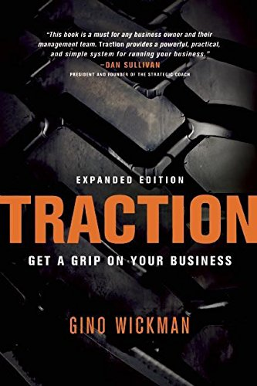

Slide 13
Business Traction
1. Strategic Alignment Component
2. People Component
3. Data/Metrics Component
4. Problem-Solving Component
5. Process Component
6. Execution Component

Slide 14
Successful organizations operate with a crystal-clear vision that is shared by everyone (1. Strategic Alignment Component). The WHY

Slide 16
They have the “Right People” in the “Right Seats.” (2. People Component)

Slide 18
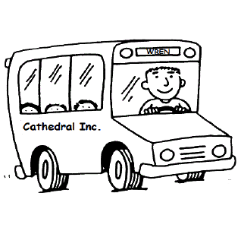
Good to Great
Right People on the Bus (Recruitment/Selection)
Right People in the Right Seat (Unique Ability)
Wrong People off the Bus! (With self-esteem intact if possible)

Slide 19
G.W.C
Gets It (Understanding)
Wants It (Passion/Energy)
Capacity To Do It (Skills/Experience)

Slide 20
They have a pulse on their operations by watching and managing a handful of numbers on a weekly basis (3. Data/Metrics Component)

Slide 21
They identify and solve issues promptly in an open and honest environment (4. Problem-Solving component )

Slide 22
They get everyone on the same page with essential procedural steps and then get everyone to follow (5. Process Component)

Slide 23
They bring discipline and accountability into the organization (6. Execution component)

Slide 24
Information without Execution = Delusion

Slide 26
Discipline 1
Focus on your W.I.G (Wildly Important Goal)

Slide 28
Discipline 2
Measure Lead Behaviors that support Lag Results
(Critical day-to-day activities)

Slide 29
Discipline 3
Keep Score!
(We play differently when we know the score)

Slide 30
Discipline 4
Schedule Weekly Accountability Talks
Friday Afternoon/Monday Morning

Slide 31
Six Critical Questions
Why do we exist? (The Why/The Cathedral)
How do we behave? (Values)
What do we do? (Mission)
How will we succeed? (Strategies)
What is most important, right now? (W.I.G)
Who must do what? (Role Clarity)

Slide 32
Meeting Agenda Format
Outcome (At the end of this meeting, we will have……..)
Agenda
Roles
Norms
Parking Lot
Action Plan

Slide 33
Outcome
At the end of this session (3pm), We will have revisited our Mission & Vision, codified our Values Statements and started the Problem-Solving & Action Planning Process.

Slide 34
Roles
Yours→ Active Team Members sharing your thoughts, ideas, concerns moving forward.
Greg’s → Facilitator: Content Neutral/Process Servant to this Team

Slide 35
Norms
Full-Participation
Attack Issues; Not Each Other/Depts.
Confidentiality
Watch Time
Monitor Sacred Cows
Think “Outside the Box”

Slide 36
Thinking Outside the Box:

Slide 37
Parking Lot
*
*
*
*
*
*

Slide 38
Action Plan(s)
What | Who | When
Individual, Team & Organization

Slide 39
Problem-Solving

Slide 40
The Goal: Consensus

Slide 41
Consensus: Can I live with a decision and can I support it once the board meeting is over?

Slide 42
The Three Questions
What’s Going Well?
Where are we Getting Stuck?
What should we be Doing Differently?

Slide 43
Process
Build the List (Round Robin/Brainstorming)
Clarify List
Elimination
Combination
Categorization
Prioritization
Problem-Solving
Action-Planning

Slide 44
A Problem-Solving Model
Goal
Barriers
Alternatives
Select
Sequence

Slide 45
Prioritization
Priority A: High Value and Primary Concern
Priority B: Medium Value and Secondary Importance
Priority C: Little Value and Minor Importance

Slide 46
Multi-Voting
3 Post-It Notes per participant
Participants place Post-It Note(s) on Item(s) they think most important.
Facilitator tallies Post-It Notes as simply a place to start the Problem Solving.
All items will/must get a hearing. This is just a place to start.

Slide 47
Action Plan(s)
What | Who | When

Slide 48
Greg Coker Leadership Development, Keynote Speaking, Coaching & Strategic Planning
270.223.8343

Slide 49
Tying it all Together

Slide 50
Resource Expo
Coffee Break
9:45 – 10:05
Sponsored by:

Slide 51
Marketing For
Small Business Panel
Video Marketing
Andrew Swanson – Forerunner
Social Media
Hillary Rickel – Inked Brands
Website Design
David Downing – Yellowberri

Slide 52
Business Fundamentals
Panel
Finance & Tax Service
Michael Elmore – Elmore Financial
Loans for Entrepreneurs
Miller Slaughter – Community Venture
Human Resources
Bree Stephens – B.Stephens HR Consulting
Developing a Global Strategy
Brian Miller – U.S. Dept. of Commerce, Int. Trade Administration

Slide 53
BREAKOUT
SESSIONS
11:30 – 12:10

Slide 54
BREKOUT SESSIONS
All About Small Business Development Center Resource
Brittanie Dawson – SBDC – Room 129
Funding Resource for Startups
Lisa Bajorinas – Kentucky Innovation – Corridor
Cybersecurity for Small Businesses
Harry Erskin – Cornerstone Information Systems – 130
Grow your Business into 2050 – BG 2050
Sam Ford – CREATE – 320

Slide 55
Funding Resources
Lisa Bajorinas
Executive Director, Kentucky Innovation Hubs

Slide 56
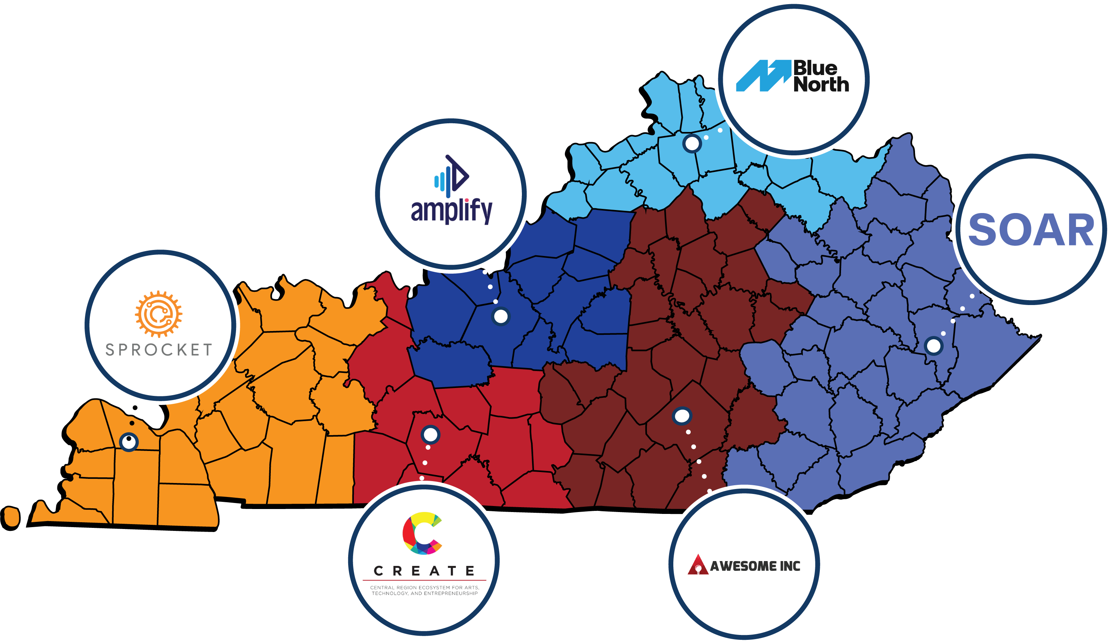
Kentucky Innovation Hubs

Slide 57
What are the Innovation Hubs?
Funded both publicly and privately, the Kentucky Innovation Hubs form a collaborative network of six regional centers across the state, dedicated to driving economic development through entrepreneurship and innovation.

Slide 58
What’s the Goal of the Hubs?
Funded both publicly and privately, the Kentucky Innovation Hubs form a collaborative network of six regional centers across the state, dedicated to driving economic development through entrepreneurship and innovation.
Each Hub serves as the “front door” to entrepreneurial support services in its region, leveraging local partnerships and regional organizations to assist entrepreneurs across various industries and stages of development. These efforts help entrepreneurs advance their businesses and contribute to the state's economic growth.

Slide 59
What Do the Hubs Actually Provide?
Funded both publicly and privately, the Kentucky Innovation Hubs form a collaborative network of six regional centers across the state, dedicated to driving economic development through entrepreneurship and innovation.
Each Hub serves as the “front door” to entrepreneurial support services in its region, leveraging local partnerships and regional organizations to assist entrepreneurs across various industries and stages of development. These efforts help entrepreneurs advance their businesses and contribute to the state's economic growth.
Kentucky’s Innovation Hubs help startups raise capital, accelerate growth, and hire talent by equipping the next generation of leading tech entrepreneurs with the tools they need to build, launch, and scale impactful businesses. Through curated coaching, the Hubs assist startups in building successful companies by connecting them to capital, customers, mentors, talent, partners, and a community of entrepreneurs.

Slide 60
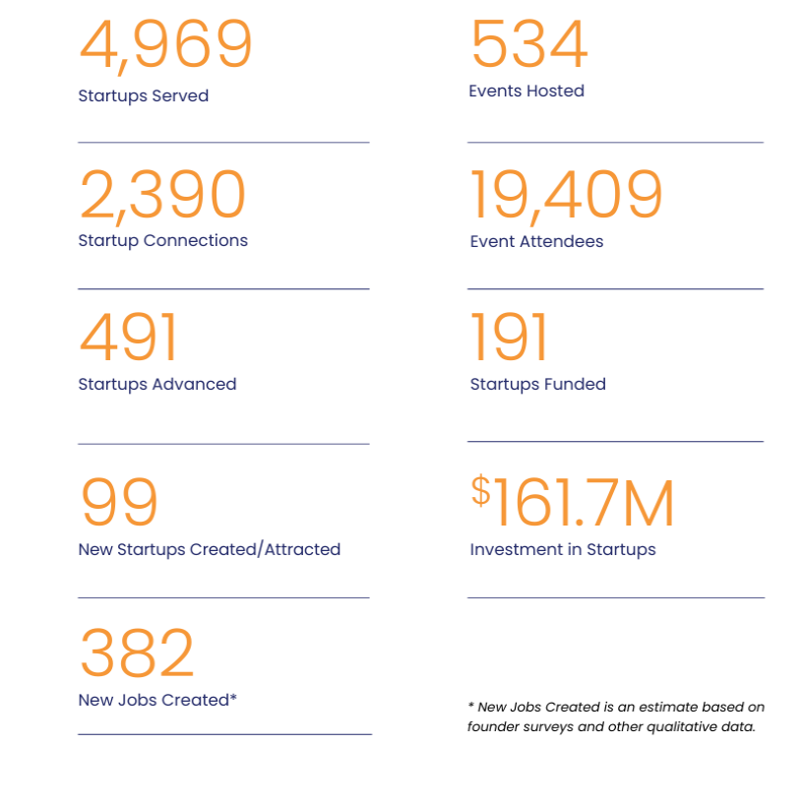
FY24 Metrics & Results

Slide 61
Startup Connections
Mentors
Capital
Customers
Connections
Community
Talent

Slide 62
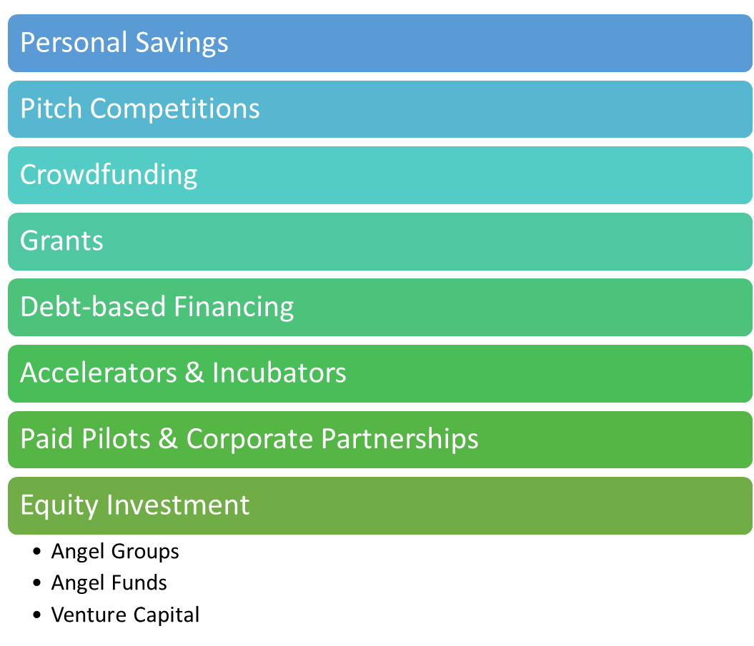
Agenda

Slide 63
Determine Funding Strategy
Notes:
Each funding source has its unique dynamics, so the best choice depends on the stage of the startup, the industry, and the founder’s long-term goals.

Slide 64
Bootstrapping
Personal Savings
Credit Cards
Friends & Family
Notes:
Personal savings or “bootstrapping”
Personal Savings
Pros: Retain full control and ownership; no debt or investor interference.
Cons: High personal financial risk; limited to available savings.
Friends and Family
Pros: Flexible terms; may offer funding with minimal legal formalities.
Cons: Potential strain on relationships if the business struggles; may come with informal expectations.
Best -- Find first or more customers to grow revenue

Slide 65
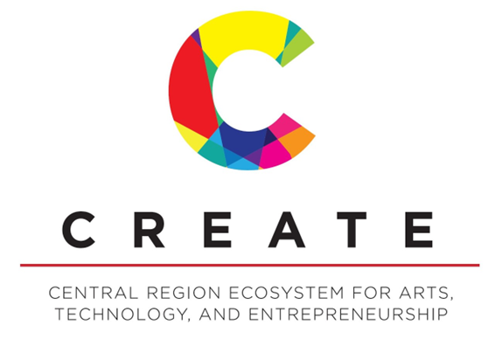
Pitch Competitions
Notes:
Some competitions are regional, some are statewide including 5Across and Venture Sharks.
KY Pitch – business plan competition for all private and public college and university students building a startup.
CREATE Next Big Idea pitch competition
Grants and Competitions
Pros: No repayment or equity exchange required; recognition can boost credibility.
Cons: Highly competitive; limited amounts; often tied to specific industries, like tech, science, or social impact.

Slide 66
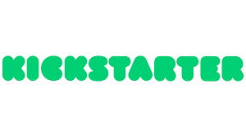
Crowdfunding
Notes:
The key is knowing which platform can better set you up for success.
Crowdfunding – for smaller amounts of funding and some early validation
GoFundMe – personal story
IndieGoGo -- a broader collection of projects, including tech and design, health and fitness, education, transportation, phones and accessories
Kickstarter -- sharing creative or serviceable products and media
Start Engine - more tech focused
Wefunder – most utilized in Kentucky
GE’s Opal Nugget Ice Maker story -- $2,768,650 by 6,478 backers on Indiegogo
Crowdfunding
Types: Includes platforms like Kickstarter (reward-based) and equity crowdfunding sites like SeedInvest.
Pros: Good for market validation; reach a broad audience without giving up too much equity (depending on type).
Cons: Time-intensive; success not guaranteed; potential public scrutiny if project fails.

Slide 67
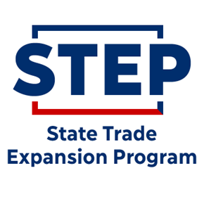
Grants
Kentucky SBIR-STTR
Federal Funds
Phase 0 or 00
Phase 1
Phase 2
Notes:
Federal Small Business Innovation & Research or Small Business Tech Transfer Research grants. If received, you are then eligible to apply for a KY SBIR/STTR Matching grant
Phase 0 – assistance for writing grant
Phase 1 – prototype stage development
Phase 2 – commercialization stage development
KSEF has Micro Awards ($5000) to assist with research/writing grant application
STEP – reimbursement grant for export costs spent
Grants and Competitions
Pros: No repayment or equity exchange required; recognition can boost credibility.
Cons: Highly competitive; limited amounts; often tied to specific industries, like tech, science, or social impact.

Slide 68
Debt-Based Financing = Loans
Kentucky Small Business
Credit Initiative (KSBCI)
Traditional Bank Loan
SBA 7(a) Loan
Notes:
Traditional bank loan -- a traditional bank loan is a sum of money loaned for business purposes, that is repaid through regular repayments over the duration of the loan term. ** Use your local SBDC to help you prepare for and package up your loan application and to connect you to startup friendly banks.
SBA 7(a) Loan – sba.gov
The 7(a) Loan Program, SBA’s most common loan program, includes financial help for small businesses with special requirements. This is the best option when real estate is part of a business purchase, but it can also be used for:
Short- and long-term working capital
Refinance current business debt
Purchase furniture, fixtures, and supplies
The maximum loan amount for a 7(a) loan is $5 million. Key eligibility factors are based on what the business does to receive its income, its credit history, and where the business operates. Your lender will help you figure out which type of loan is best suited for your needs.
Bank Loans or Small Business Loans
Pros: No equity or ownership given up; established credit can help secure better terms.
Cons: Requires repayment with interest; may need collateral or a strong credit history.

Slide 69
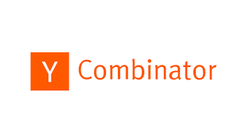
Accelerators & Incubators
AWESOME FELLOWSHIP
A one year, mentor-driven program designed to accelerate your high-tech startup.
Notes:
Accelerators and Incubators
Pros: Offer funding, mentorship, and resources to grow; often come with networking opportunities and office space.
Cons: Usually require equity in exchange; programs are competitive and intense.
A startup accelerator is a program that helps early-stage companies grow by providing them with resources, mentorship, and funding in exchange for equity. These programs are usually intensive, lasting around 3 to 6 months, and focus on quickly advancing the startup's growth, refining the business model, and preparing it for potential investment rounds. Here are some key features of startup accelerators:
1. Funding
Most accelerators provide an initial seed investment, often in exchange for a small percentage of equity in the company. The amount varies but typically ranges from $10,000 to $150,000 or more, depending on the program and the startup’s needs.
2. Mentorship and Networking
Accelerators pair startups with experienced mentors, including successful entrepreneurs, industry experts, and potential investors. These mentors offer advice on product development, scaling, marketing, and strategy, helping startups avoid common pitfalls.
3. Intensive Programs
Accelerator programs are fast-paced, generally lasting a few months. During this time, startups focus intensely on refining their product, honing their business strategy, and achieving specific growth milestones.
4. Resources and Workspace
Many accelerators provide workspace, access to technical and business resources, and software tools to help startups build their product. This environment fosters collaboration among the startups in the cohort, enabling them to learn from each other.
5. Demo Day
At the end of the program, accelerators typically hold a "Demo Day," where startups pitch their business to a room full of investors, potential customers, and media. Demo Day offers startups a chance to secure further funding and gain visibility.
6. Community and Peer Support
Accelerators bring together a cohort of startups, creating a sense of community and a support network. Founders can share their experiences, solve problems together, and build connections that last beyond the program.
7. Well-Known Accelerators
Some well-known accelerators include Y Combinator, Techstars, and 500 Startups. These programs are highly competitive and offer not only funding but a powerful reputation boost for startups.
Startup accelerators are best suited for startups that are past the idea stage and are looking to scale quickly. They often look for startups with a strong team and a product with market potential, as these factors increase the likelihood of rapid growth and successful fundraising after the program.

Slide 70
Paid Pilots & Corporate Partnerships
Paid Pilots
Corporate Partnerships
Strategic Investments
Notes:
Corporate Partnerships or Strategic Investments
Pros: Funding can come with valuable resources and industry connections; validation from a reputable company.
Cons: May come with stipulations on product development or strategy alignment with the corporate partner.
Paid Pilots
Definition: A paid pilot is a short-term, trial-based engagement where a corporate partner pays a startup to test its product or service in a real-world setting.
Purpose: Paid pilots are designed to assess the feasibility, effectiveness, and impact of the startup’s solution within the corporate environment.
Benefits for Startups:
Revenue and Funding: Since it’s paid, a pilot offers immediate income, which can help fund further development and operations.
Product Validation: Pilots allow startups to test and refine their products with real users in a realistic setting, gathering feedback that can help improve the product.
Customer Case Studies: Successful pilots can lead to powerful case studies and testimonials that startups can use to attract more customers or investors.
Path to Long-Term Contracts: A paid pilot often serves as a gateway to a long-term contract if the results meet the corporate partner’s goals.
Challenges: Pilots can sometimes be lengthy, requiring startups to adjust their product to fit specific corporate requirements. If the pilot does not lead to a full contract, the investment of time and resources may not pay off.
Corporate Partnerships
Definition: A corporate partnership is a broader, often longer-term collaboration between a startup and a corporation. It typically involves mutual benefits and a more strategic alignment between the two entities.
Purpose: Corporate partnerships aim to leverage the strengths of both the startup and the corporation. While the corporation gains access to innovative technologies or solutions, the startup benefits from resources, credibility, and expanded market reach.
Types of Corporate Partnerships:
Co-Development: Both parties work together to develop or improve a product, integrating the startup’s technology with the corporation’s offerings.
Sales & Distribution: The corporation may help the startup distribute its product, enabling wider market reach.
Investment Partnerships: Some partnerships include an equity investment from the corporation, offering the startup both funding and a vested partner.
Benefits for Startups:
Increased Market Access: The corporate partner’s network, customer base, and distribution channels can accelerate the startup’s market entry and growth.
Credibility and Validation: Associating with a well-known corporation can enhance a startup’s reputation, boosting its attractiveness to potential customers and investors.
Resources and Infrastructure: Corporate partnerships may provide access to infrastructure, resources, or expertise that startups may lack on their own.
Challenges: Corporate partnerships can come with high expectations and may require the startup to adapt its product or service. Additionally, negotiations can be complex, and maintaining alignment on goals and priorities can be challenging over time.
Why Corporations Seek These Arrangements
Large corporations often work with startups to stay agile and competitive. Startups bring fresh perspectives and innovations, allowing corporations to explore new solutions without the high internal R&D costs. Both paid pilots and partnerships are cost-effective, lower-risk ways for corporations to stay at the forefront of emerging trends.
For startups, these collaborations can be a powerful way to scale faster, gain valuable insights, and build credibility—often key elements for long-term success.
4o

Slide 71
Equity Investment
Venture Capital Funds
Angel Investment Funds
Angel Groups
Individual Angels
Notes:
Individual Angels – a high-net-worth individual who funds startups at the early stages, often with their own money, typically in exchange for ownership equity in the company. Requires relationships and being within their investment thesis.
Angel groups – groups of angel investors who regularly convene as a group, usually in-person, to evaluate and invest in startups. Investors can purchase equity in the company, giving them a certain percentage of the ownership. This equity stake can then be cashed out at a later date when the company has increased in valuation, earning a profit for the investors.
Angel Funds – a business organization with the purpose of making seed investments directly in one or more target companies.
VC Funds -- professional investment managers raise money from a disconnected group of passive investors, usually later stage startups with traction and larger rounds.

Slide 72
Angel Groups
Lincoln Trail Venture Group
Notes:
Bluegrass Angels – Lexington, KY
Derby City Angels – Louisville, KY and TN
Lincoln Trail Venture Group – Elizabethtown, KY
Render Capital – Louisville, KY
Tri State Investment Group – Ashland KY, WV, OH
Nashville Angels
Greater Nashville Venture Capital Association
Angel Investors
Pros: Often experienced entrepreneurs themselves who can offer mentorship and networking in addition to funding.
Cons: May require a significant equity stake; less patient than venture capitalists for ROI.

Slide 73
Angel Investment Funds
Bluegrass Angels Fund
Commonwealth Seed Capital
Connetic Ventures
Keyhorse Capital
Launch Blue Ventures
Lunsford Capital
Marshall Ventures
Poplar Ventures
Radicle Capital
Render Capital
Scalable Ventures
Sheltowee Venture Fund
Strike Ventures
Thornton Capital
Unbridled Ventures
Wabi Capital
Notes:
CSC and Keyhorse are state funded and provide equity at the pre-seed and seed stage, with some follow-on capital
Venture Capital (VC)
Pros: Large funding amounts; VCs can offer expertise, networking, and help with scaling.
Cons: High expectations for rapid growth; requires giving up some control and ownership; VCs often want an exit within a few years.

Slide 74
Venture Capital Funds
Chrysalis Ventures
Poplar Ventures
Radicle Capital
Scalable Ventures
Notes:
Chrysalis Ventures -- Healthcare and Technology Series A
Poplar Ventures -- Technology-enabled Series A
Radicle Capital -- Technology-enabled and Social & Environment focused Seed, Series A
Scalable Ventures -- Marketplaces, Platforms, Analytics, Web3, AI & ML, SaaS, eCommerce, Mobile Apps
Venture Capital (VC)
Pros: Large funding amounts; VCs can offer expertise, networking, and help with scaling.
Cons: High expectations for rapid growth; requires giving up some control and ownership; VCs often want an exit within a few years.

Slide 75
Thank You! Lisa Bajorinas Executive Director, Kentucky Innovation Hubs e: lbajorinas@kstc.com m: 502-836-0735 x: @LisaBajorinas

Slide 76
LUNCH
Sponsored by:

Slide 77
MARK FORD
ABOUND Credit Union
Lunch Sponsor

Slide 78
KEYNOTE SPEAKER
Spence Sheldon
Donatos Pizza

Slide 79
SPENCE SHELDON
Sheldon Restaurant Group

Slide 81
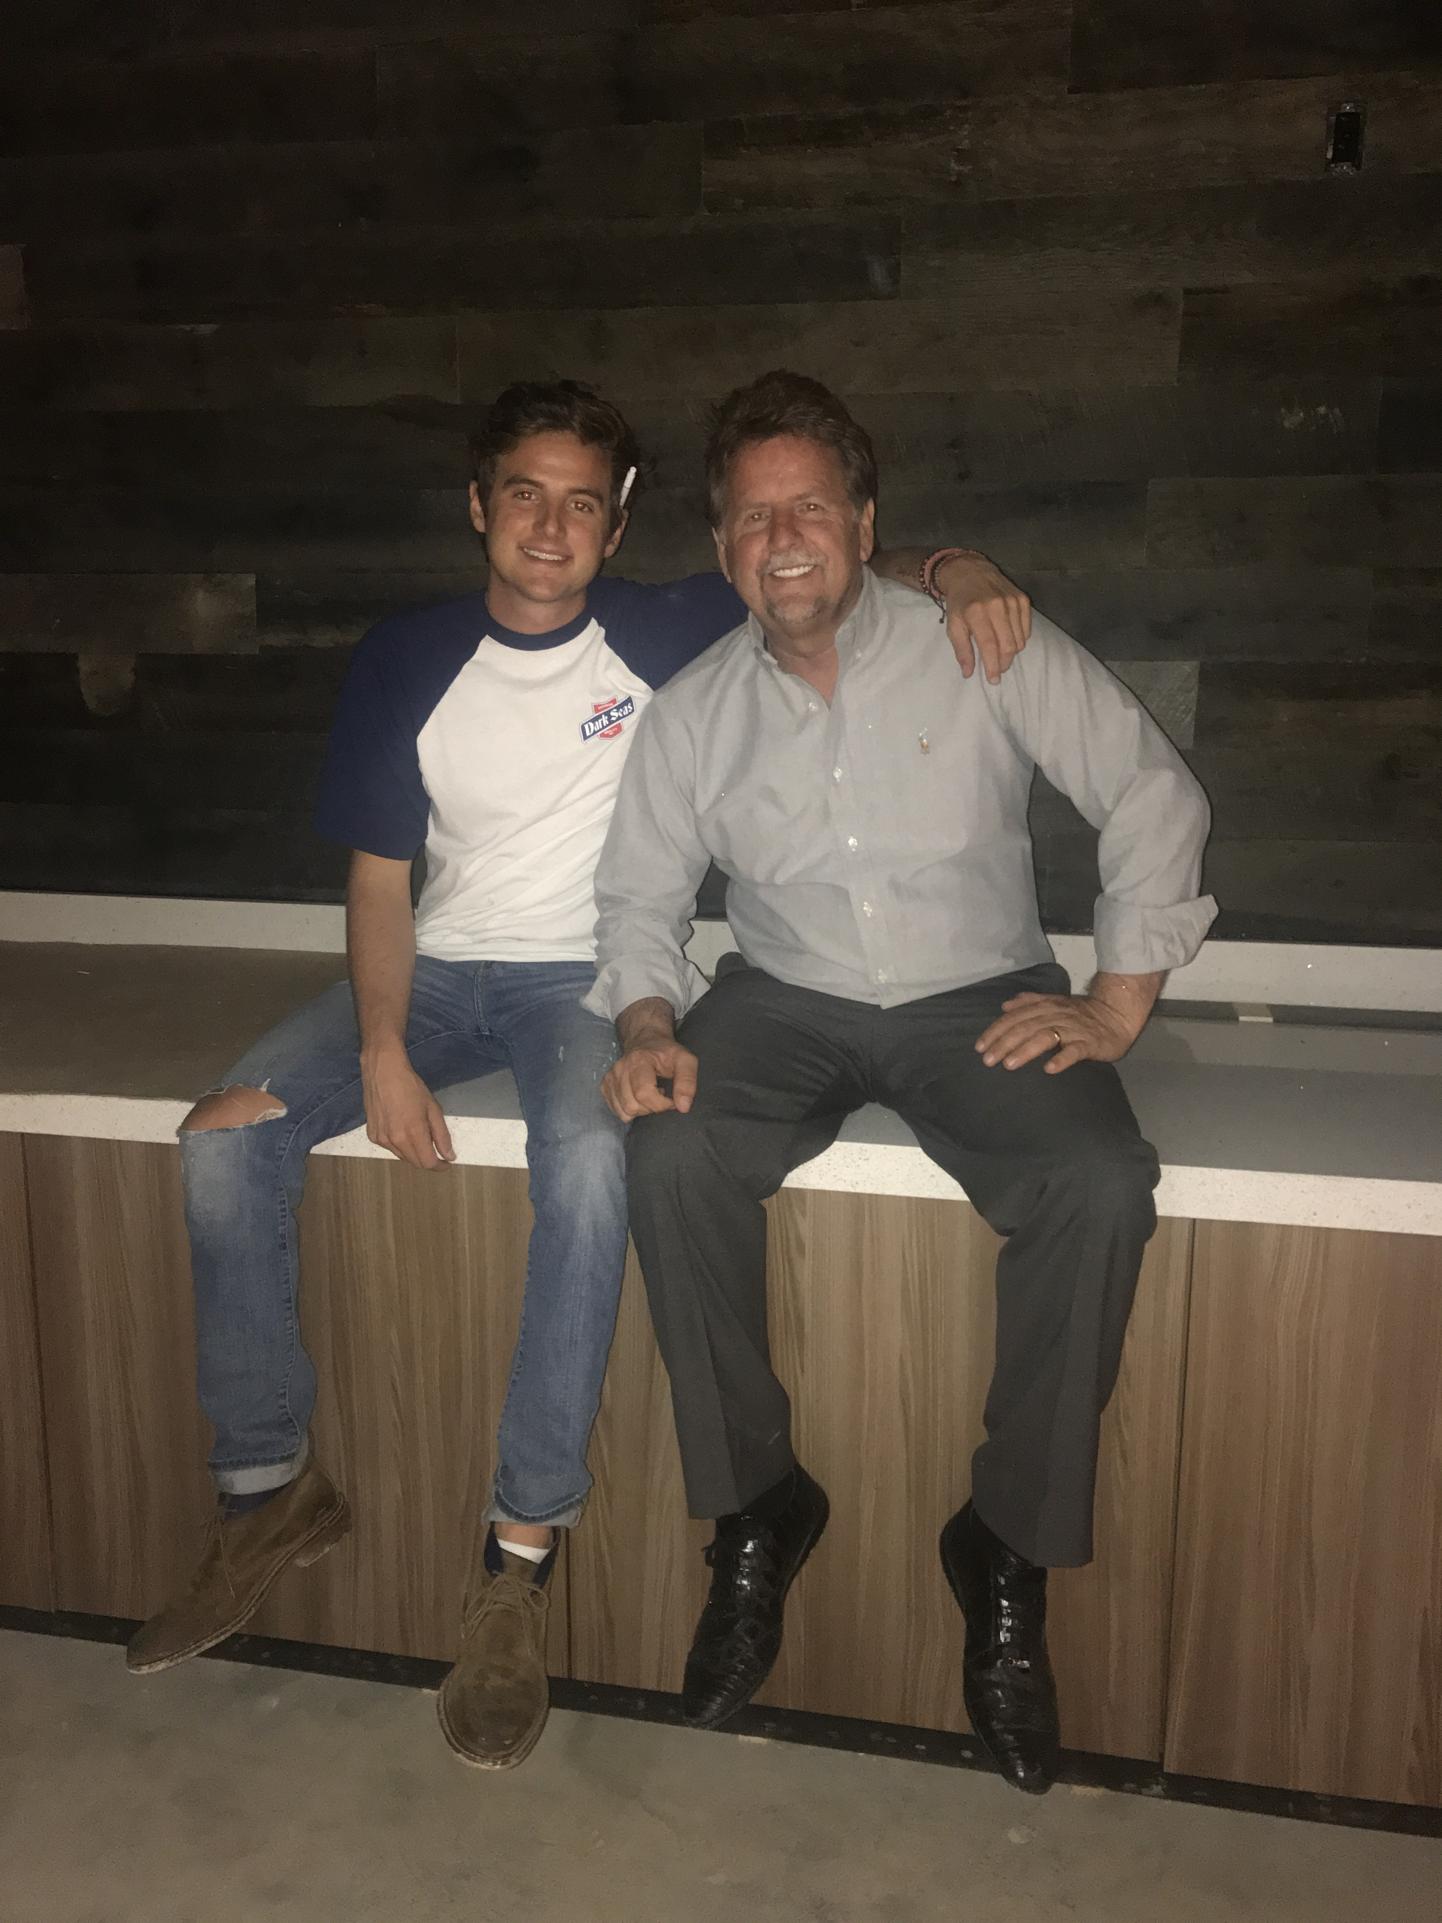
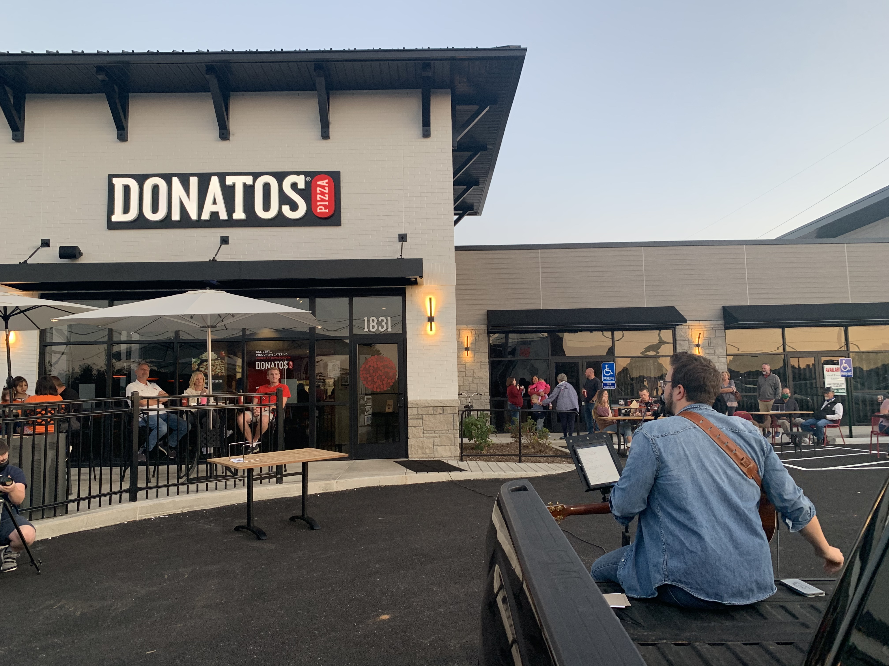

Slide 86
Where do you want to be in 10 years?

Slide 87
How do we get there?

Slide 88
First 4 Years (non negotiables)

Slide 89
Years 5-7
Back to the classroom I went

Slide 90
When its all said and done your life is just going to be a story to tell.
How do you want yours to read?

Slide 91
Donatos TN
Murfreesboro
Nashville (Closed 11/4/2024)

Slide 93
“I have failed over and over in my career , that is why I succeed. “
-Michael Jordan

Slide 94
STAY HUMBLE STAY CURIOIUS STAY PUT AND DON’T YOU EVER GIVE UP
-SS

Slide 95
SPONSORS

