Slide 1
MPH Report
February 8, 2017

Slide 2
Graduate School Forum
Student MUST be enrolled semester of graduation (Fall, Spring, Summer): Maintaining Matriculation
Cannot do degree audits with IP
Get grades turned in!
Unlimited transfer of certificate hours
Cracking down on appeals:
250% increase last four years
International Scholarships: 9 cr @ 4 sem (fa/sp)
Recruitment & retention
Notes:
Here are some of the highlights from the grad school forum on 2/7/2017:
Students must be enrolled in at least 1 cr. hour in the semester they graduate. This will be strongly enforced beginning in the fall. So, even if all the student is doing is finishing up a thesis, any remaining internship hours, or even an IP grade, he/she needs to be enrolled. Speaking of IP grades, a degree audit cannot be done if there’s an IP grade and this can delay graduation and affect the maintaining matriculation policy.
While only 12 credit hours can be transferred into a program, an unlimited number of certificate hours can be transferred into a program to support certificate programs that are nested with a program.
They are really starting to crack down on appeals to graduate policies, so expect pushback for course substitutions, esp. core courses. Also, need to make sure students are graduating before six year window of time.
Currently, every international student – except those who are government sponsored – get a scholarship that brings tuition down to in-state rates for 9 credit hours each for 4 semesters – fall and spring only. As this is not enough to cover the required credit hours for MPH, Dr. Lyons is looking into it..
Grad School push for recruitment and retention. We’ll be asked how many we can take…

Slide 3
MPH Program Changes
Program revision
Admissions
Description
Curriculum
One new course proposal
12 course revisions
1 course deletion (402G)
Notes:
As a result of our January workdays, we adopted several changes, all of which have been voted on and approved at the program and departmental level.

Slide 4
In Progress
Develop guidelines for APEs
Develop guidelines for ILEs
Develop 5 competencies
Assessments
Embed in required courses
Notes:
Currently in the process of developing guidelines for applied practice experiences (APEs) and integrative learning experiences (ILE)

Slide 5
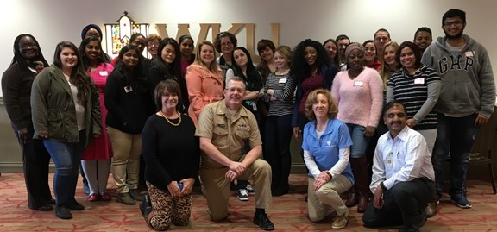
K-PHAST Training
24 Students 2 Faculty 1 HD Employee
4 Trainers
Notes:
We had our first ever K-PHAST training. Thanks to Dr. English for providing lunch and to PHUGAS for its sponsorship and assistance. We hope to make this an annual event.

Slide 6
Call to Action
Nation’s Health article:
goal of graduating public health students ready to practice from day one
need curricula that align with workforce needs
integrated education that delivers public health knowledge through a lens of real-life public health practice
Notes:
The training, coupled with some of the comments from a recent Nation’s Health article on the new CEPH criteria, really reinforced how
big the chasm is between public health practice and academia. Also, because of the greying of PH, opportunities for mentorship are dwindling. Thus, the article itself is a strong call to action: We MUST graduate students who not only know, but who can do. As stated in the article, the goal of the new criteria is to graduate PH students who are ready to practice from day one. Therefore we need to ensure that our curricula aligns with workforce needs – NOT with what WE think the students need to know.

Slide 7
Due Diligence
First and foremost, we are preparing practitioners.
Course reviews by PH professionals?
Focused interviews with PH practitioners?
Notes:
We need to ensure we are doing our part by remembering that first and foremost, we are preparing practitioners. We don’t have to teach them everything WE think they need to know, but we do need to make sure they are competent in the things they need to be able to do.
I suggest that where feasible, we let PH practitioners take a look at our courses and see if what we’re teaching is meeting their needs or at least have conversations or focused interviews with practitioners.

