Slide 1
Department of Public Health
Award & Hooding Ceremony
December 14, 2018

Slide 2
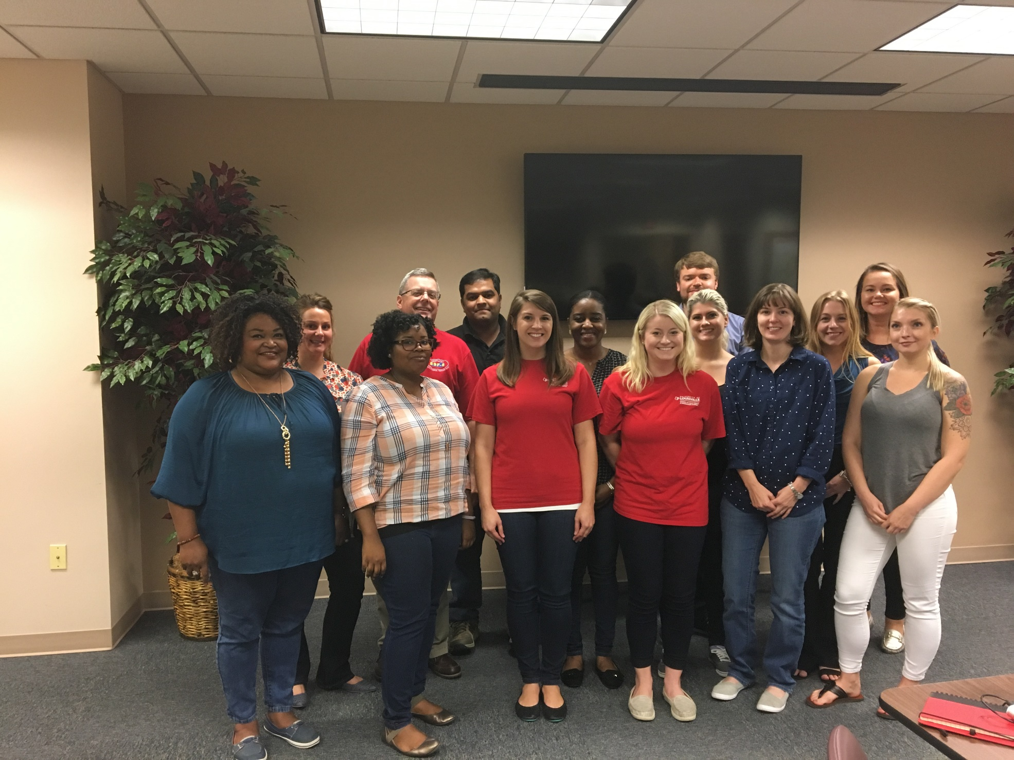
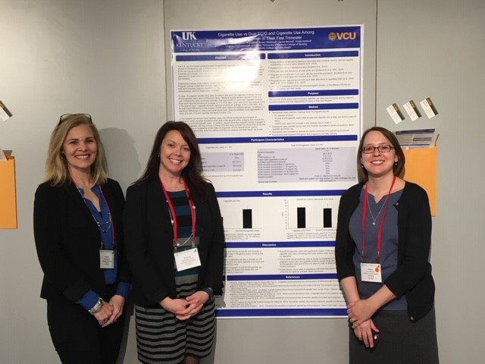
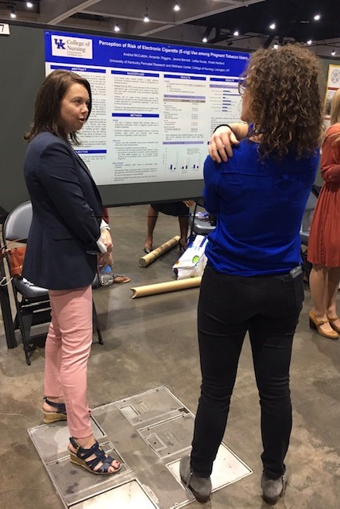
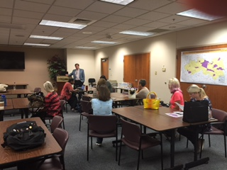
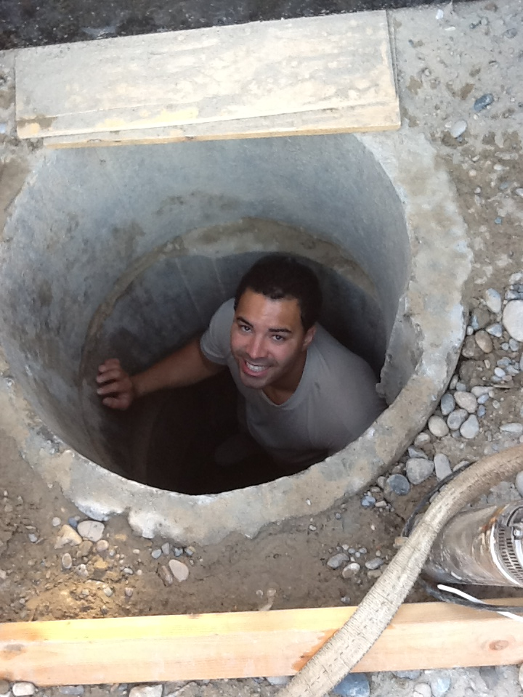

Slide 3
Master of Science Environmental & Occupational Health Science Graduates

Slide 4
Felicia Marie Merkson
Westminster, Maryland
“What you do makes a difference, and you have to decide what kind of difference you want to make.”
– Jane Goodall

Slide 5
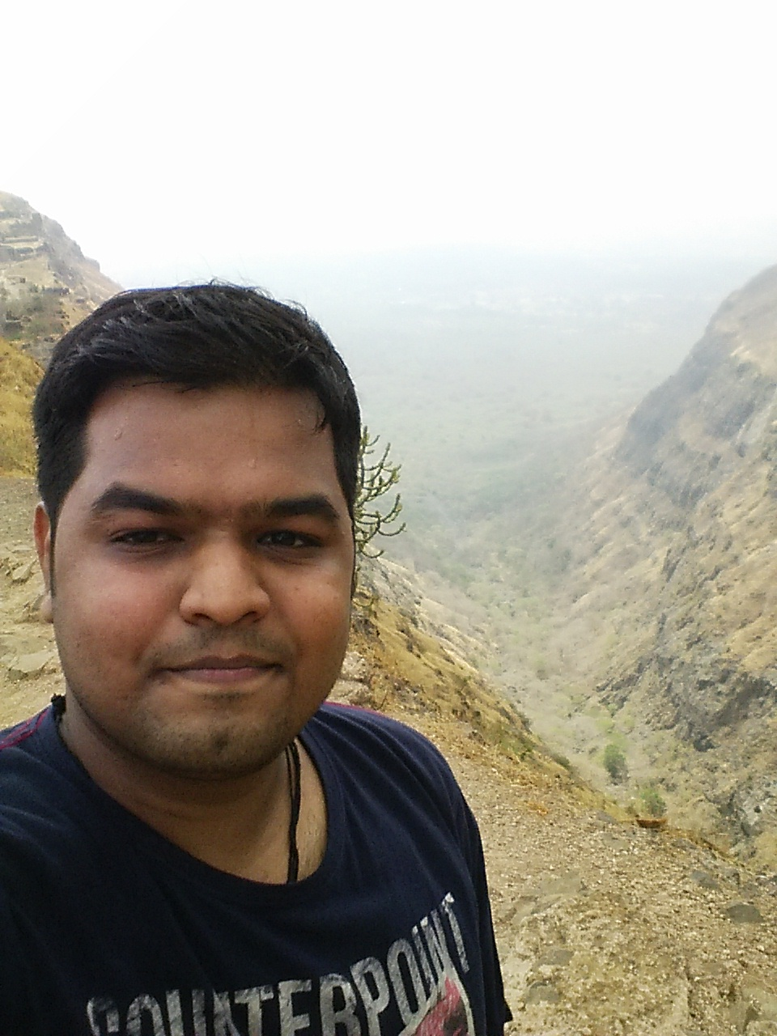
Ankitkumar Dilipkumar Patel
Vadodara, Gujarat, India
AT LAST, IT’S OVER.

Slide 6
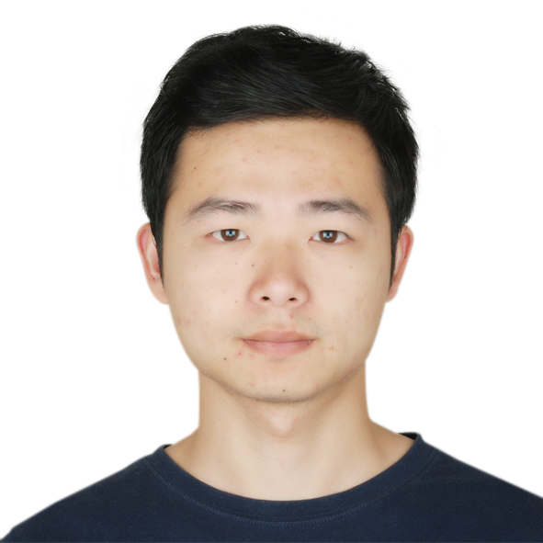
Jian Qiu
XiNing, QingHai, China
“The best time to plant a tree was 10 years ago. The second best time is now.”

Slide 7
Master of Health Administration Graduates

Slide 8
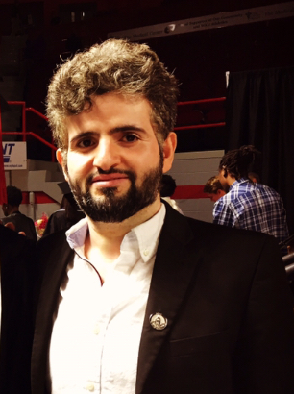
Hussain Alharethi
Saudi Arabia
“When everything seems to be going against you, remember that the airplane takes off against the wind, not with it.”
-Henry Ford

Slide 9
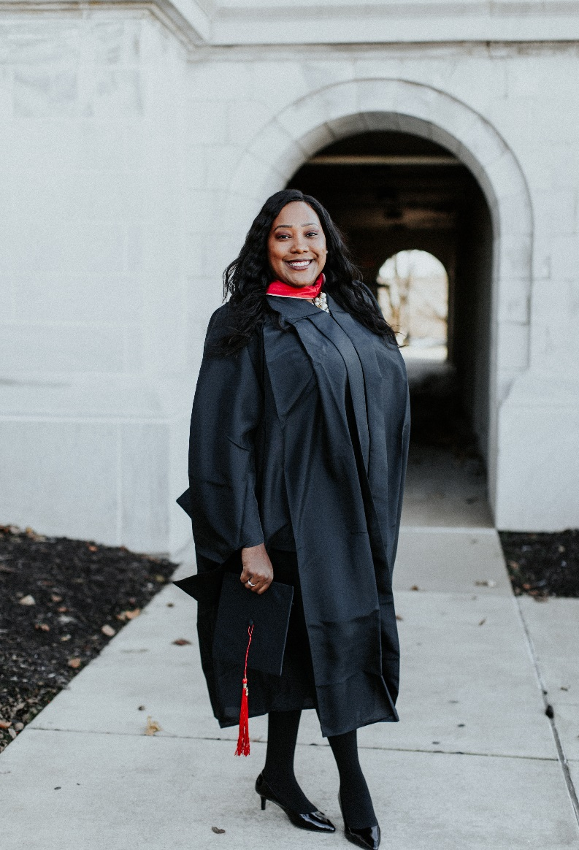
Desirae Jeanette Cocanougher
Lebanon, Kentucky
“Never stop fighting until you arrive at your destined place - that is, the unique you. Have an aim in life, continuously acquire knowledge, work hard, and have perseverance to realize the great life.”
-A. P. J. Abdul Kalam

Slide 10
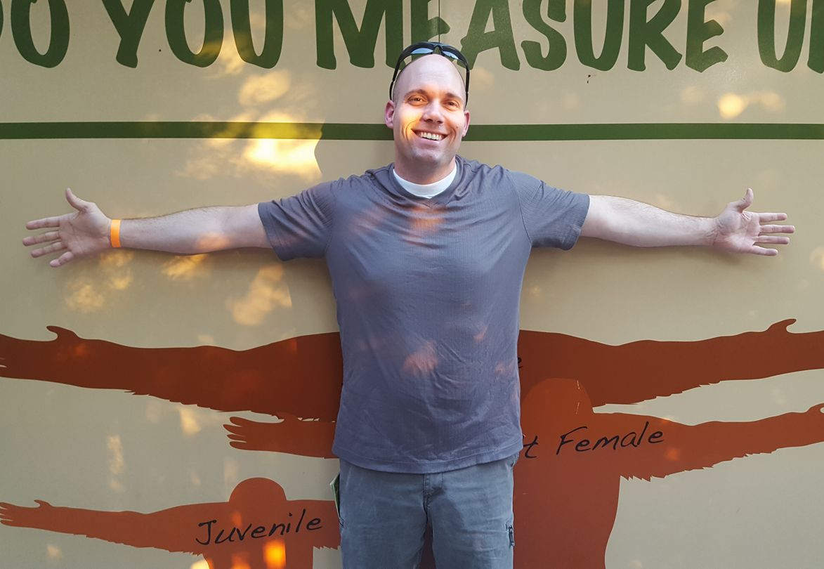
Matthew Jarboe
Clarkson, Kentucky

Slide 11
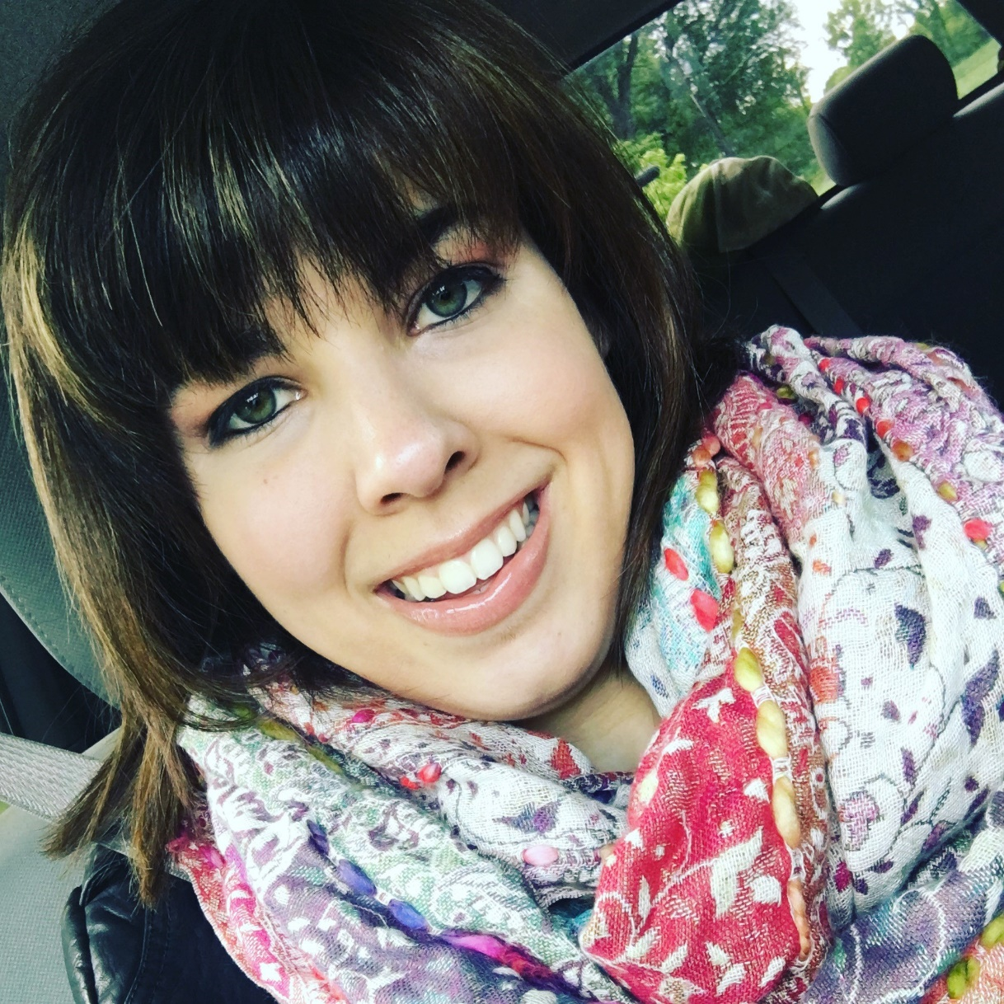
Kelsey Marie Julius
Jeffersonville, Indiana
The only things in life you regret are the risks you didn’t take.

Slide 12
Dr. Preeti Kumar
Nashville, Tennessee
“Intelligence plus character, that is the goal of true education.”
-Dr. Martin Luther King, Jr.

Slide 13
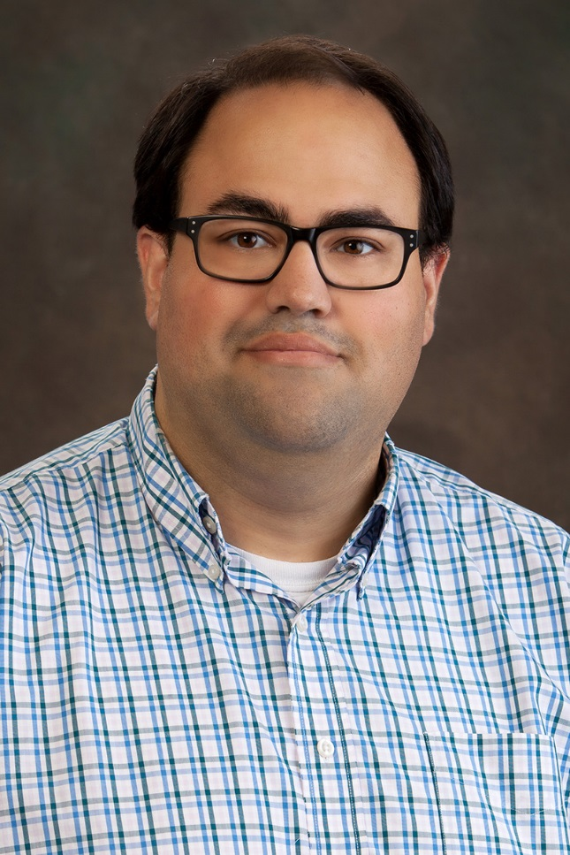
Dariush Shafa
Owensboro, Kentucky
“Things are only impossible until they’re not.”
-Patrick Stewart as Jean-Luc Picard

Slide 14
Charles W. Shepherd
Owensboro, Kentucky
Industries and opinions are ever-changing and difficult to navigate. As leaders, we work in hope that our decisions may rudder a positive direction for those we influence.

Slide 15
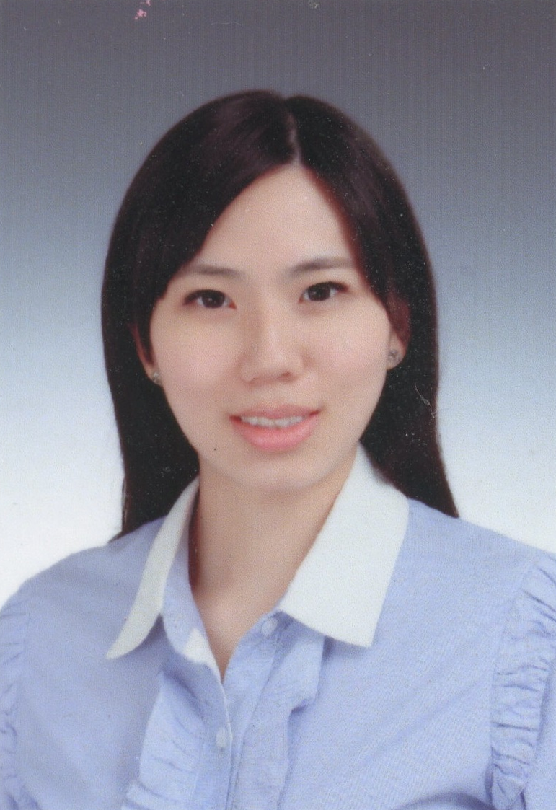
Shengjia Wan
Shanghai, China
“What doesn’t kill you makes you stronger.”
-Kelly Clarkson

Slide 16
Master of Public Health Graduates

Slide 17
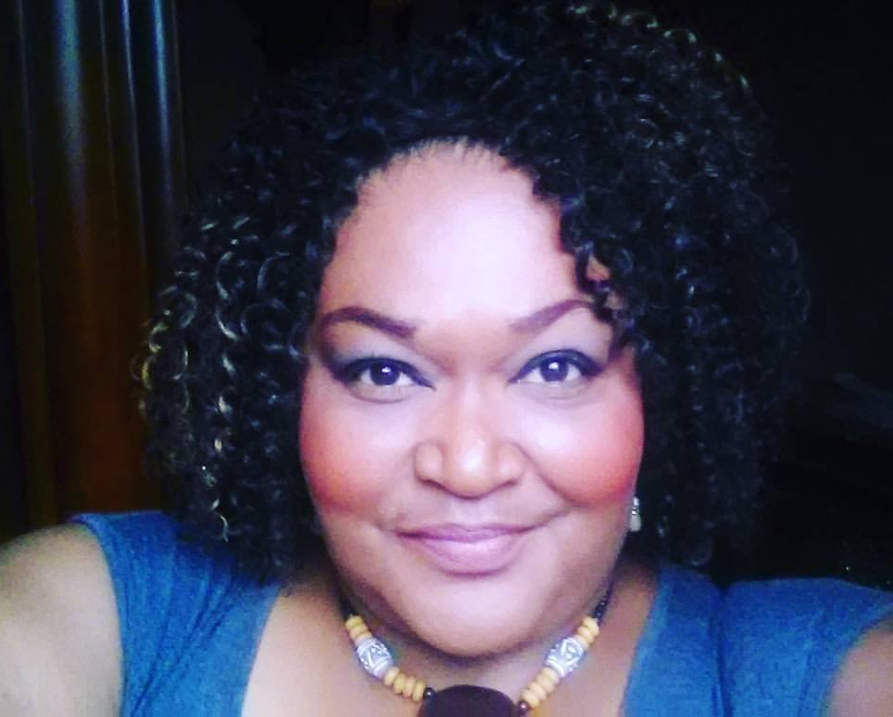
DeSha Regina Adegun
Madisonville, Kentucky
The moment you make contact with your future…EVERYTHING changes.

Slide 18
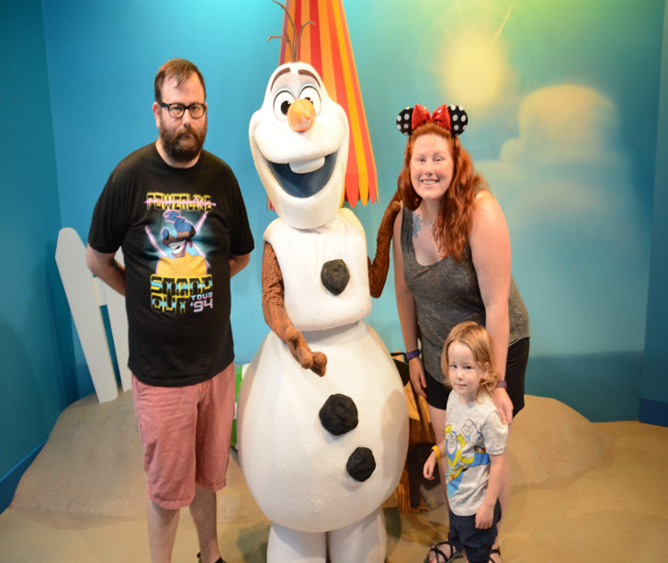
Katie Bennett
Louisville, Kentucky
“It’s kind of fun to do the impossible.”
-Walt Disney

Slide 19
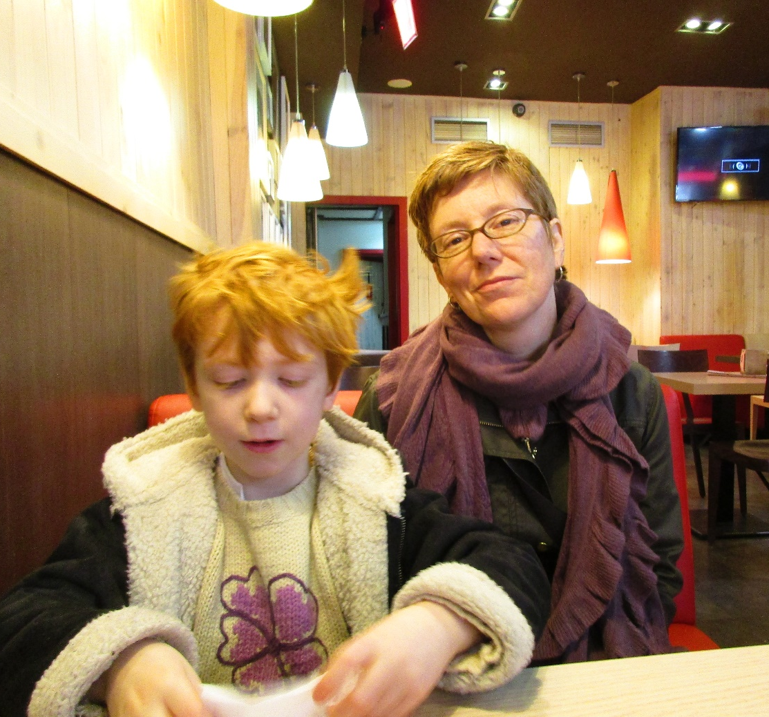
Susan Eagle
Bowling Green, Kentucky
“Of all the forms of inequality, injustice in health care is the most shocking and inhumane.”
-Dr. Martin Luther King Jr.

Slide 20
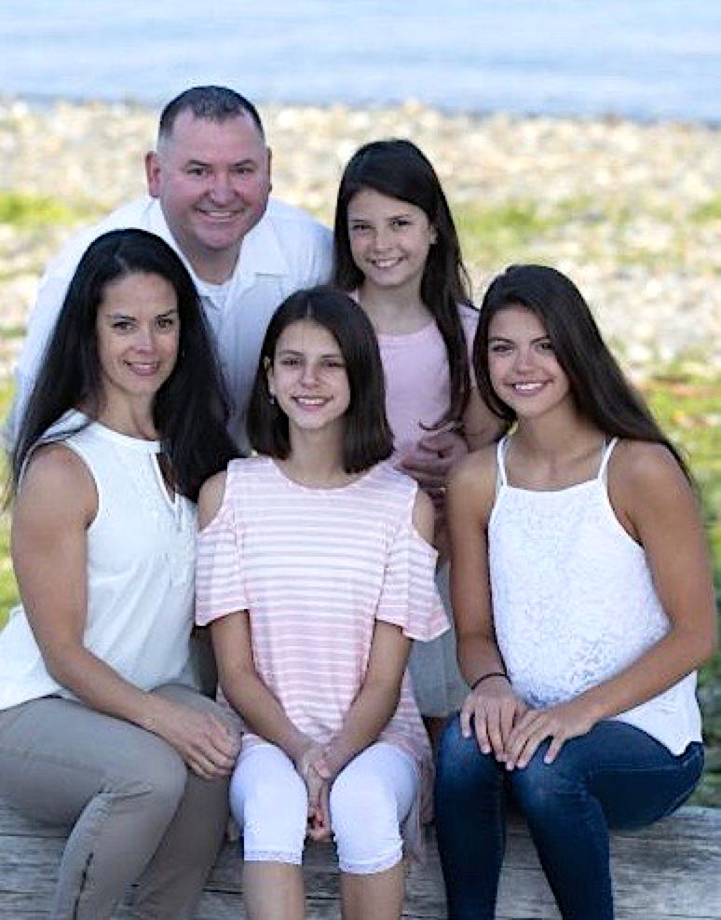
Derek Hickey
University Place, Washington
“All courses of action are risky, so prudence is not in avoiding danger (it’s impossible), but calculating risk and acting decisively. Make mistakes of ambition and not mistakes of sloth. Develop the strength to do bold things, not the strength to suffer.”
-Niccolo Machiavelli, The Prince (1513)

Slide 21
Ronald R Johnson Jr
Laurel, Maryland
I want to thank my family for the support and personal sacrifice for allowing me the time to start and finish my MPH. I want to thank all the professors, especially Dr. Gardner, for being patient and providing guidance when I needed it. Lastly, I would like to thank Mr. Hickey for introducing me to the WKU program.

Slide 22
Hunter Evan Laws
Martin, Tennessee
“Screws fall out all the time, the world’s an imperfect place.”
– John Bender

Slide 23
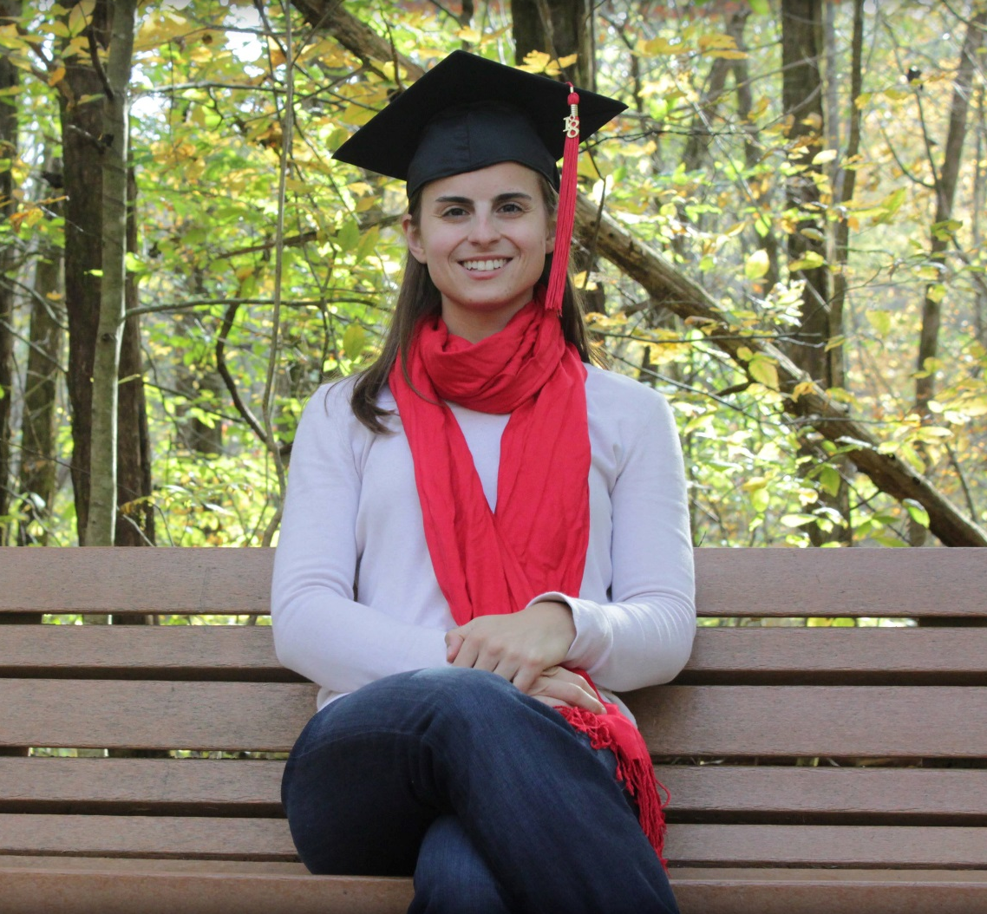
Catherine M. Malin
Bowling Green, Kentucky
“Be bold, but wary! Keep up your merry hearts, and ride to meet your fortune!”
-Tom Bombadil
Lord of the Rings
The Fellowship of the Ring

Slide 24
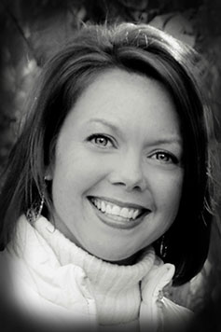
Andrea K. McCubbin
Lexington, Kentucky
“I’d rather attempt to do something great and fail than to attempt to do nothing and succeed.”
–Robert H. Schuller

Slide 25
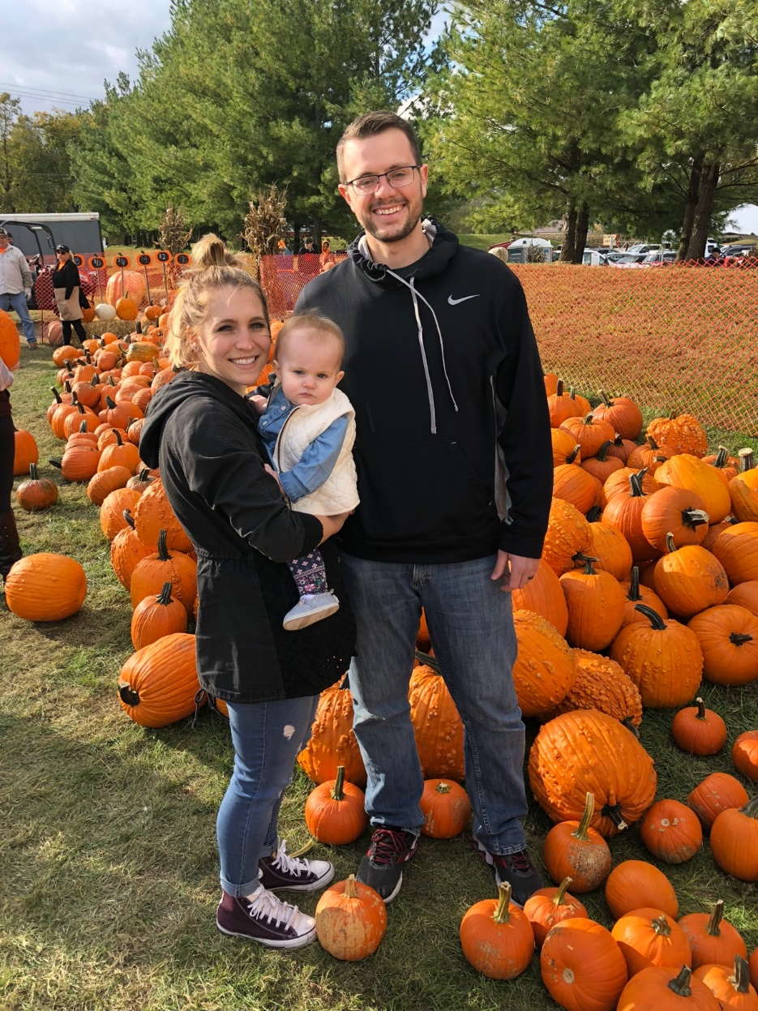
Kelsey Otten
Cincinnati, Ohio
“Where you invest your love, you invest your life.”
–Mumford & Sons
Thank you to my family for all of your support!

Slide 26
Neha Kishor Vora
Owensboro, Kentucky
“The best way to find yourself is to lose yourself in the service of others.”
–Mahatma Gandhi

Slide 27
