Slide 1




ata Visualization

Slide 2

    Dr. Leyla Zhuhadar
    Email: Leyla.zhuhadar@wku.edu

Slide 3
PART I
SIMPLE 5 Rules…

Slide 4







Notes:
Presentations are a powerful communication medium.

Slide 5







5
RULES
Notes:
Along the way we’ve discovered Five Rules…

Slide 6
5
RULES
FOR
WORLD
CREATING
PRESENTATIONS
CHANGING
Notes:
…five simple rules for creating world-changing presentations.

Slide 7

TREAT
YOUR
AUDIENCE
KING
AS
Notes:
The first rule is: Treat your audience as king.

Slide 8
















Notes:
Your audience deserves to be treated like royalty. Design a presentation that meets their needs, not just yours.

Slide 9
WHY
WHY
THE
THE
THEY
THEY
WHAT
WHAT
STEPS
STEPS
YOU
YOU
THEY
THEY
NEED
NEED
TO
SHOULD
TO
SHOULD
ADOPT
ADOPT
YOUR
YOUR
FOLLOW
FOLLOW
CAN
CAN
DO
DO
FOR
FOR
THEM
THEM
TO
TO
TAKE
TAKE
VIEW
VIEW
ACTION
ACTION
Notes:
Audiences want to know what you can do for them, why they should adopt your view, and the steps they need to follow to take action.

Slide 10

$
Notes:
Give them those things in a clear, easily understandable way…

Slide 11






Notes:
…and you will undoubtedly find favor with the king.

Slide 12

2
SPREAD
IDEAS
AND
MOVE
PEOPLE
Notes:
The second rule is: Spread ideas and move people.

Slide 13
BLAH
BLAH
BLAH
BLAH
BLAH
BLAH
BLAH
Notes:
Your audience didn’t show up to read your 60 page on screen dissertation.

Slide 14
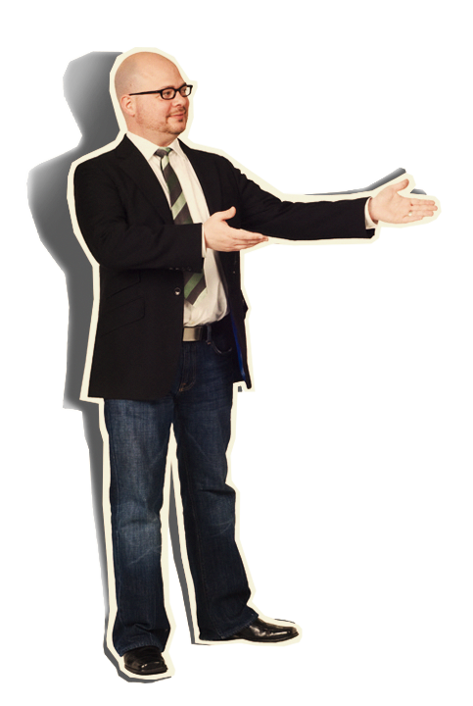






Notes:
They’re there to see you. To be inspired by your message…

Slide 15
Notes:
…and witness the quality of your thought.

Slide 16
AN
OTHER
ME
ET
ING
Notes:
You are not giving your presentation to have another meeting. You are there to covey meaning.

Slide 17



Notes:
So, consider including imagery that powerfully illustrates your point.

Slide 18





Notes:
Sometimes moving images can inspire in a way that static slides cannot. A slow moving animation creates a sense of nostalgia.

Slide 19



WHICH
RESEARCH
HAS
IT
ALL?
Notes:
A sequential build adds a sense of suspense.

Slide 20

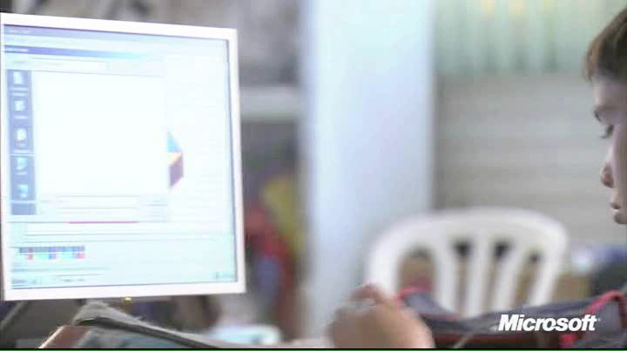
Notes:
And a thought-provoking video moves your audience in a way that can change not only minds, but hearts.

Slide 21



3
HELP
THEM
SEE
WHAT
YOU
ARE
SAYING
Notes:
The next rule is: Help them see what you are saying.

Slide 22


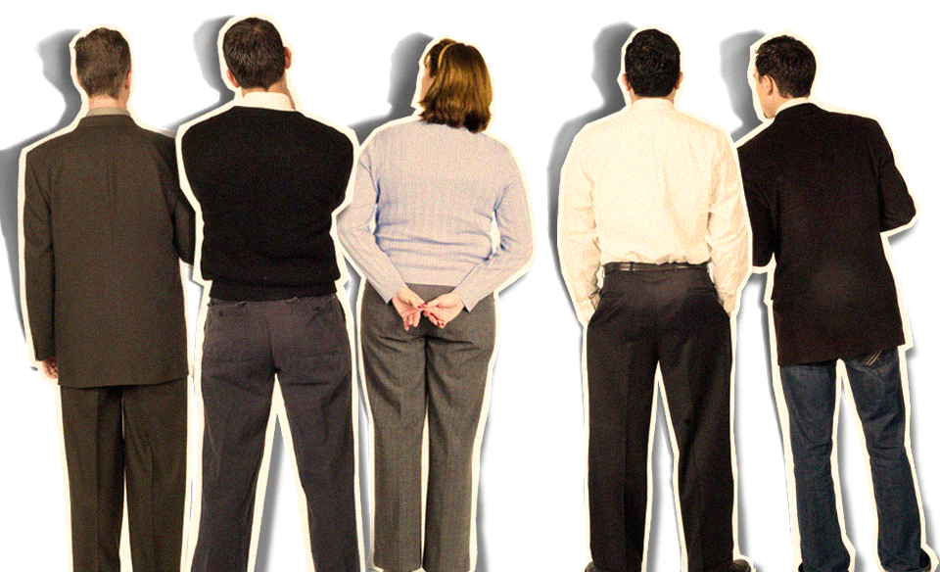

Notes:
Half of the people in your audience are verbal thinkers and the other half are visual.

Slide 23

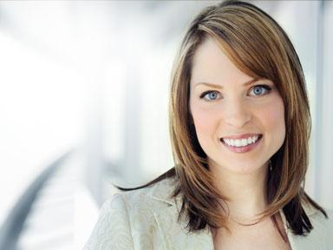








Notes:
Combining minimal text with meaningful visuals means that you’ll reach everyone.

Slide 24
Notes:
Brainstorm graphics that will effectively communicate your message…

Slide 25




CANS
THE
RECYCLED
PROCESS
= 1000 CANS
JANUARY
FEBRUARY
MARCH
Notes:
…and replace those words with a picture, chart or diagram. Then apply a consistent treatment to your graphics to give your whole presentation a unified look so that your audience is attracted to, rather than distracted from, your message.

Slide 26










4
PRACTICE
DESIGN
NOT
DECORATION
Notes:
Rule number 4: Practice design, not decoration.

Slide 27
Notes:
As tempting as it is to fill your slides with stuff, often de-decorating is the best policy.

Slide 28


Notes:
Any writer or designer will tell you that 90% of the creative process…

Slide 29






















































Notes:
…is destructive.

Slide 30



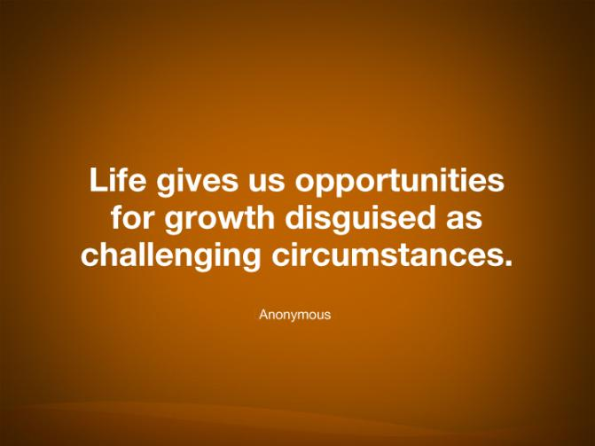




Notes:
Do you have a main point? Consider putting just one word on the slide by itself. Want them to remember a few items? Don’t show everything at once. Instead, show one item at a time. Have a picture that expresses your idea? Scale that picture so that it fills the slide. Have a quote that says it all? Let it say it and remove everything else.

Slide 31

















5
CULTIVATE
HEALTHY
RELATIONSHIPS
Notes:
The last rule is: Cultivate healthy relationships (with your slides and your audience)

Slide 32

Community Development
In order to bring lasting change, we
must first prioritize the things that will
bring about the maximum impact
Then we must organize schedules and
resources that will support the priorities
Finally, we need to mobilize people to be
able to take action and bring
about that change
Notes:
Letting go is hard, we know.

Slide 33

Community Development
In order to bring lasting change, we
must first prioritize the things that will
bring about the maximum impact
Then we must organize schedules and
resources that will support the priorities
Finally, we need to mobilize people to be
able to take action and bring
about that change
Notes:
But don’t hide behind your slides.

Slide 34


Community
Development
In order to bring lasting
change, we
must first
prioritize
the things that will
bring about the
maximum impact
Then we must
organize
schedules and
resources that will
support the priorities
Finally, we need to
mobilize
people
to be able to take
action and bring
about that change
Notes:
Breaking your dependence on your slides can do a world of good for your relationship with your audience.

Slide 35



Community
Development
In order to bring lasting
change, we
must first
prioritize
the things that will
bring about the
maximum impact
prioritize
organize
mobilize
Then we must
organize
schedules and
resources that will
support the priorities
Finally, we need to
mobilize
people
to be able to take
action and bring
about that change
Notes:
Reduce the amount of text to a few key words. Put the rest into your notes.

Slide 36

prioritize
organize
mobilize
Notes:
And practice, practice, practice.

Slide 37

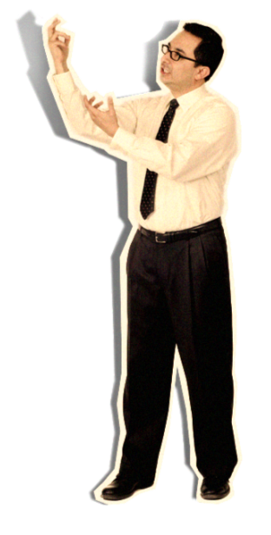

prioritize
organize
mobilize
Notes:
Thinking of your slides as digital scenery,

Slide 38


prioritize
organize
mobilize
Notes:
Allows you to connect eye-to-eye with your audience in a meaningful way.

Slide 39
RULES
TREAT YOUR AUDIENCE AS KING
SPREAD IDEAS AND MOVE PEOPLE
HELP THEM SEE WHAT YOU ARE SAYING
PRACTICE DESIGN, NOT DECORATION
CULTIVATE HEALTHY RELATIONSHIPS
Notes:
So there are the rules.

Slide 40

Notes:
But the question remains—Why go to all this trouble?

Slide 41

Notes:
Why not do it the way you are used to?

Slide 42
Notes:
The answer is simple. Because everyone else does it that way, too. You need to stand apart and be different.

Slide 43
5
RULES
Notes:
When you apply these rules,

Slide 44
Notes:
and keep the audience’s needs top of mind,

Slide 45


prioritize
organize
mobilize
Notes:
your presentation will not only hold their attention,

Slide 46




Notes:
But also change the world. (Well, at least your part of the world.)

Slide 47
PART II
HOW?

Slide 48


Flowing Data
Pics: David McCandless
http://www.informationisbeautiful.net/

Slide 49
Big Questions
Where can You & I get Data?
Which Graphics are best for our data?
What software should I use?
What should I include in my Poster/Presentation for SRC
How do I evaluate data visualization?
http://designyoutrust.com/2009/04/50-great-examples-of-infographics/
Notes:
Today I am going to answer some of these questions, at the very least try to give some tips that will help you answer these questions.

Slide 50
What is Data Visualization?
Visual.ly
“the study of data in a visual way”
Information IS Beautiful
More than analysis, more than illustration
Gapminder
Can complement text or be self-contained
Notes:
Visual.ly: both the visual representation of data and the study of presentation (The best definition I have seen through the web is from Visual.ly which is the study of) of data in a visual way
More than analysis, more than illustration (both)
Can complement text or be self-contained (informational to draw your conclusion, or the author would like to only present his conclusion)
Examples: hand waving, charts/graph. Maps, infographics, interactive data visualizations

Slide 51
Data Sources
Google Public Data Explorer
http://www.google.com/publicdata/directory
Census
http:/census.gov
Gapminder
http://gapminder.org
Watson Analytics
https://watson.analytics.ibmcloud.com

Slide 52
Building Blocks of Design
Visual Elements (create a focal point)
Typography (text and how it looks.. avoid default, and keep it simple)
Space (negative space…white spaces)
Design flow: top to bottom , left to right
Colors: check colorblindness: http://www.vischeck.com
Designing for Web or Print (RGB vs CMYK)
Notes:
Visual elements (create a focal point)
Typography (text and how it looks.. avoid default, and keep it simple)
Space (negative space…white spaces)
Design flow: top to bottom , left to right
Colors: check colorblindness: http://www.vischeck.com
Designing for Web or Print (RGB vs CMYK)

Slide 53
Effective Design for Conference
Begin with learning objectives/goals
Develop design specs for final project
Break project into series of discrete tasks
Set up milestones with deadlines & regular check-ins to ensure your progress
Critique! Critique! Critique!

Slide 54
Data Visualization Software
General
R, STATA, SAS, Excel
Open source
Adobe Illustrator
Microsoft Word
Google Public Data Explorer
https://www.google.com/publicdata/directory
Many Eyes
http://www-958.ibm.com/software/analytics/manyeyes/
Tableau
http://www.tableausoftware.com/
StatSilk/StatPlanet (maps)
http://www.statsilk.com/
Gapminder
http://www.gapminder.org/
Visual.ly
http://visual.ly/

Slide 55
Big Questions
Where can You & I get Data?
Which Graphics are best for our data?
What software should I use?
What should I include in my Poster/Presentation for SRC
How do I evaluate data visualization?
Notes:
Today I am going to answer some of these questions, at the very least try to give some tips that will help you answer these questions.

Slide 56
Hands-on Training
https://goo.gl/JNM0HH

